Slide 1

English
This presentation is automatically generated.
You can freely edit it and add any extra content you wish.
Español
Esta presentación se genera automáticamente.
Puedes modificarla a tu criterio y añadir cualquier contenido adicional que desees.
Italiano
Questa presentazione è generata automaticamente.
Puoi modificarla liberamente e aggiungere eventuali contenuti extra che desideri.

Slide 2
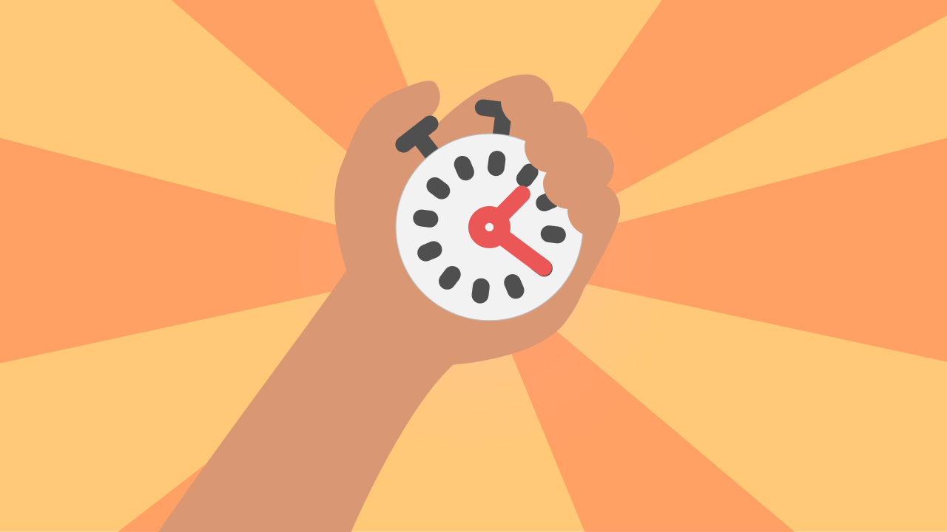
The Scream Battle
Show off everything you know about programming in this final challenge. Manage complex states to build a 'screamometer' that measures how long your screams last.

Slide 3
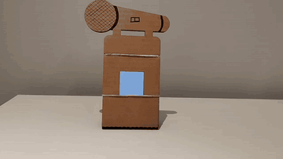
What will we do?

Slide 4
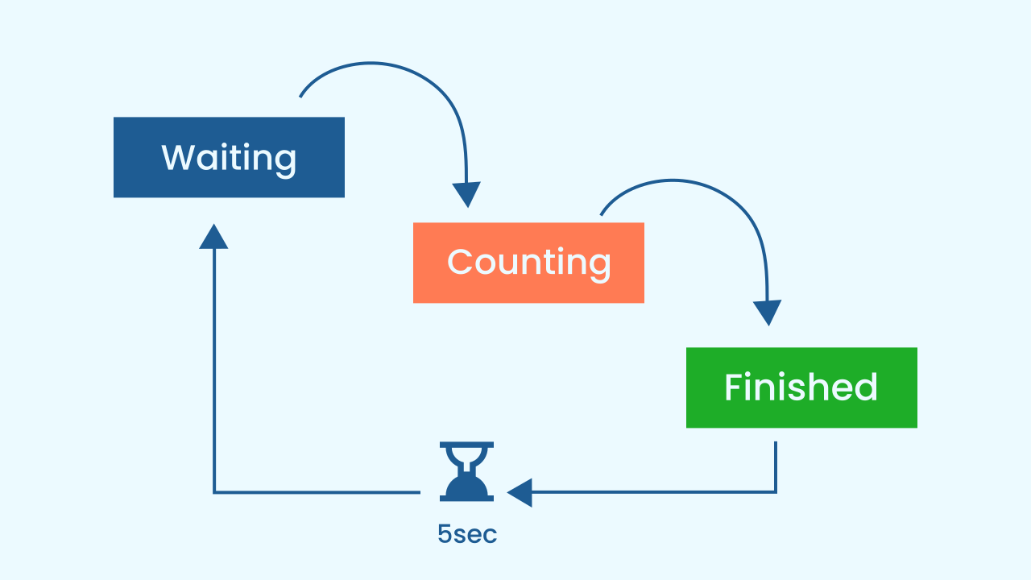
State Machines: The "Modes" of a Program
Almost every complex program can be described as a state machine. That means the program can be in different "modes" or "states", and there are clear rules for moving from one state to another. Our screamometer has three main states:
1. Waiting State: The game is ready to start, it just needs the starting signal. The `gameInProgress` variable is false.
2. Counting State: The LED bar keeps advancing. The `gameInProgress` variable is true.
3. Finished State (Cooldown): The game is over and shows the result with music for 5 seconds. During that time, `gameInProgress` stays true, so no new round can be started. After those 5 seconds, `gameInProgress` goes back to false and the game is ready to start again. Watch out: a scream let out during this cooldown is lost without warning — you have to wait for the screen to go dark and scream again.

Slide 5
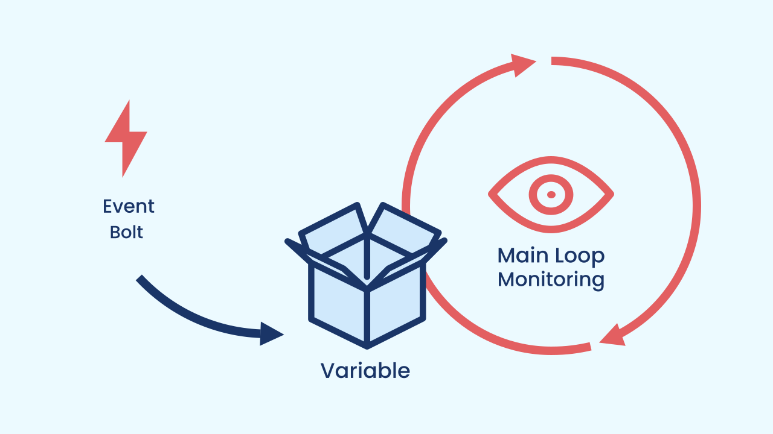
The Synergy of Events and Loops
In complex projects, you often don't use *only* an event or *only* a loop. You use a clever combination of the two, letting each one do what it does best:
Events: Perfect for starting actions or switching states instantly. In our case, a loud noise event is the starting gun that kicks off the round.
Loops: Perfect for managing ongoing processes that depend on a state. Our main loop doesn't start the game. When gameInProgress is true, it keeps the game running for as long as the noise level is greater than or equal to 5. When the noise drops below that value, the loop ends and the program moves on to the final stage of the round.

Slide 6
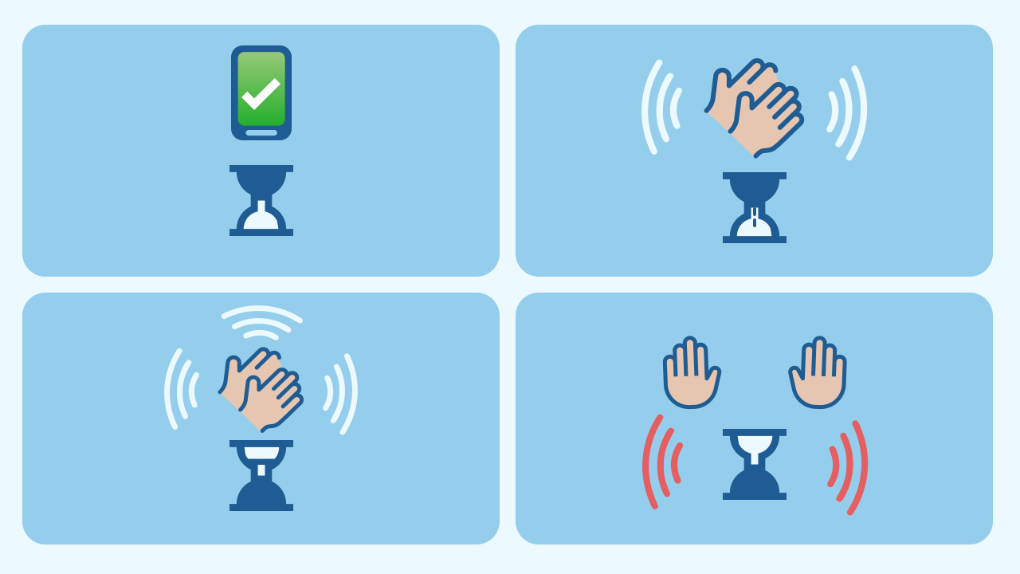
The Logic of Our Battle
Our design combines everything we've learned:
We use a boolean variable, `gameInProgress`, to control whether a new round can start (it handles the Waiting and Cooldown states).
We check whether the game has started and, for as long as the noise level is greater than or equal to 5, the bar keeps advancing by one LED every half second (this handles the Counting state, which lights up the LED screen).
A loud noise event starts the game by switching `gameInProgress` on. The event always fires; it's the main loop that only listens to it when we are in the Waiting state.
The main loop takes care of the rest: it updates the screen while we're Counting and, when the noise stops, moves to the Finished state.

Slide 7
Create
Let the Scream Battle begin!
We'll need 3 components: NoiseLevel to listen to the screams, LEDDraw to show how long the scream lasts using the LEDs, and AudioPlayer to give us feedback every time the time goes up and when the round is over.
Make sure you have them ready in your workspace. You can open them in the same window.

Slide 8

Code Composition
Look at how the event and the loop work as a team. The event block has a single mission: if it detects a sudden jump in noise, it starts the game by switching `gameInProgress` on.
The main loop handles everything else: if `gameInProgress` is on (the game is running), the `column` and `row` variables are set to the first position of the LED screen; then, for as long as the noise level is greater than or equal to 5, the program travels across the LED screen row by row and column by column. Inside this `repeat while` loop, the LED screen lights up bit by bit based on the `row` and `column` variables, then a sound plays to show you're making progress, the program waits half a second and carries on: this is where the `column` variable moves forward to light up the next LEDs, since 1 is added to its value. The advance works like writing in a notebook: add 1 to the column; if you've gone past the edge, go back to the first column and down one row; and if you've gone past the last row, go back to the top — once the screen is full, the screamometer repaints over what's already lit and you no longer see any change even if the scream goes on.
When the noise level drops below 5, it means you've stopped screaming, so the round is over. To show this, a final sound plays and the program waits 5 seconds, and finally sets `gameInProgress` back to false so you can play again.
https://app.protobject.com/generate?eq-gritometro-tiempo-gritos&en&dynamic&-1

Slide 9
Reflect
This program manages several "states". Can you name the different states and the variables that control them?
Describe what the event is for and what the main loop is for. Why do you need both for this game to work properly?
If you wanted to make the game harder (so you have to scream longer for the LEDs to light up), which value in the code would you change?

