Slide 1

English
This presentation is automatically generated.
You can freely edit it and add any extra content you wish.
Español
Esta presentación se genera automáticamente.
Puedes modificarla a tu criterio y añadir cualquier contenido adicional que desees.
Italiano
Questa presentazione è generata automaticamente.
Puoi modificarla liberamente e aggiungere eventuali contenuti extra che desideri.

Slide 2

The DJ Metronome
Combine sensors, math, and advanced timing logic to build a professional DJ tool: a metronome whose tempo you control by tilting your phone.

Slide 3
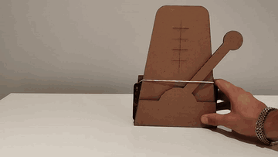
What will we do?

Slide 4
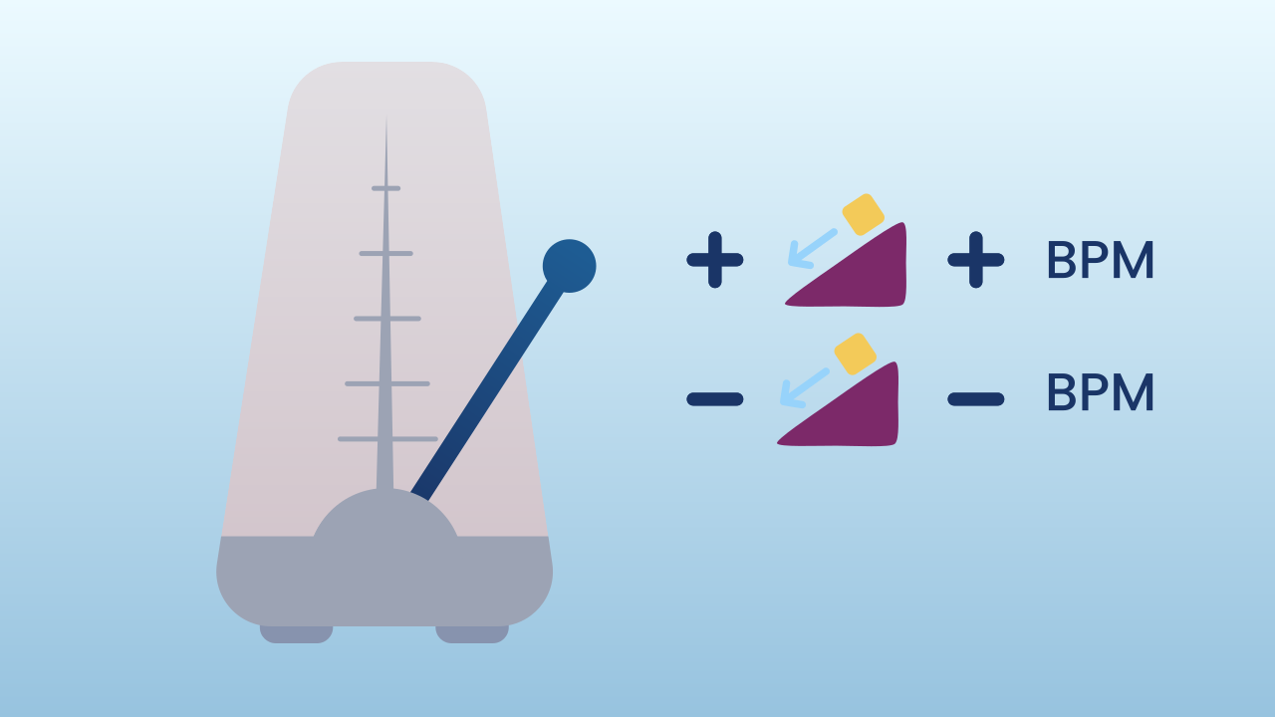
What is a Metronome?
A metronome is an essential tool for musicians. It produces a beat, or click, at a steady, adjustable speed to help them hold a stable tempo. That speed is measured in BPM (Beats Per Minute). A tempo of 60 BPM means exactly one beat every second.

Slide 5
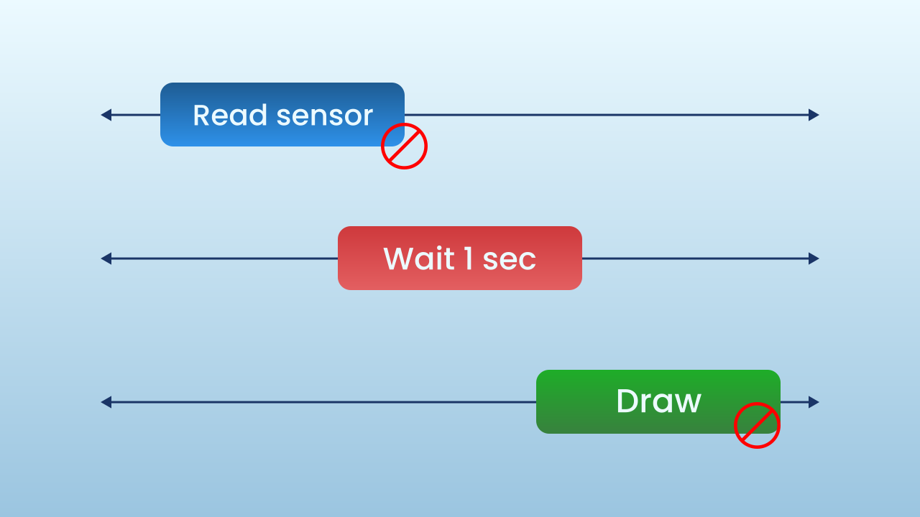
The Problem with 'Wait'
Our first instinct might be to use a loop with a `wait` block. The trouble is that `wait` blocks the program. While it is paused, it can't do anything else: it can't read the tilt sensor to adjust the tempo, it can't update the screen, it can't respond to buttons. For a tool that has to stay smooth and responsive in real time, this method simply doesn't work.

Slide 6
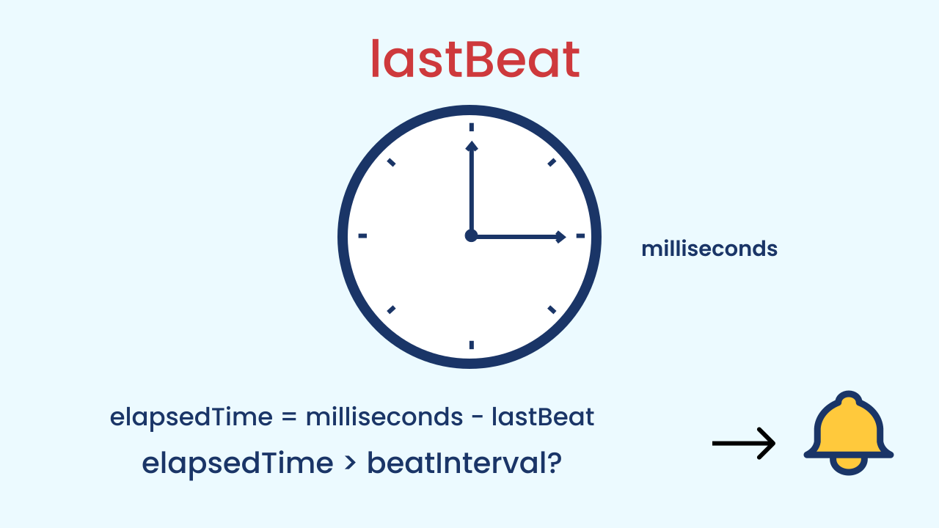
Advanced Timing Logic (Non-Blocking)
Professionals use logic that never "freezes" the program. It works like a stopwatch in your hand:
1. We store the exact moment the last beat happened in a variable (`lastBeat`).
2. Inside a loop that runs very, very fast, we constantly work out how much time has gone by and store it under a name of its own: `elapsedTime = milliseconds − lastBeat`.
3. IF that `elapsedTime` is greater than the `beatInterval` we want — `if (elapsedTime > beatInterval)` — we know it's time for a new beat!
4. When the beat happens, the most important step is to update `lastBeat` to the value of `milliseconds`, which effectively "resets" the stopwatch for the next beat.

Slide 7
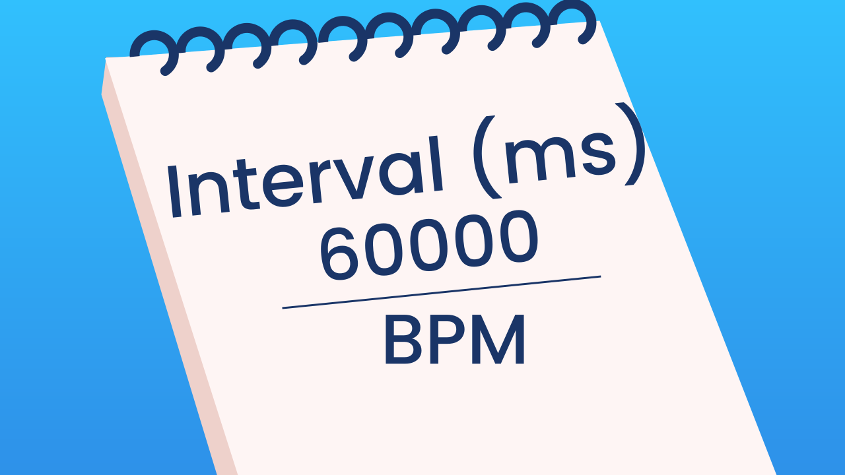
The Math of the Beat
For our timing logic to work, we need to calculate the right interval from the BPM. The formula is simple. Knowing that there are 60 seconds in a minute and 1000 milliseconds in a second, there are 60,000 milliseconds in a minute.
`Interval (in milliseconds) = 60000 / BPM`
We'll use this formula to turn the tempo we read from the sensor into the exact gap our program needs.

Slide 8
Create
Let's build the DJ metronome!
We'll need 2 components: Inclination to control the BPM and MusicalDrum for the sound of the beat.
Remember to scan or open all the components.

Slide 9

Code Composition
Inside the `main loop`, we first map the tilt to a range of `bpm`. From that `bpm` we calculate the `beatInterval` we need and, from the clock, the `elapsedTime` since the `lastBeat`. The `if` conditional is the brain of the metronome: it compares those two durations — `elapsedTime > beatInterval`. If enough time has gone by, it plays the sound and — the most important step — updates `lastBeat` to the current time so the cycle can start over.
https://app.protobject.com/generate?eq-metronomo-con-inclinacion&en&dynamic&-1

Slide 10
Reflect
Explain in your own words why we use this timing logic with variables and milliseconds instead of a simple `wait` block.
The formula for the interval is `60000 / BPM`. If the BPM is 60, what is the interval? And if the BPM is 120? Does the result of the math make sense in the real world?
What do you think would happen if you forgot to update the `lastBeat` variable inside the `if` block?

