Slide 1

English
This presentation is automatically generated.
You can freely edit it and add any extra content you wish.
Español
Esta presentación se genera automáticamente.
Puedes modificarla a tu criterio y añadir cualquier contenido adicional que desees.
Italiano
Questa presentazione è generata automaticamente.
Puoi modificarla liberamente e aggiungere eventuali contenuti extra che desideri.

Slide 2
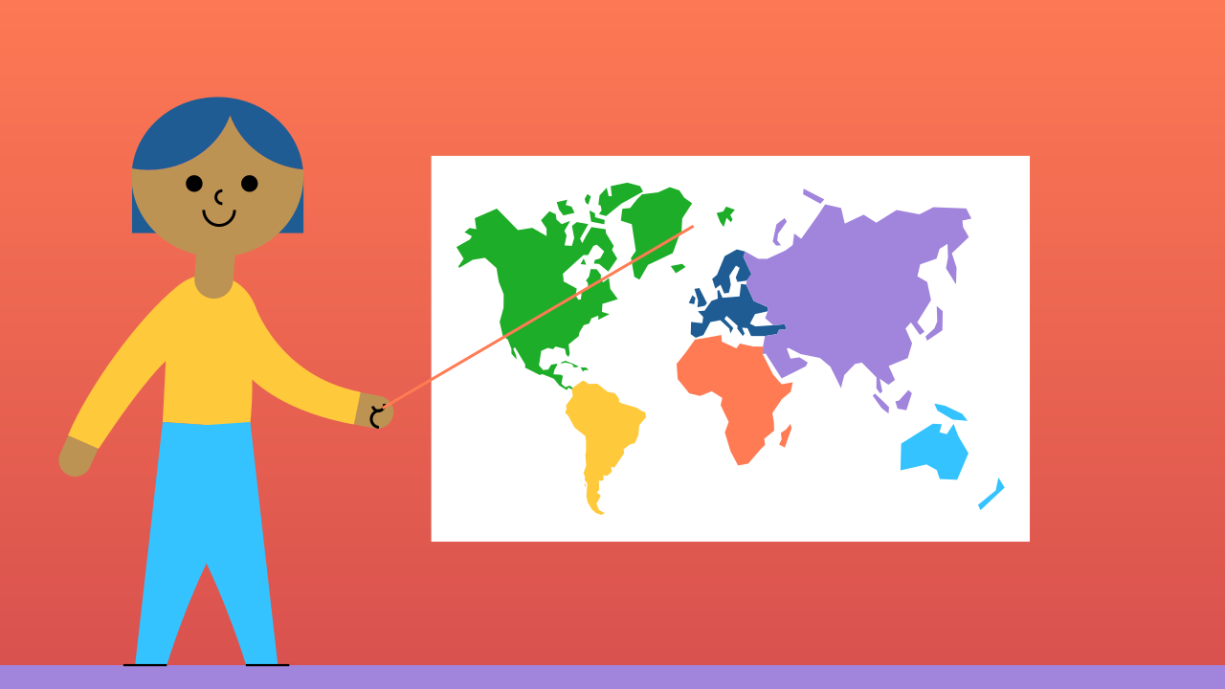
The Digital Pointer
Combine your phone's accelerometer, gyroscope, and magnetometer to create a pointer you can control with motion.

Slide 3
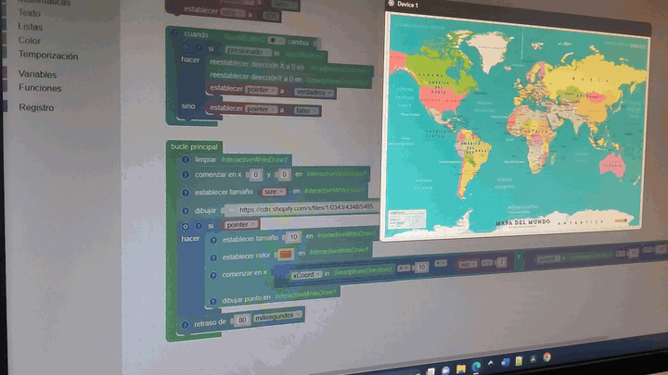
What will we do?

Slide 4

How does the phone know its orientation?
Imagine you're in a dark, empty room with your eyes blindfolded. You could probably still point 'up' and 'down' because you can feel gravity. Your phone does something similar, but it's much more advanced. To know its exact orientation in 3D space, it uses a team of specialized sensors.

Slide 5
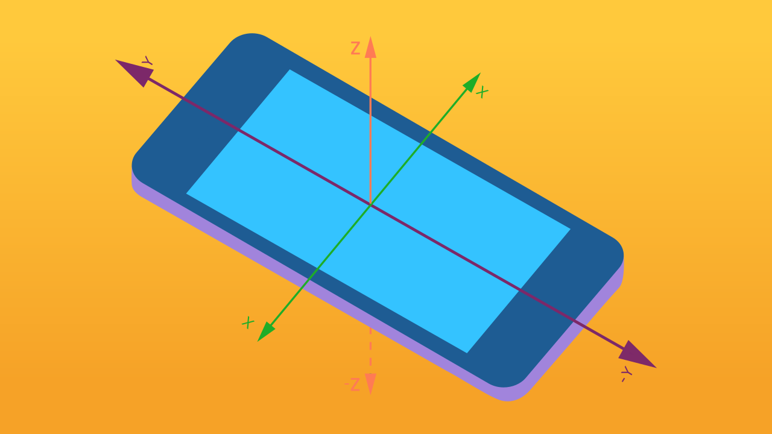
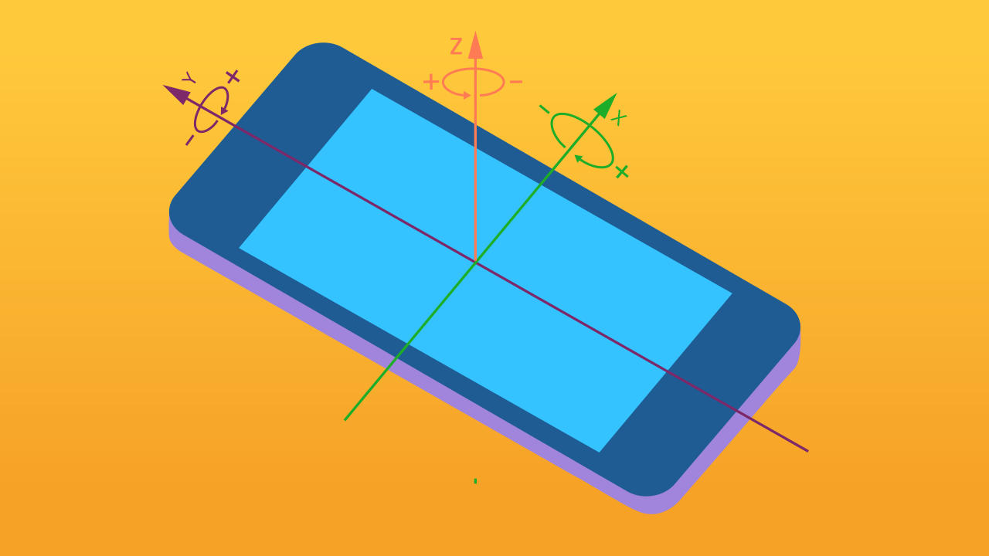
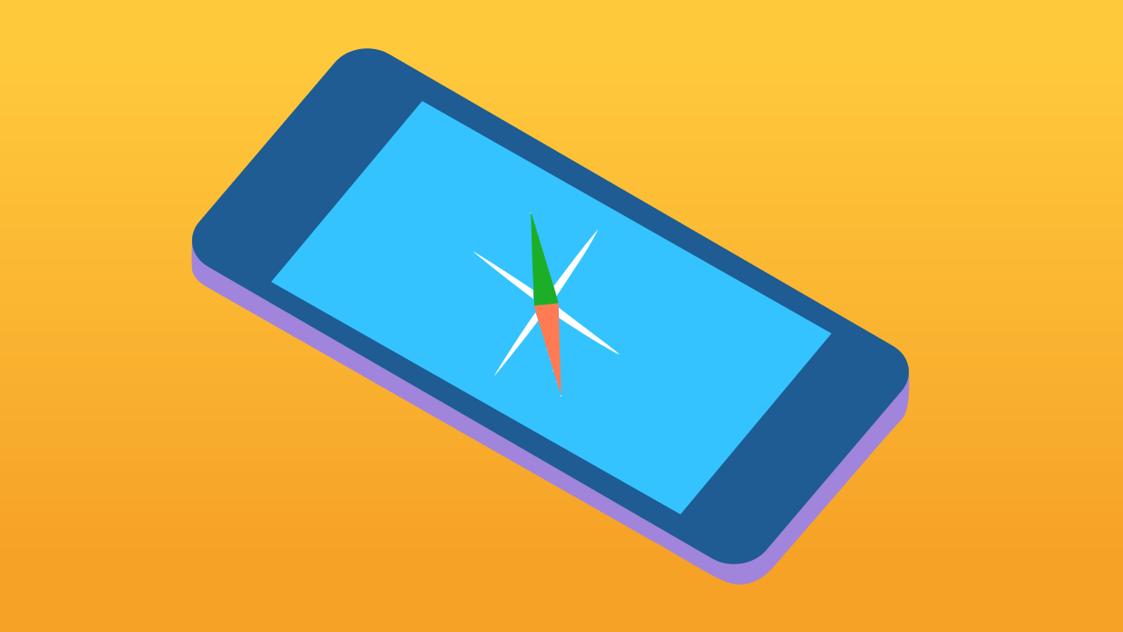
Meet the Sensor Team
Your phone's sense of direction comes from three main specialists:
★ Accelerometer: The 'Motion Detector.' It feels linear acceleration—moving forward/backward, left/right, and up/down.
★ Gyroscope: The 'Rotation Specialist.' It detects twists and turns, measuring changes in the phone's angle.
★ Magnetometer: The 'Navigator.' It's a digital compass that detects magnetic fields, always knowing which way is North.

Slide 6
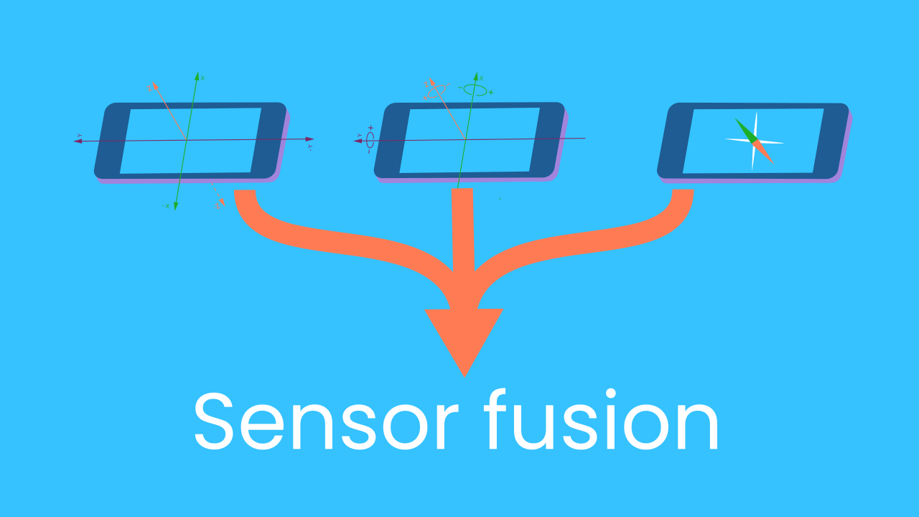
Working Together: Sensor Fusion
None of these sensors is perfect on its own. The accelerometer can be jittery, and the gyroscope can 'drift' over time. But when they work together, their strengths cover for each other's weaknesses. This collaboration is called Sensor Fusion. The phone's software intelligently 'fuses' the data from all three sensors to get a single, highly accurate reading of its orientation. It's the ultimate teamwork!

Slide 7
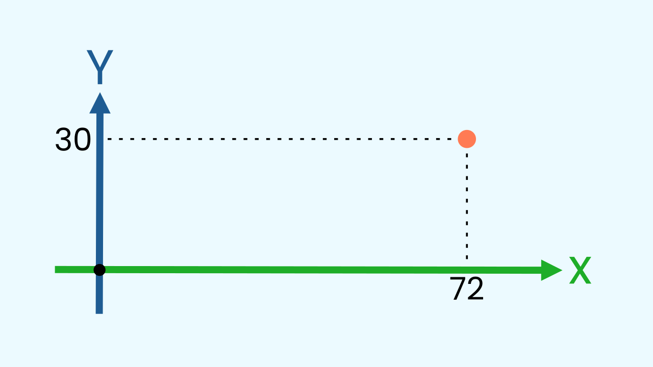
From Fusion to Coordinates
The result of Sensor Fusion is a stream of numerical data. Our job as programmers is to give that data meaning. When we move the phone, the values for the X and Y axes of rotation change. By reading these values, we can map the phone's physical movement to the X and Y coordinates of a pointer on our digital canvas.

Slide 8
Make the Presentation Pointer
Let’s create the prototype: we will need a smartphone and a computer/tablet.
On the same smartphone, add the Direction and TouchButton components.
Add the WriteDraw device by opening it on your computer/tablet by clicking Open in this window.

Slide 9
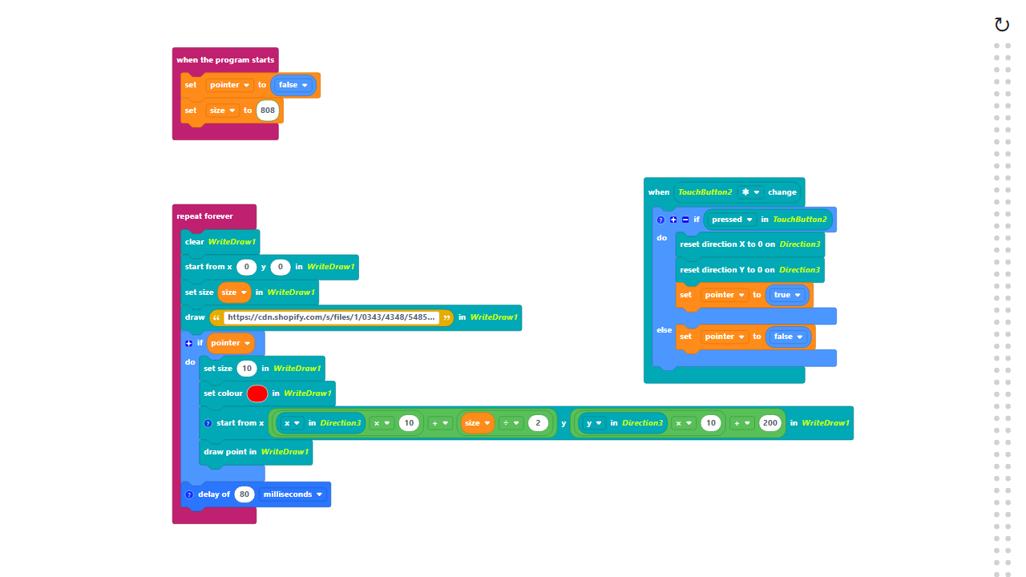
Code Composition
Click on the question mark icon to open the comments that explain the code.
https://app.protobject.com/generate?en-a22-pointermap&en&dynamic&-1

Slide 10
Reflect
★ Which sensor acts like a compass, detecting magnetic north?
★ Which sensor is best at detecting tilting and spinning?
★ What is the purpose of the 'reset' button in this project? What happens if you don't use it?

