Slide 1

English
This presentation is automatically generated.
You can freely edit it and add any extra content you wish.
Español
Esta presentación se genera automáticamente.
Puedes modificarla a tu criterio y añadir cualquier contenido adicional que desees.
Italiano
Questa presentazione è generata automaticamente.
Puoi modificarla liberamente e aggiungere eventuali contenuti extra che desideri.

Slide 2
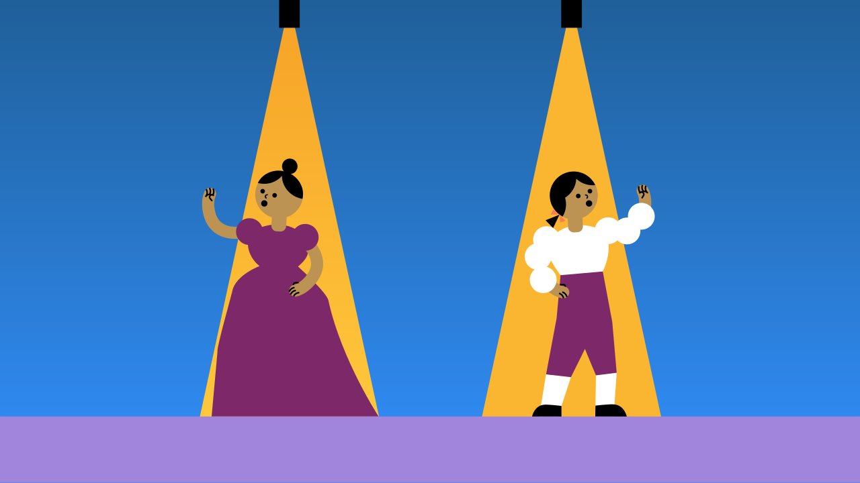
Smart Code: Using Functions
Learn to write cleaner, reusable code by creating functions with parameters for a two-button light game.

Slide 3
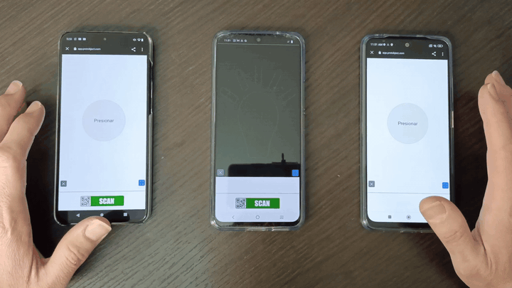
What will we do?

Slide 4

What are functions?
Functions are reusable groups of code that you can name and then "call" whenever you need them.
Imagine you have a favorite recipe with five steps to make dinner. Instead of writing those five steps out every single time, you can create a single "recipe card" named "DINNER". Now, you only need to call that one function, and the program runs all five steps. This is a function without parameters because it does the exact same thing every time.

Slide 5
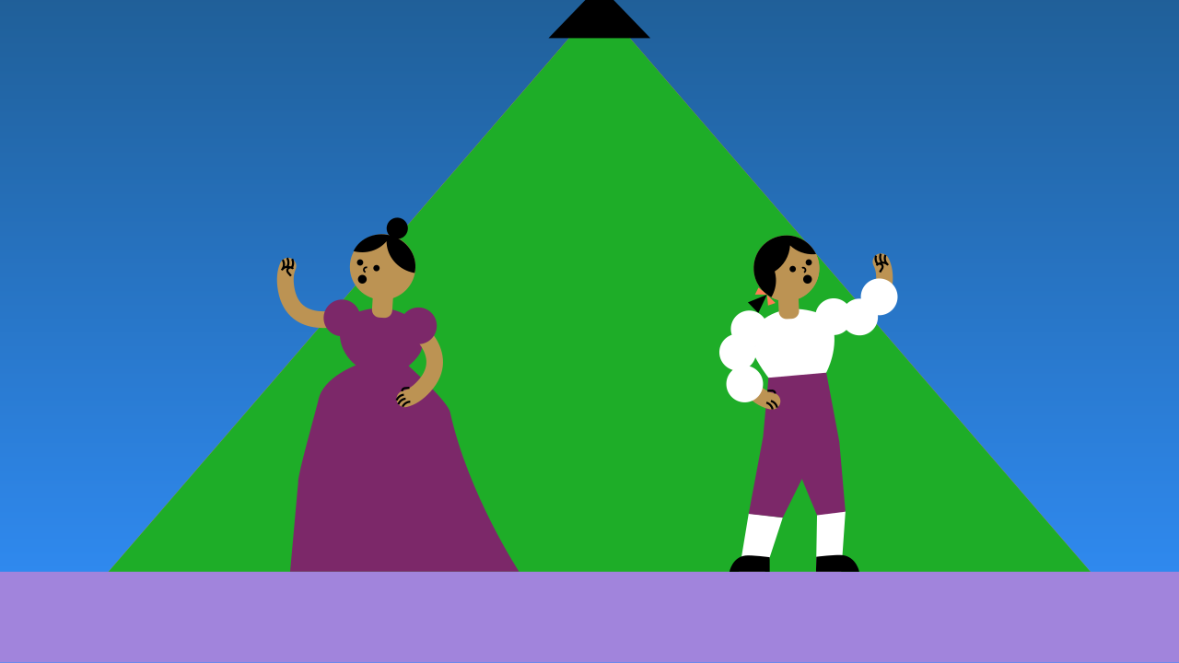
Functions with Parameters
But what if you want to make the same recipe with different main ingredients? We can make our function smarter by giving it parameters—inputs that can change the result.
Think of the DINNER function again. We can add a parameter for the main ingredient. Now, calling `DINNER(noodles)` will give a different result than `DINNER(rice)`. The steps are the same, but the input changes the outcome.
In our activity, we will create a `light_sequence` function with a color parameter. The function will always perform the same blinking pattern, but the color of the light will change based on the parameter we provide when we call it.

Slide 6
Make the Light Panel
Let's create the prototype. We'll need 3 devices (or open them in the same window).
On the first device, add the Lamp component.
On the second device, add the first TouchButton.
On the third device, add the second TouchButton. Remember, you can use Open in this window to open components on your computer.

Slide 7
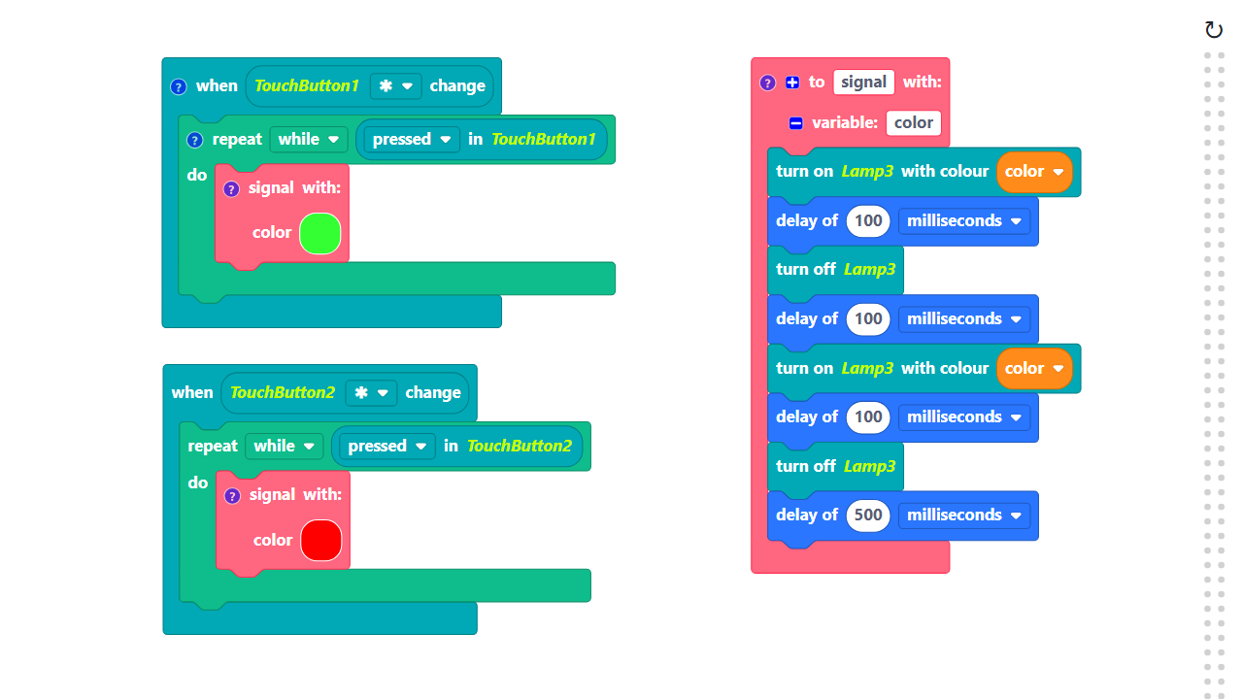
Code Composition
Click on the question mark icon to open comments that explain the code.
https://app.protobject.com/generate?en-a20-functions&en&dynamic&-1

Slide 8
Reflect
★ How would you add a third button that calls the same function but with the color blue?
★ How would you change the speed of the blinking? (Hint: you only have to edit the function in one place!)
★ What if you wanted to create a second, completely different light pattern? Would you create a new function?

