Slide 1

English
This presentation is automatically generated.
You can freely edit it and add any extra content you wish.
Español
Esta presentación se genera automáticamente.
Puedes modificarla a tu criterio y añadir cualquier contenido adicional que desees.
Italiano
Questa presentazione è generata automaticamente.
Puoi modificarla liberamente e aggiungere eventuali contenuti extra che desideri.

Slide 2
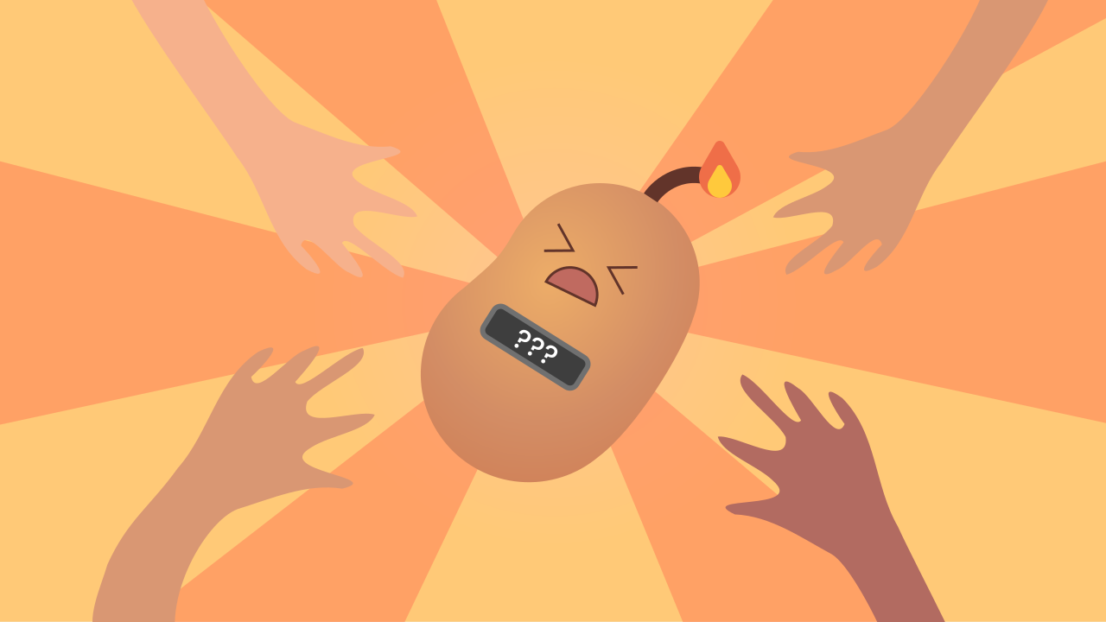
The Digital Hot Potato
Code a suspenseful game with an unpredictable timer. Learn how to use the 'while' loop for actions that must repeat an unknown number of times.

Slide 3
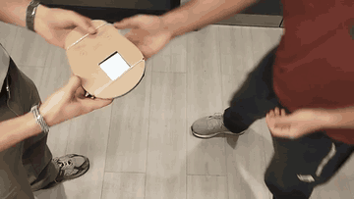
What will we do?

Slide 4
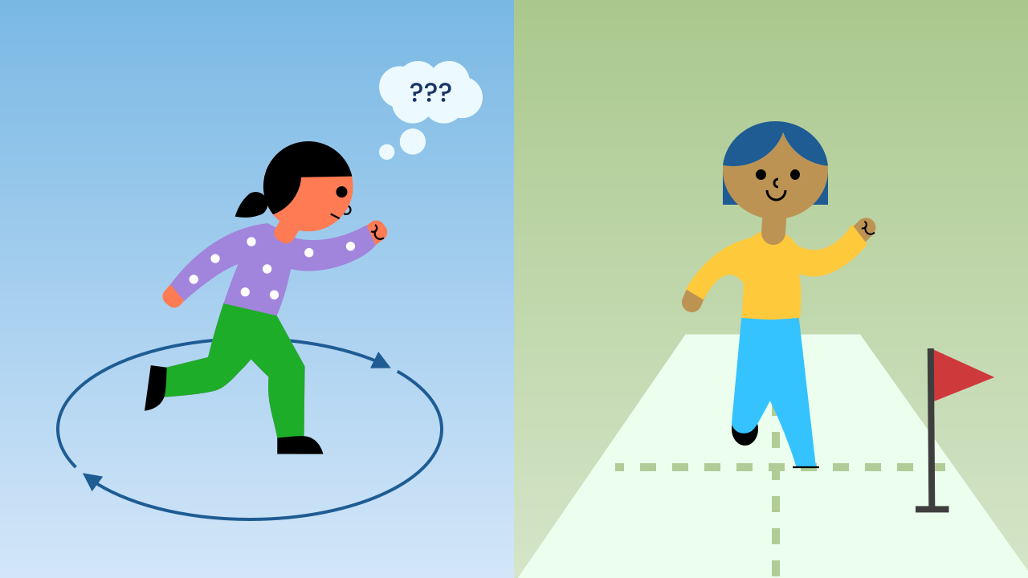
When You Don't Know When to Stop
The `for` loop is great when you know the exact number of repetitions in advance (for example, "repeat 10 times" or "go through the 7 pixels in a row").
But in many cases, like a game with a random timer or waiting for someone to press a key, you have no idea how long it will take. You need a loop that can keep running while a condition is true, no matter how many repetitions that turns out to be.

Slide 5
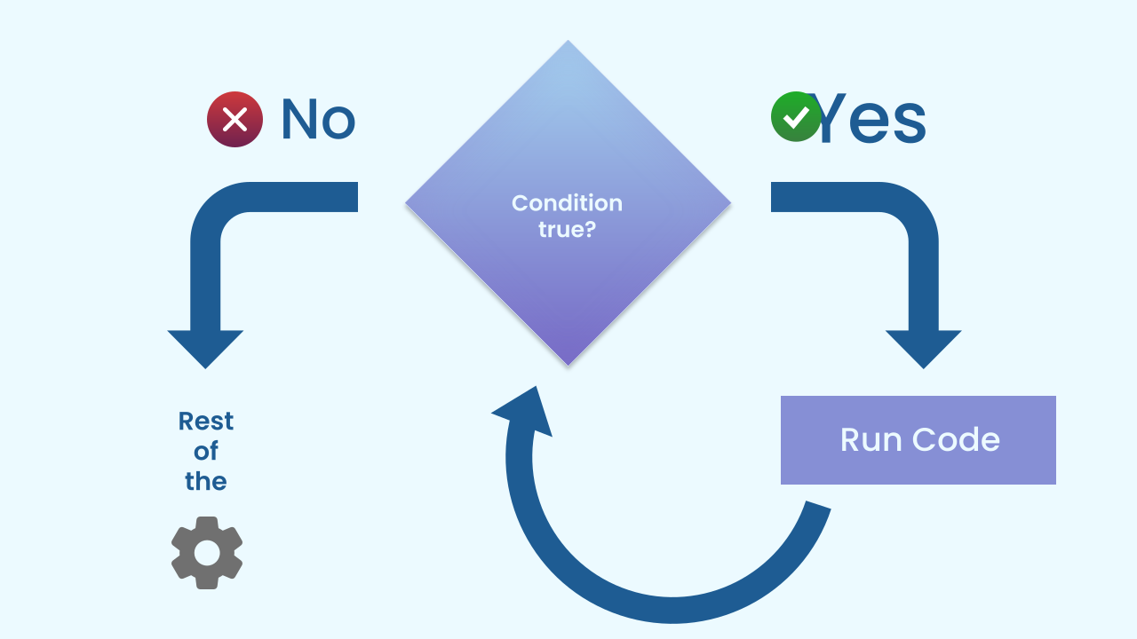
The 'While' Loop (Repeat While)
The "while" loop (or "repeat while") is the perfect solution for these cases. It works with simple logic:
1. First, it checks a condition (for example, `is timeLeft > 0?`).
2. While that condition is true, it runs the code inside it over and over again.
3. On every repetition, it goes back to step 1 and checks the condition again.
4. The moment the condition becomes false, the loop stops immediately and the program moves on to the next block.

Slide 6
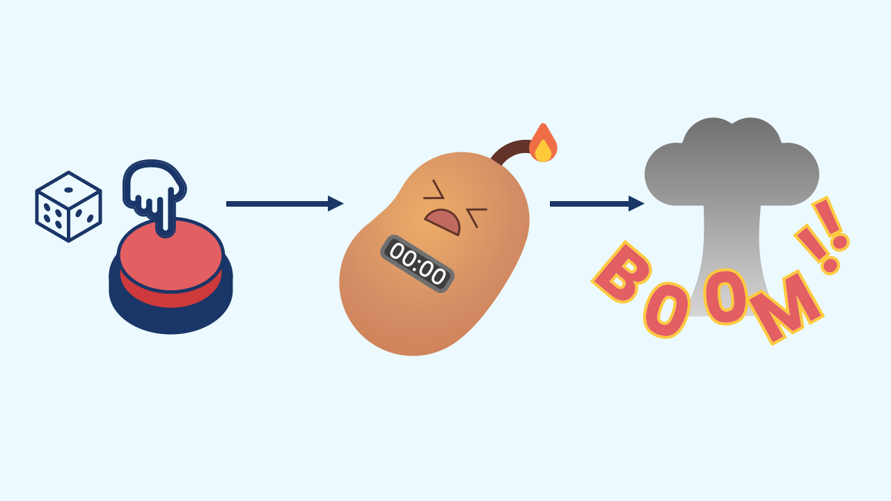
The Logic of the Hot Potato
Our game combines several ideas you already know in a brand new way:
- Event: Pressing the screen starts a new round — if there isn't one already running.
- Flag: The `ready` variable remembers whether the game is free. It starts out true in `when the program starts`; the event only starts a round `if ready`, and the first thing it does is set it to false, so a second touch can't restart the round in progress.
- Variable and Randomness: The `timeLeft` variable stores a random number so that every round is unpredictable.
- While Loop: The main game loop runs while `timeLeft > 0`. Inside the loop, we subtract 1 from `timeLeft` every second.
- The End: When `timeLeft` reaches 0, the loop's condition becomes false, the loop finishes, and the potato "explodes"!

Slide 7
Create
Let's play Hot Potato!
We'll need 2 components: TouchButton to act as our start button, and AudioPlayer for the suspense music and the sound effect.
Make sure you have them ready in your workspace. You can open them in the same window.

Slide 8

Code Composition
Almost all of the game's logic lives inside the `when ... is touched` event, guarded by an `if ready`. First the flag goes to false, then a random `timeLeft` is drawn and the music starts. Then the `repeat while timeLeft > 0` loop kicks in. It is crucial that inside the loop we change the variable that is being checked (with the `change timeLeft by -1` block). If we forgot this step, `timeLeft` would never reach 0, the condition would always be true, and the loop would run forever!
https://app.protobject.com/generate?eq-papas-caliente-juego&en&dynamic&-1

Slide 9
Reflect
What is the main difference between a "for" loop and a "while" loop? Why was "while" the best choice for this game?
Inside a "while" loop, it's really important to make sure the condition eventually becomes false, so you don't get stuck in an infinite loop. Which block inside our loop guarantees that the game always ends?
What would happen if the random number could come out as 0? Would the game still work properly?

