Slide 1
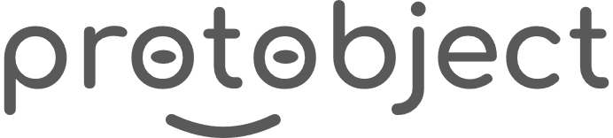
English
This presentation is automatically generated.
You can freely edit it and add any extra content you wish.
Español
Esta presentación se genera automáticamente.
Puedes modificarla a tu criterio y añadir cualquier contenido adicional que desees.
Italiano
Questa presentazione è generata automaticamente.
Puoi modificarla liberamente e aggiungere eventuali contenuti extra che desideri.

Slide 2

The Lighthouse
Master the 'For' loop to create a beautiful, gradual flashing effect for a lighthouse that you can turn on and off.

Slide 3
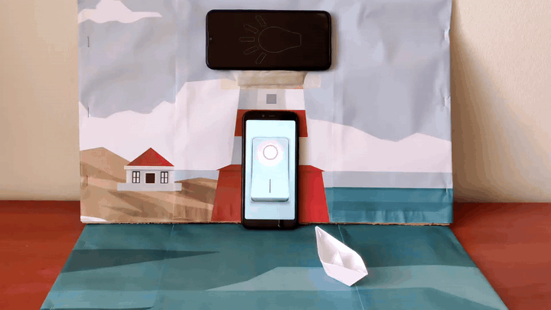
What will we do?

Slide 4

The FOR Loop
A ‘count with variable’ loop, known in most programming languages as a ‘for’ loop, is designed to repeat a block of code a specific, known number of times. It uses a counter variable to keep track of its progress from a start point to an end point.

Slide 5
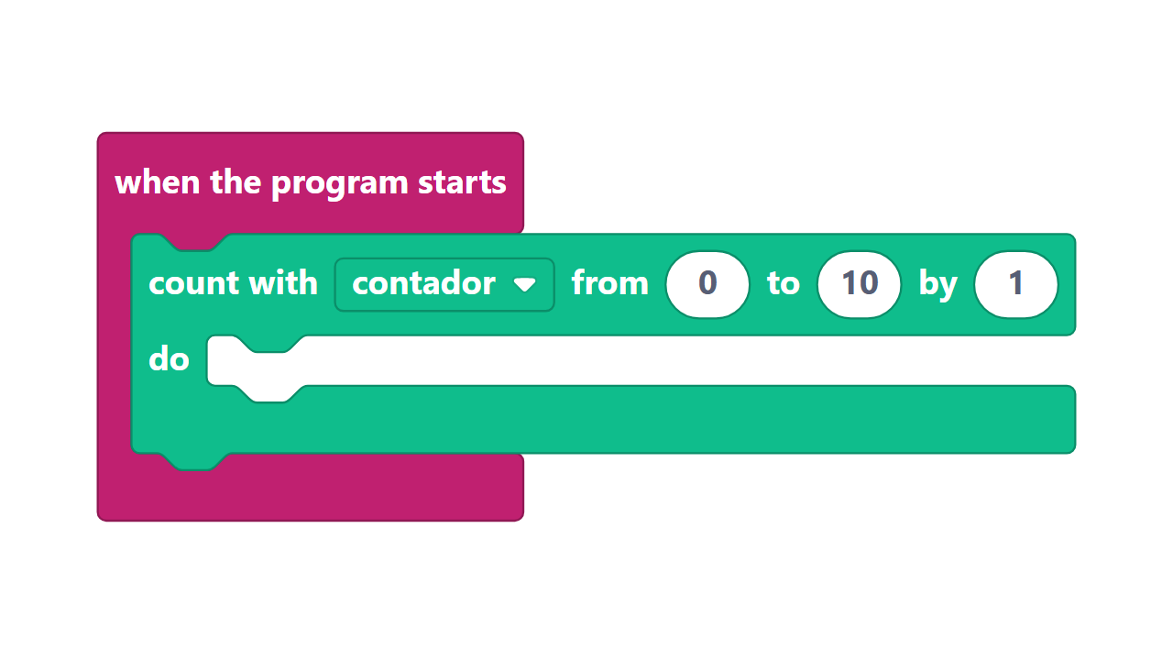
Components of the FOR loop
Think of a 'For' loop like a mission plan:
1. Variable: Your counter or "agent" that will be doing the counting (e.g., `i` or `intensity`).
2. Initial value: The starting number for your counter.
3. Final value: The target number where the loop will stop.
4. Steps: How much the counter changes in each repetition (e.g., counting up by 1, or down by 1).

Slide 6
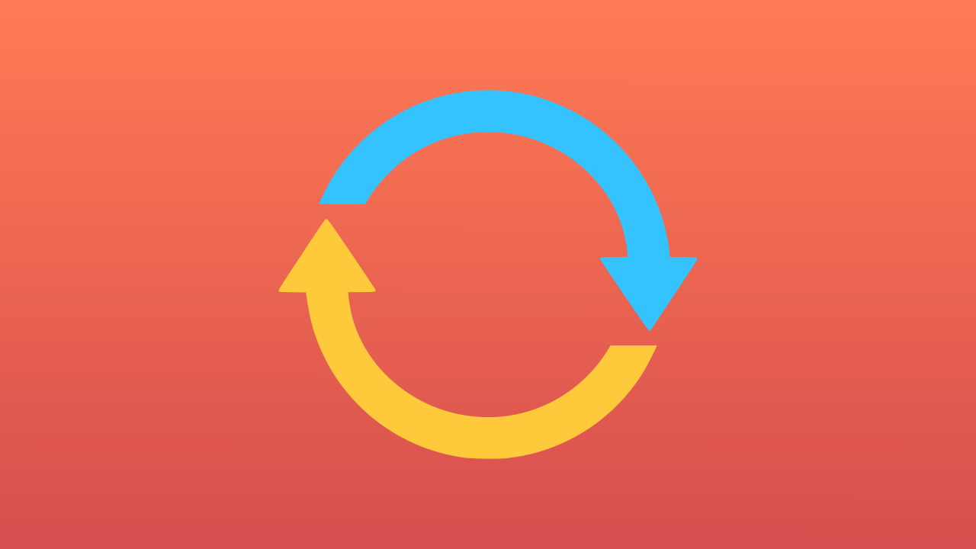

How do we use it for a gradual glow?
A 'for' loop is perfect for animation because it runs for a known number of steps.
To make our lighthouse light up gradually, we'll use a 'for' loop that counts an `intensity` variable from 0 to 100. In each step, we set the light's brightness to the current value of `intensity`. This creates a smooth fade-in.
To make it dim, we'll use a second 'for' loop that counts `intensity` from 100 back down to 0!

Slide 7
Make the Lighthouse
Let’s create the prototype that allows us to control the lighthouse.
Press Add Device, select Lamp, and use Open in this Window or a smartphone.
Press Add Device and select Switch.

Slide 8
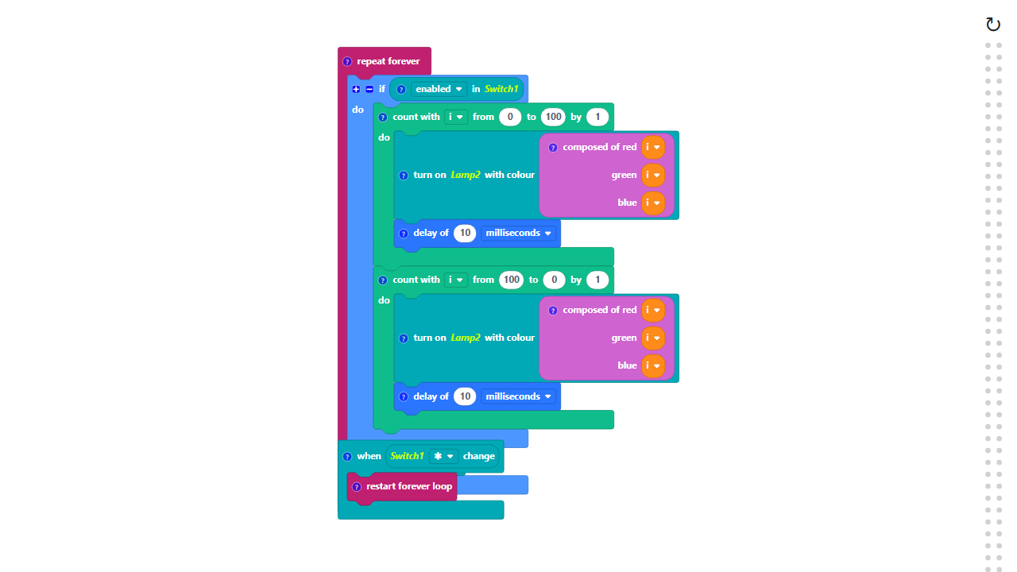
Code Composition
Click on the question mark icon to open comments that explain the code.
https://app.protobject.com/generate?en-a19-lighthouse&en&dynamic&-1

Slide 9
Reflect: FOR vs. WHILE
★ What is the main difference between a 'for' loop (count with variable) and a 'while' loop (repeat while)?
★ A 'for' loop is great when you know the exact start and end points (like 0 to 100). A 'while' loop is great when you just need to wait for a condition to change.
★ Are there cases where you could use either one? Absolutely!

