Slide 1

English
This presentation is automatically generated.
You can freely edit it and add any extra content you wish.
Español
Esta presentación se genera automáticamente.
Puedes modificarla a tu criterio y añadir cualquier contenido adicional que desees.
Italiano
Questa presentazione è generata automaticamente.
Puoi modificarla liberamente e aggiungere eventuali contenuti extra che desideri.

Slide 2
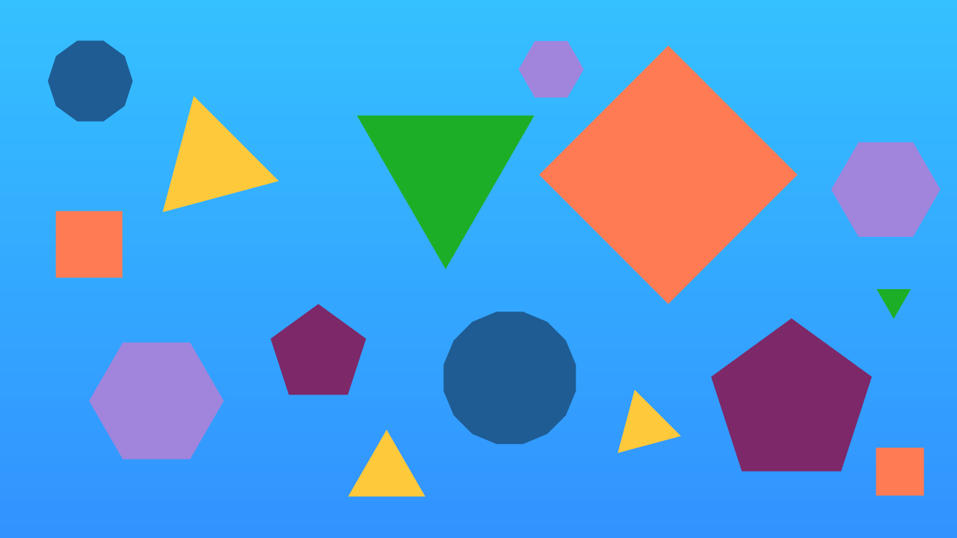
Geometric Art: Drawing Polygons
Explore the power of 'While' loops to programmatically draw perfect geometric shapes, from triangles to hectogons.

Slide 3
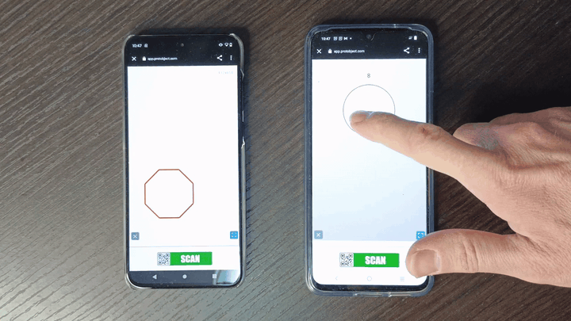
What will we do?

Slide 4
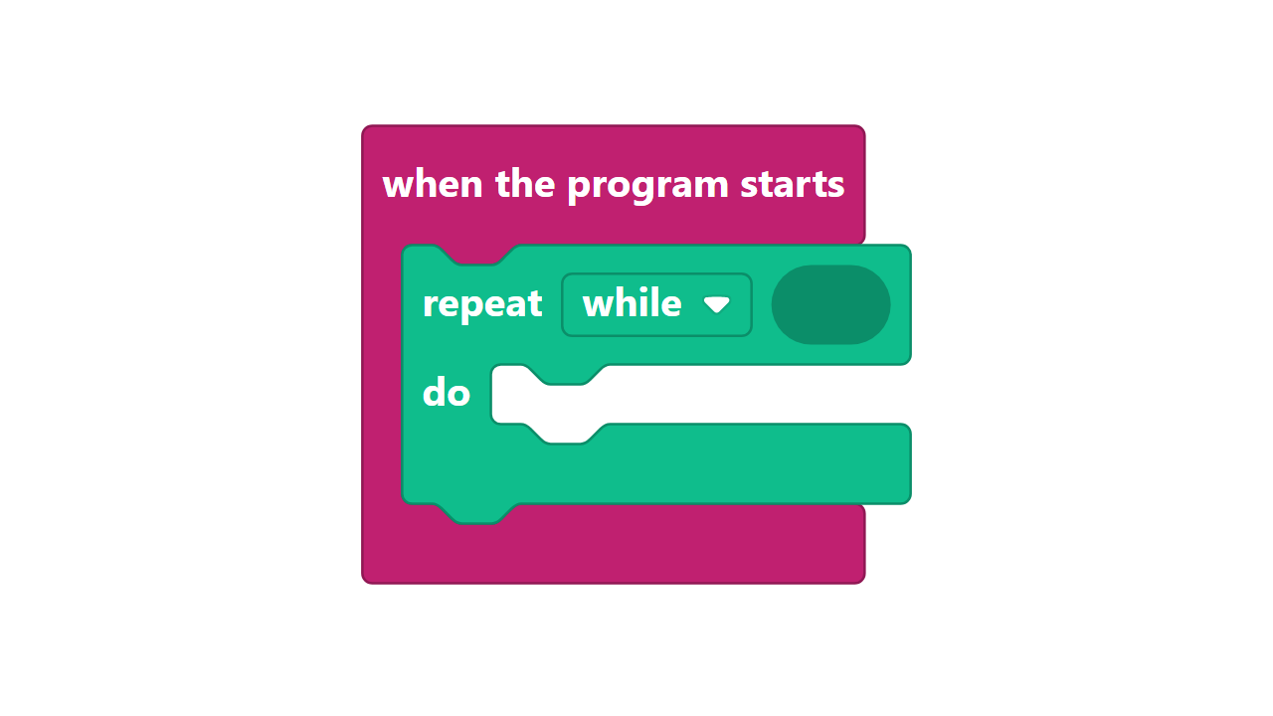
The 'Repeat While' Loop
A ‘repeat while’ loop is like a persistent guard. It first checks a condition. While that condition is true, it runs a block of code over and over again. The moment the condition becomes false, the loop stops.
This is perfect for situations where you don't know the exact number of repetitions in advance, but you know the goal you're trying to reach.

Slide 5
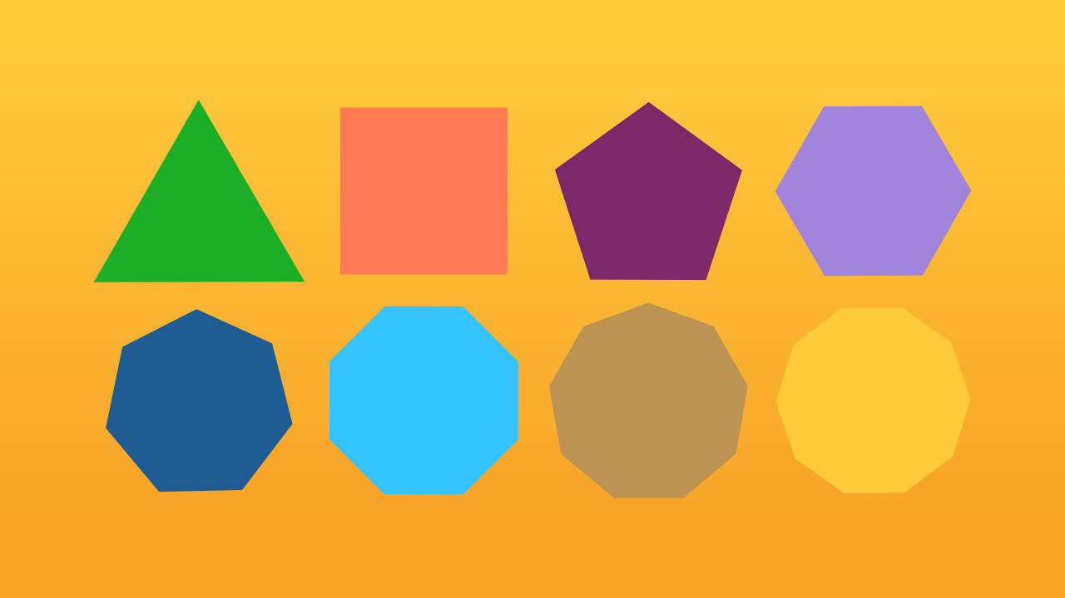
What is a regular polygon?
A regular polygon is a shape where all sides have the same length and all interior angles are equal. You know the simple ones: an equilateral triangle (3 sides), a square (4 sides), a pentagon (5 sides).
But what about a decagon (10 sides) or an icosagon (20 sides)? Drawing these by hand would be very tedious!

Slide 6
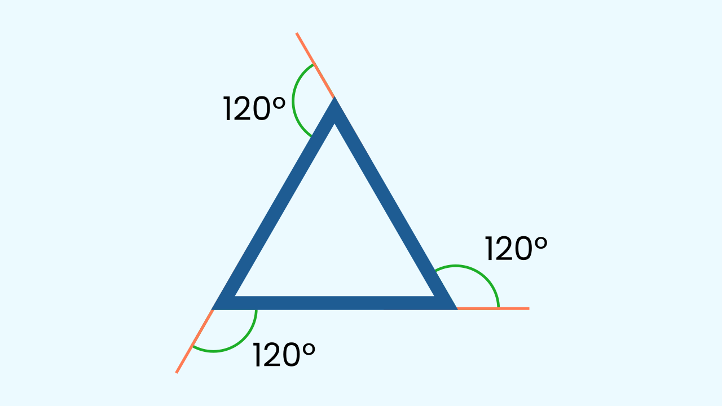
The Geometry Secret: 360 Degrees
Here's a cool geometry trick: the sum of the exterior angles of *any* regular polygon is always 360°.
So, to figure out how much our "pen" needs to turn at each corner, we just divide 360 by the number of sides!
- Triangle: 360 / 3 = 120° turn
- Square: 360 / 4 = 90° turn
- Pentagon: 360 / 5 = 72° turn

Slide 7
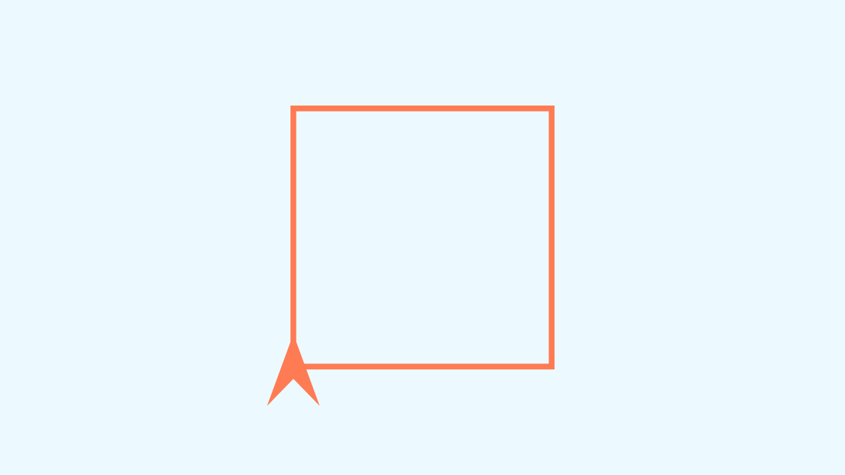
Let’s combine loops and geometry!
Notice the repeating pattern for drawing any polygon: draw a line, then rotate. We repeat this process until we've drawn all the sides.
This is a perfect job for a `repeat while` loop! We can tell the program: WHILE the number of sides we've drawn is less than the total number of sides we want, DO the "draw and rotate" action.

Slide 8
Make the Polygon Drawer
Let’s create the prototype. We’ll need a smartphone and a computer/tablet.
Add the device Knob to control the number of sides.
Add the device WriteDraw by opening it on the same computer/tablet by clicking Open in this window.

Slide 9
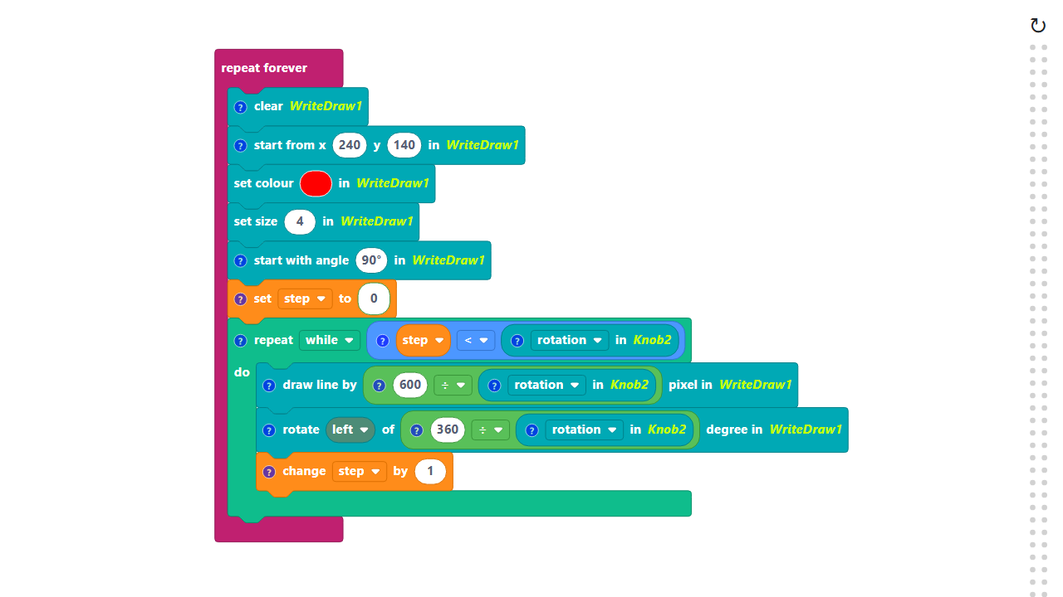
Code Composition
Click on the question mark icon to open comments that explain the code.
https://app.protobject.com/generate?en-a18-polygons&en&dynamic&-1

Slide 10
Challenge: Creative Coding Mods
★ Mod #1: Perimeter Control. How would you change the code to make the polygon bigger or smaller?
★ Mod #2: Spin Direction. What happens if you rotate to the right instead of rotating to the left?
★ Mod #3: Dynamic Color. How can we change the color of the lines based on the number of sides of the polygon?

