Slide 1

English
This presentation is automatically generated.
You can freely edit it and add any extra content you wish.
Español
Esta presentación se genera automáticamente.
Puedes modificarla a tu criterio y añadir cualquier contenido adicional que desees.
Italiano
Questa presentazione è generata automaticamente.
Puoi modificarla liberamente e aggiungere eventuali contenuti extra che desideri.

Slide 2

The Cinematic Power-On
Go beyond the instant switch-on. Learn to use the 'for' loop to control every pixel individually and create a gradual, cinematic fade-in and fade-out effect.

Slide 3
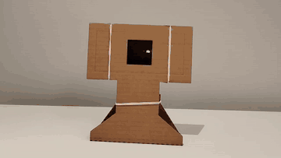
What will we do?

Slide 4
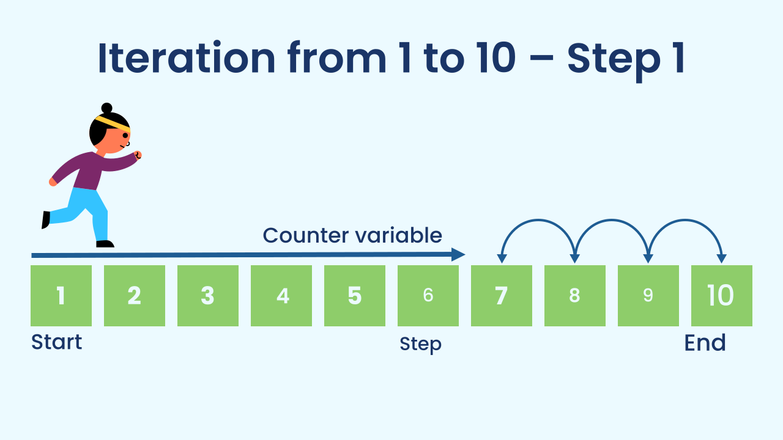
When We Need to Count: The 'For' Loop
We've seen loops that repeat forever (`repeat forever`). But sometimes we need a loop to run an exact number of times. The "for" loop (in Protobject, "count with") is the perfect tool for this. It's like giving the program a very precise order: "I want you to run this code, starting the count at 1, finishing at 7, and moving up 1 at a time".

Slide 5
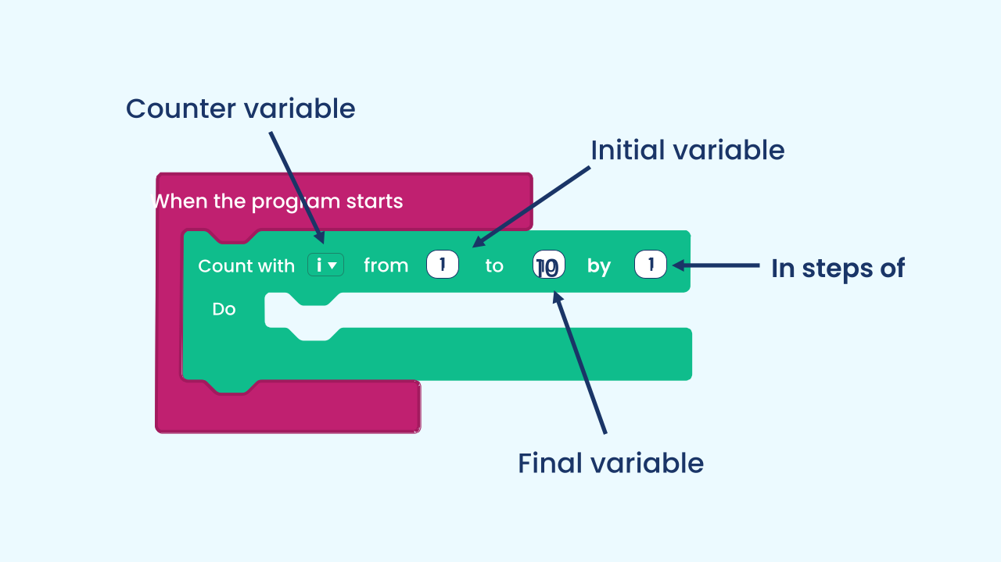
The Parts of a 'For' Loop
A "for" loop has four key parts that define its mission:
1. Counter Variable: A temporary variable the loop uses to keep count (for example, `i`, `row`, `column`).
2. Initial Value: The number where the counter variable starts counting (for example, `1`).
3. Final Value: The number where the loop will stop (for example, `7`).
4. Step: How much the counter variable adds (or subtracts) on each repetition (for example, `1`).

Slide 6
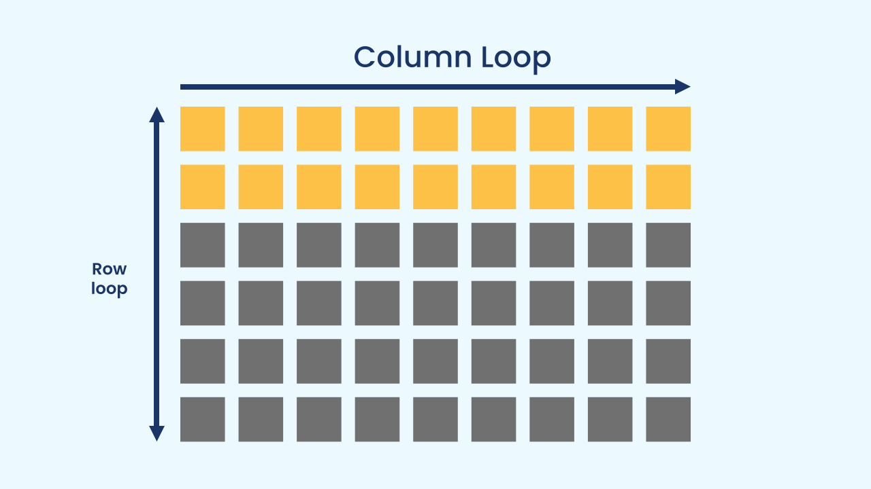
Nested Loops for 2D Grids
Our LED screen is a two-dimensional (2D) grid: it has rows and columns. To visit every pixel, a single loop isn't enough. The solution is to use nested 'for' loops: we put one loop inside another.
The outer loop runs through the rows (from 1 to 7): it picks one line of the grid.
For each row, the inner loop runs through the columns, lighting up the pixel `x = columns, y = rows` as it goes.
The inner variable is the one that changes fastest: it makes its 7 full laps for every value of the outer one — that's why the `draw` block runs 7 × 7 = 49 times, once for every LED.

Slide 7
Create
Let's build the cinematic effect!
You'll need 2 components: NoiseLevel and LEDDraw.
Make sure they are ready in your workspace.

Slide 8

Code Composition
The noise event flips the `state` variable from true to false and back. The big difference is inside the `if... else...`. When `state` is true, two nested `count with` loops run through the grid: `rows` on the outside and, within each row, `columns`, lighting up each pixel (`draw on x columns y rows`) with a 10-millisecond pause. In the `else` part we do the same thing, but we paint the pixels black to create the gradual fade-out effect.
https://app.protobject.com/generate?eq-luz-encendida-ruido-animacion&en&dynamic&-1

Slide 9
Reflect
What kinds of tasks is a "for" loop ideal for, compared with a "repeat forever" loop?
Explain why we need two nested "for" loops to light up the whole screen, and not just one.
The sweep travels the grid row by row. What would you change so it travelled column by column instead? (Hint: think about which of the two loops goes on the outside and which on the inside, without touching the `draw` block).

