Slide 1
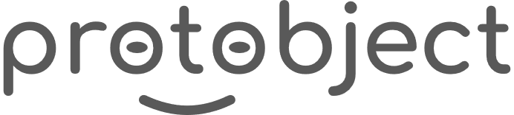
English
This presentation is automatically generated.
You can freely edit it and add any extra content you wish.
Español
Esta presentación se genera automáticamente.
Puedes modificarla a tu criterio y añadir cualquier contenido adicional que desees.
Italiano
Questa presentazione è generata automaticamente.
Puoi modificarla liberamente e aggiungere eventuali contenuti extra che desideri.

Slide 2
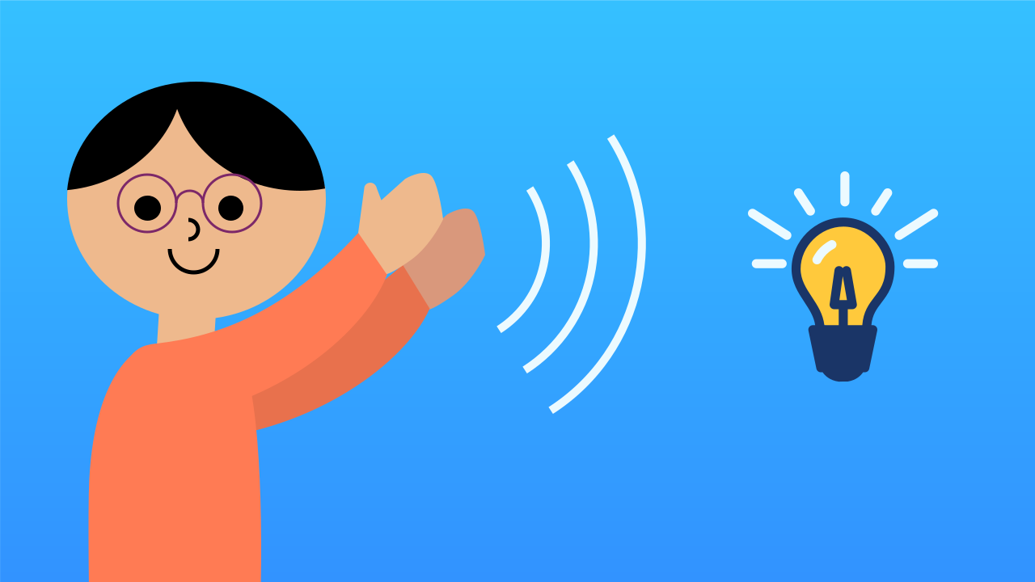
The Magic Clap Switch
Clap, and the light comes on! Bring together everything you've learned about events, variables, and conditionals to build a sound-activated switch, home-automation style.

Slide 3
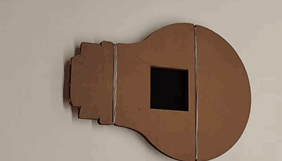
What will we do?

Slide 4
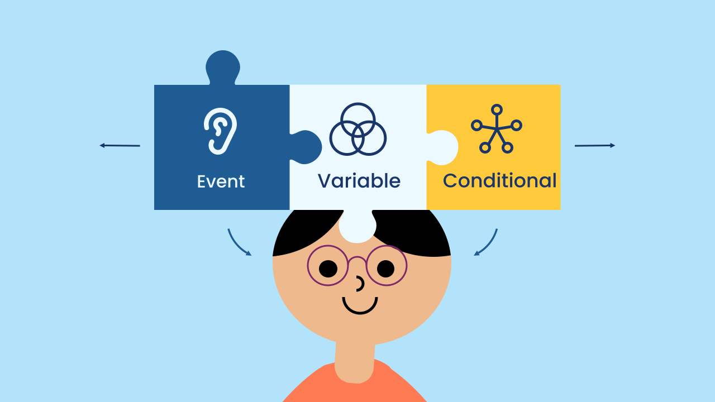
Synthesis: Putting the Puzzle Pieces Together
You've learned the three superpowers of interactive programming:
Events: To react to actions from the outside world (like a clap).
Variables: To give your program a memory and remember its state (such as whether the light is on or off).
Conditionals: To make decisions based on that state.
In this project we won't learn a new concept; instead we'll combine these three into a single elegant, working application, proving that you already have everything you need to create complex projects.

Slide 5
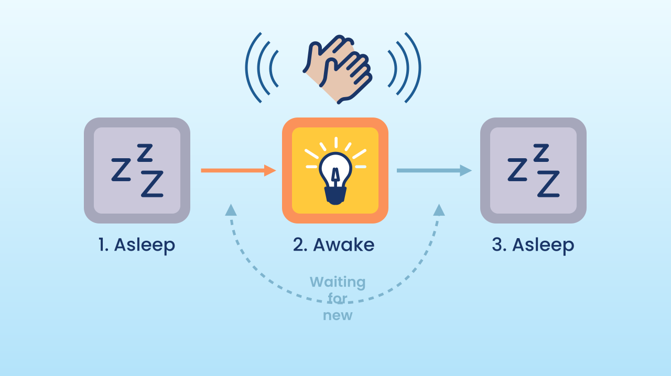
Event-Driven Architecture
This project uses a very clean and efficient program architecture. Unlike a program that needs a main loop animating non-stop, here there is no main loop for the logic!
The program sits completely idle at first. All the action (changing the variable AND deciding what to do with the light) happens *inside the very same event block*. The program "wakes up" at the clap, does its job instantly, and goes back to "sleep". This way of programming is very common in modern apps, because it saves battery and processor resources.

Slide 6
Create
Let's build the magic switch!
We'll need 2 components on our smartphone: NoiseLevel to detect the clap (a sudden increase in noise) and LEDDraw to act as our 'light bulb'.
Remember to scan or open both components on your device.

Slide 7

Code Composition
This code is a perfect example of efficiency. `when the program starts` only sets the `state` variable to `false`: the screen starts out dark and the program is left waiting for the first clap. After that, the program simply waits, doing nothing. The event block `when Noise Level sudden increase` does it all: first, it uses the 'toggle' trick (`state = not state`) to flip the current state. Immediately afterwards, an `if... else...` block reads the *new* value of that same variable and turns the light on or off. This order is not optional: if the `if... else...` read the variable *before* flipping it, the light would always show the previous state — the switch would run one clap behind. Everything happens in an instant, and only when it's needed.
https://app.protobject.com/generate?eq-luz-encendida-al-ruido&en&dynamic&-1

Slide 8
Reflect
Look at the structure of your code: there is no main loop at all — all the logic lives inside the event. What advantage does that have over a program that repeats instructions forever? Which one do you think uses less battery, and why?
The idea of "home automation" or the "smart home" is built on devices like this one. What other appliances in a house would you like to control with events such as your voice, movement, or a clap?
Right now, any loud noise flips the switch. How could you make it more robust so it doesn't trigger by accident (from a cough, for example)?

