Slide 1

English
This presentation is automatically generated.
You can freely edit it and add any extra content you wish.
Español
Esta presentación se genera automáticamente.
Puedes modificarla a tu criterio y añadir cualquier contenido adicional que desees.
Italiano
Questa presentazione è generata automaticamente.
Puoi modificarla liberamente e aggiungere eventuali contenuti extra che desideri.

Slide 2
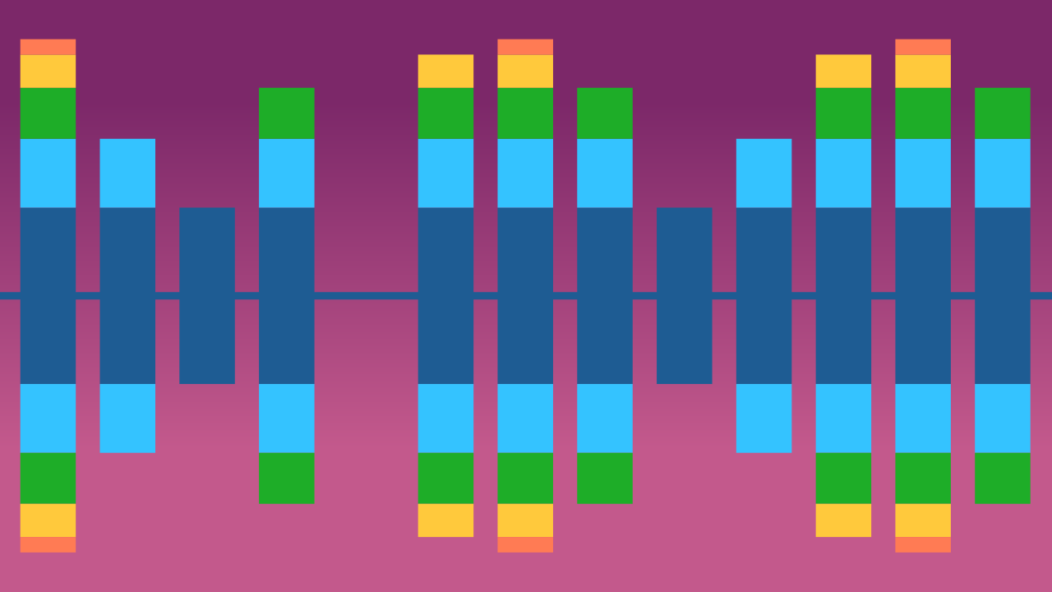
The Noise Meter
Learn the basics of drawing on a digital canvas by creating a line that grows and shrinks with the volume of surrounding noise.

Slide 3
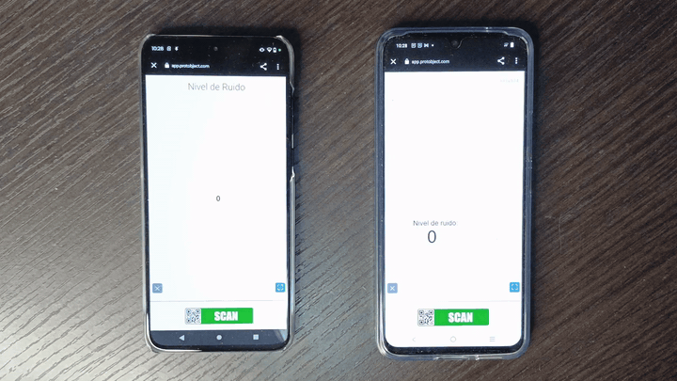
What will we do?

Slide 4
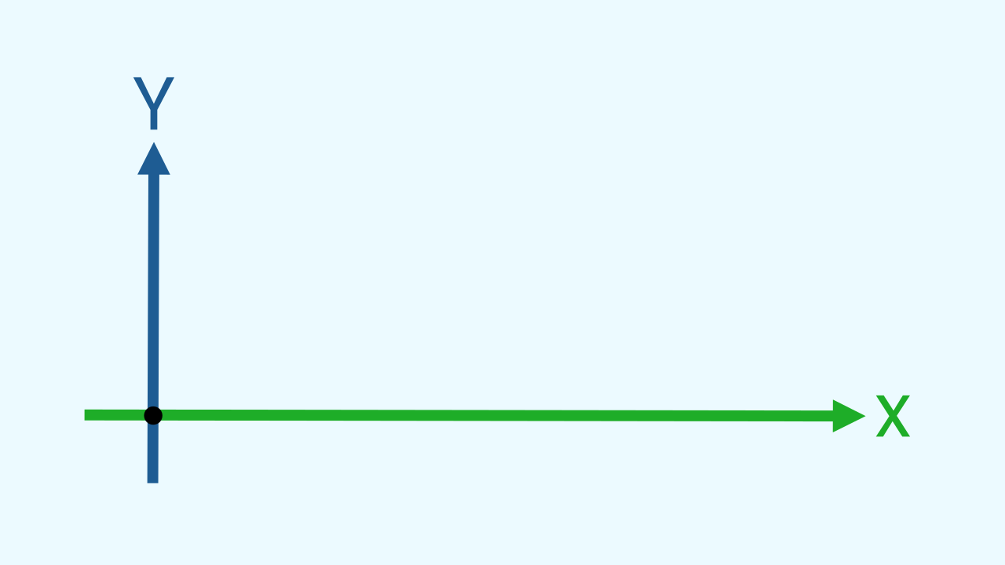
What is the Cartesian Plane?
Think of a screen not as a flat surface, but as a piece of graph paper. To tell the computer where to draw something, you need to give it an "address," just like a location on a map. This map is called the Cartesian Plane. It's a coordinate system composed of two perpendicular axes: the horizontal line is called the X-axis, and the vertical line is called the Y-axis. The point where they meet is the "origin" (0,0).

Slide 5
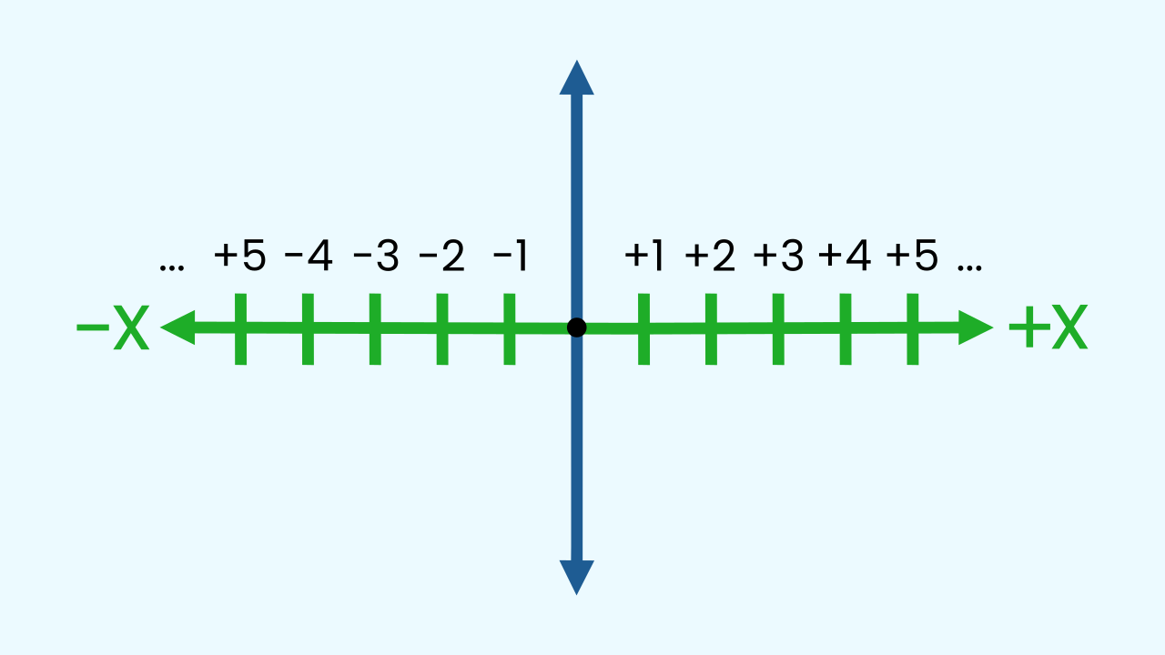
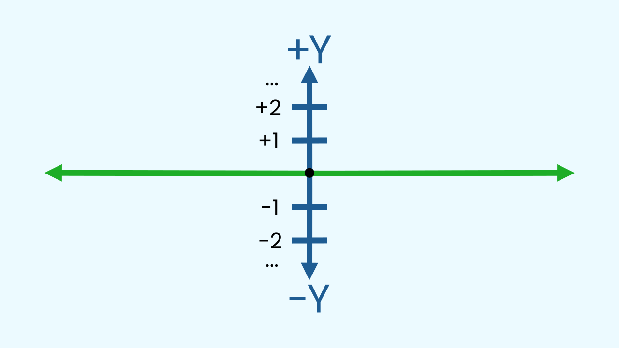
How do the X and Y axes work?
The X-axis (horizontal) works just like a number line: smaller numbers are on the left, and larger numbers are on the right. The Y-axis (vertical) places smaller numbers at the bottom and larger ones at the top. By combining an X and a Y value, we can define the precise location of any point on the screen.

Slide 6
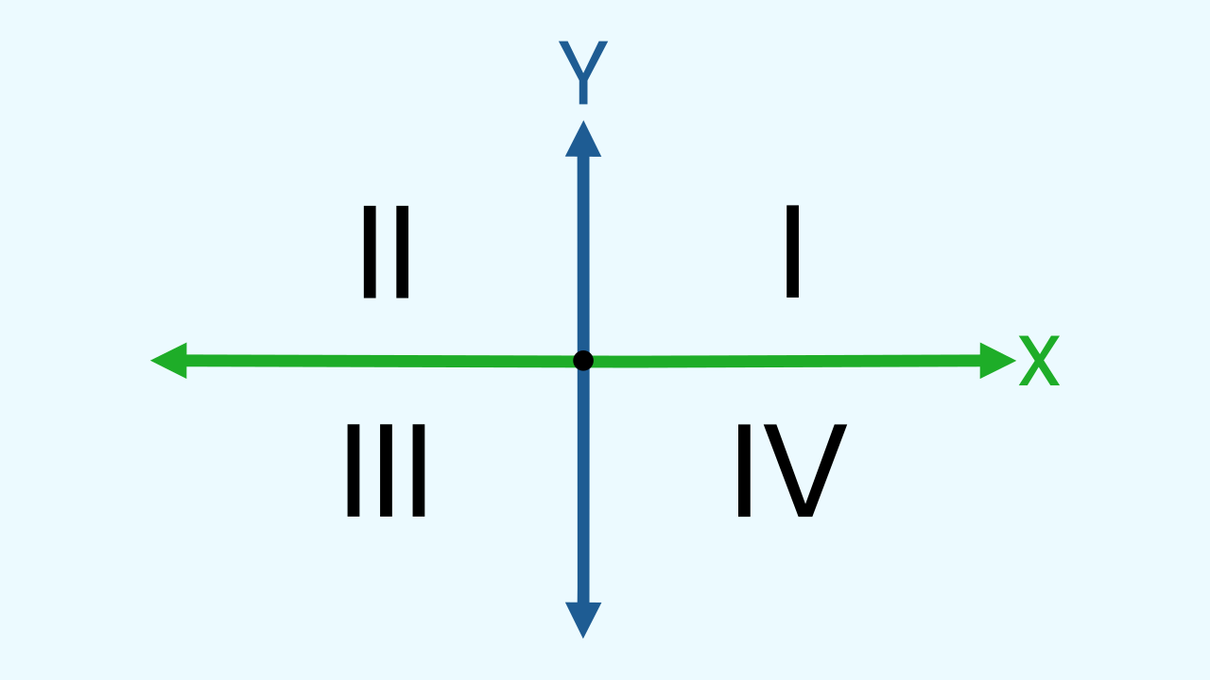
The First Quadrant
The Cartesian plane is divided into four quadrants. In Protobject, to keep things simple, we primarily use the first quadrant, where both X and Y values are positive numbers. The origin point (0,0) corresponds to the bottom-left corner of our drawing canvas.

Slide 7
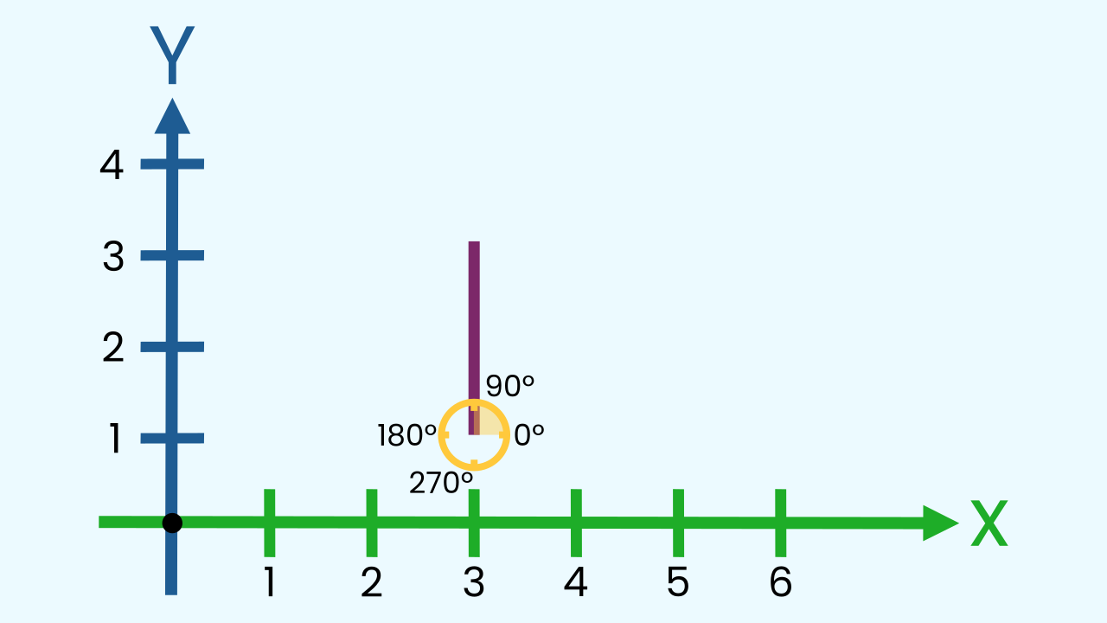
How to Draw a Line
To draw a line, you just need to give the computer three instructions: a starting point (an X, Y coordinate), the direction to travel (an angle), and how far to go (a length).
For a vertical bar, we'll start at the bottom of the screen, point straight up (a 90-degree angle), and make the length change based on the noise level!

Slide 8


Why visualize noise?
Visualizing sound intensity isn't just for fun; it's useful! In loud environments like factories, a noise meter can help protect workers' hearing. In a classroom or library, it can be a great visual cue to help everyone be more aware of noise levels, creating a better environment for learning and focusing.

Slide 9
Make the Noise Visualizer
Let’s create the prototype that visualizes the noise level in real-time.
Press Add Device, select Noise Level, and scan the QR code with your smartphone.
Click on Add Device, select WriteDraw, and press Open in this window to generate a drawing surface on the computer.

Slide 10
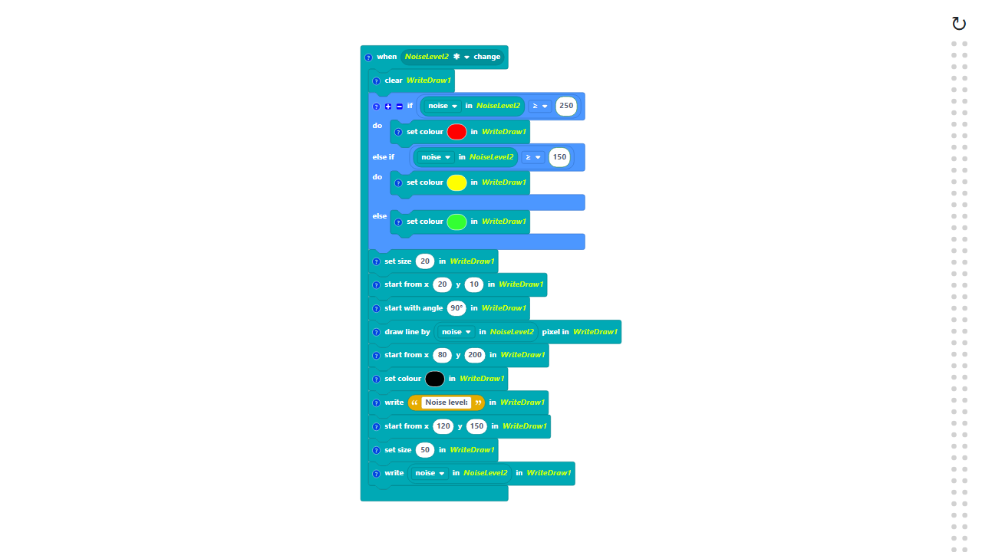
Code Composition
Click on the question mark icon to open comments explaining the code. Note that we have to clear the screen in every loop cycle to erase the old line before drawing the new one!
https://app.protobject.com/generate?en-a17-noisevisualizer&en&dynamic&-1

Slide 11
Reflect
★ Our code draws a vertical line. How would you change the parameters of the "draw line" block to make it a horizontal line instead?
★ Besides a line, what other ways could you visualize the noise? A circle that grows? A color that changes from green to red?

