Slide 1

English
This presentation is automatically generated.
You can freely edit it and add any extra content you wish.
Español
Esta presentación se genera automáticamente.
Puedes modificarla a tu criterio y añadir cualquier contenido adicional que desees.
Italiano
Questa presentazione è generata automaticamente.
Puoi modificarla liberamente e aggiungere eventuali contenuti extra che desideri.

Slide 2

Don't Spill the Liquid! - The Steady Hand Game
Put your steady hand to the test and learn about compound logic. Use the 'AND' operator to program a balancing game that needs two conditions to be true at the same time.

Slide 3
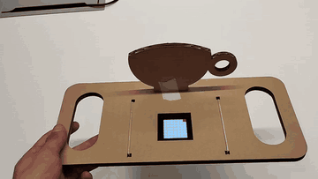
What will we do?

Slide 4
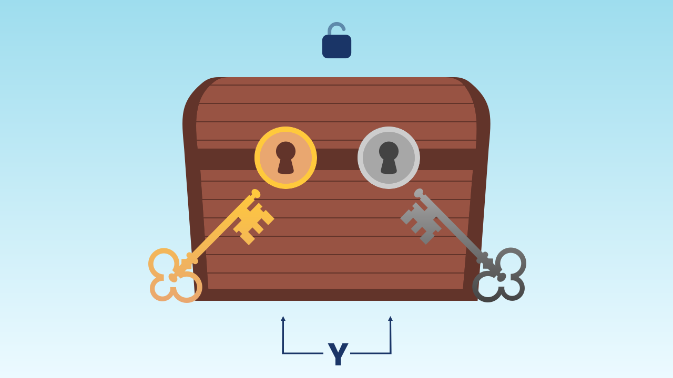
Decisions with Multiple Requirements
In real life, a single question often isn't enough. For a self-driving car to move through an intersection, the light has to be green AND there must be no pedestrians crossing. To buy an item in a game, you need to have enough gold AND have room in your inventory. Life is full of decisions that depend on several factors that all have to be true at the same time.

Slide 5
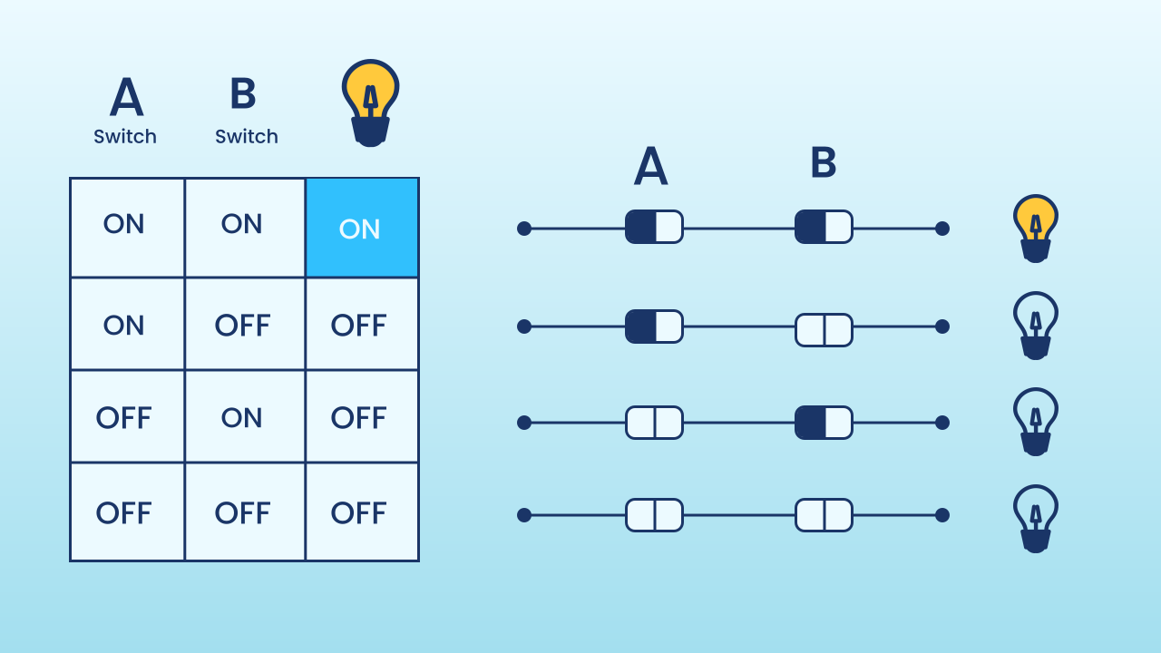
The 'AND' Logical Operator
The "AND" operator is the tool we use to combine several questions. It's like a very strict security guard who asks for two forms of ID. He will only let you through if the first one is valid AND the second one is valid too. If either of the two fails, the whole condition counts as false.
In boolean logic:
- `TRUE` AND `TRUE` = TRUE
- `TRUE` AND `FALSE` = FALSE
- `FALSE` AND `TRUE` = FALSE
- `FALSE` AND `FALSE` = FALSE

Slide 6
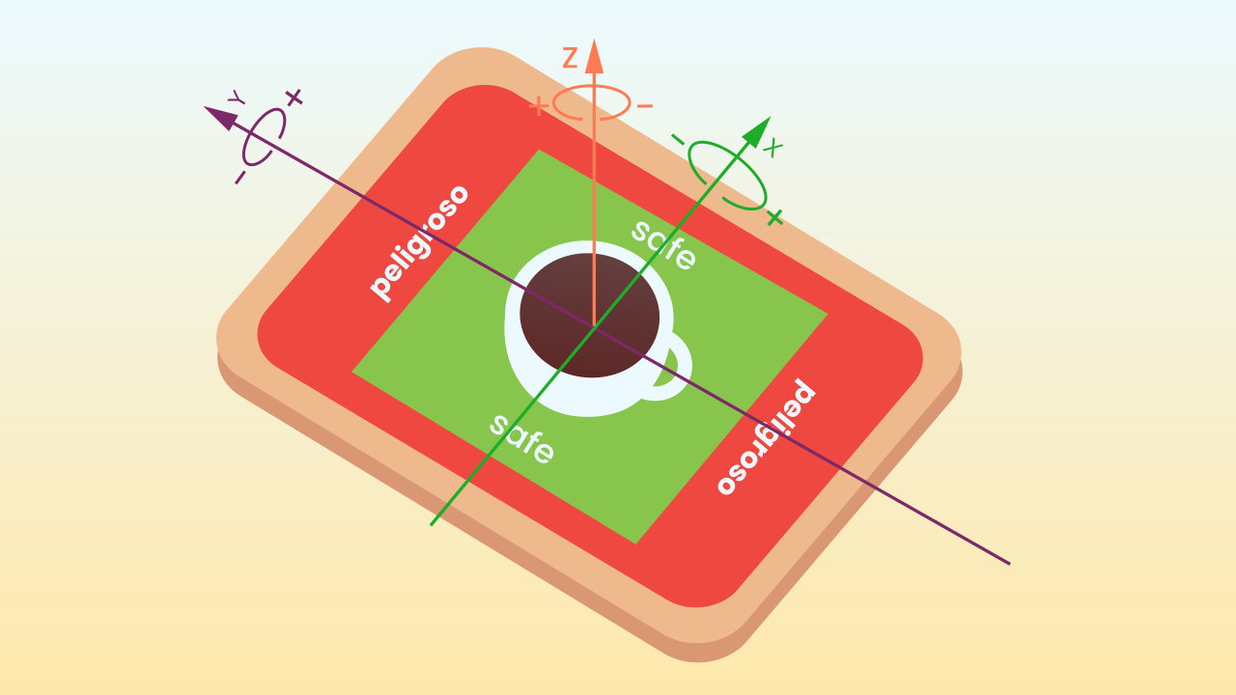
The Logic of Balance
For our game, the logic for staying in the "safe" zone is a compound condition:
IF (`the X tilt transformed into LED positions is between LEDs 3 and 5`) AND (`the Y tilt transformed into LED positions is between LEDs 3 and 5`)
THEN... you're safe.
ELSE... alarm!
If you lean too far forward (the Y condition fails) or too far to the left (the X condition fails), the overall result of the "AND" will be FALSE and you'll lose your balance.

Slide 7
Create
Put your steady hand to the test!
We'll need 3 components on our smartphone: Inclination to measure the balance on both axes, LEDDraw for the visual indicator (the level 'bubble'), and MusicalKeyboard for the success and alert sounds.
Remember to scan all the QR codes with the same device.

Slide 8

Code Composition
When the program starts, we set the `shouldSoundAlarm` variable to true. Then, in the `repeat forever` block, we set the variables `xShifted` and `yShifted`, which store the tilt values of the X and Y axes, respectively, with 100 added to shift them into a positive range. We also set the variables `ledX` and `ledY`, which tell the program at which position of the screen the LEDs should appear depending on how the device is tilted: in each one we store the matching shifted tilt variable multiplied by 7 (to scale it to the size of the LED screen), with that result then divided by 198, all of it placed inside the `round up` block. This makes sure the tilt of our phone always fits onto the LED screen.
Now comes the key to this code: we set the variables `centeredX` and `centeredY`, each of which checks two separate conditions. For example, `centeredX` checks whether `ledX` is on the third LED of the screen or further along and, at the same time, thanks to the `and` block, whether `ledX` is on the fifth LED or an earlier one: the result is that the `centeredX` variable will only be true if `ledX` is between LEDs 3 and 5. Something similar happens with the `centeredY` variable, only with `ledY`.
Then, inside the `if` block, you'll see an `and` block holding two separate conditions, one for the X axis and one for the Y axis. The program checks both of them on every cycle. Only if the two are true at the same time will the code for the green indicator run. Inside the green path there is also an `if shouldSoundAlarm`: it makes the success note play only once as you enter the zone (the flag switches to false), and the alarm branch sets it back to true, leaving it ready for the next time you recover your balance. The moment one of them fails, the whole `and` condition becomes false, and the program jumps straight to the `else` block to set off the alarm, where the LEDs are drawn in red along with sound effects telling you that the phone is off level.
Finally, one clarification: to plot the LED's position, the program draws the value of `ledY` on the X axis and the value of `ledX` on the Y axis. That's because the phone's tilt sensors originally count their values with the phone upright, but for this activity we use it lying flat, screen facing up, so we have to swap the axes.
https://app.protobject.com/generate?eq-nivel-con-ruido&en&dynamic&-1

Slide 9
Reflect
What does the "AND" operator do? Why did we need it for this game instead of a simple "if"?
Describe a situation in which the alarm would go off. What values would `ledX` and `ledY` have to have for that to happen — and which way would you have to tilt the phone to make it happen?
If you wanted to make the game easier, would you widen or narrow the range of safe numbers (which is currently between 3 and 5)?

