Slide 1
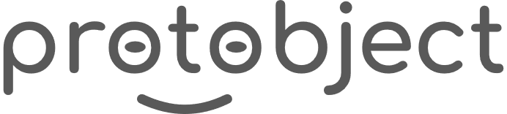
English
This presentation is automatically generated.
You can freely edit it and add any extra content you wish.
Español
Esta presentación se genera automáticamente.
Puedes modificarla a tu criterio y añadir cualquier contenido adicional que desees.
Italiano
Questa presentazione è generata automaticamente.
Puoi modificarla liberamente e aggiungere eventuali contenuti extra che desideri.

Slide 2

The Magic Birthday Candle
Make a wish and blow! Learn the complete cycle of interactivity by combining events, state variables, and conditionals to build a digital candle you can blow out.

Slide 3
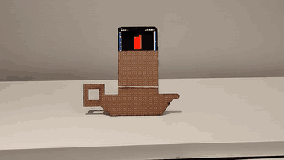
What will we do?

Slide 4
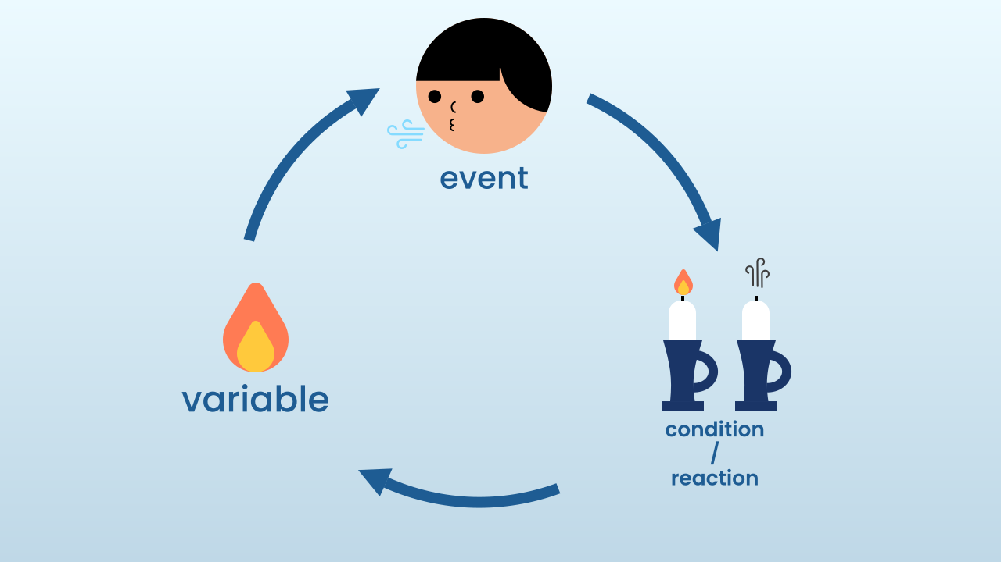
The Complete Interactive Cycle
Most of the apps you use, from video games to social media, are built on one fundamental three-step cycle:
1. User Action (Event): You do something (a click, a tap, a puff of air). The program detects it as an event.
2. State Update (Variable): In response to the event, the program updates its memory (a variable) to remember what happened.
3. Program Reaction (Conditional): The program, which is running non-stop, reads that memory and decides how to change what you see or hear.
Today, you'll build that exact cycle!

Slide 5
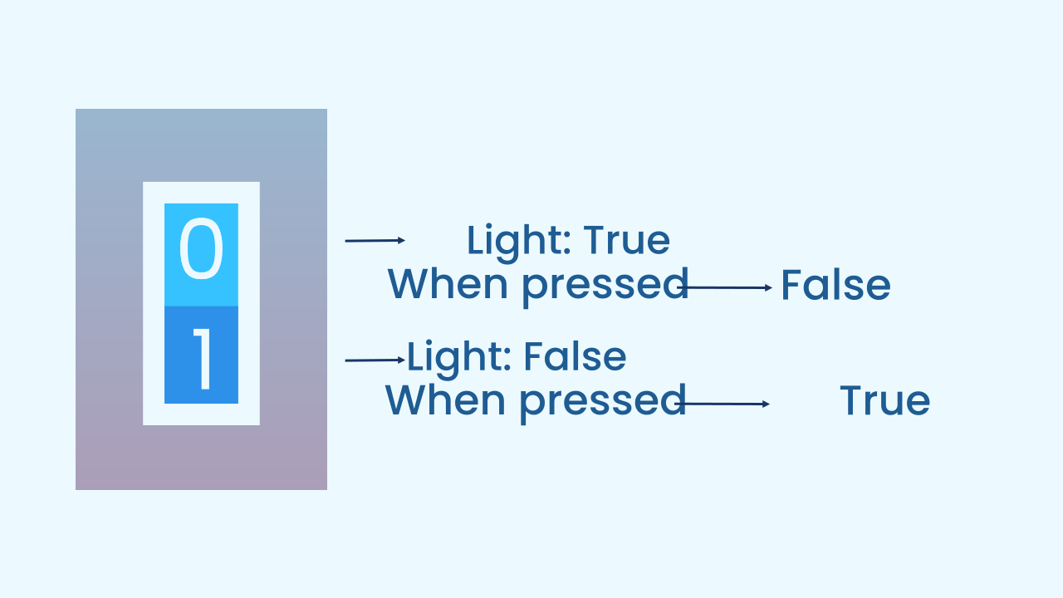
Switch Logic (Toggle)
Our candle doesn't just go out; it can be lit again with another puff! This is called "switch" or "toggle" logic.
Instead of simply setting the `candleLit` variable to FALSE, we set it to `(not candleLit)`. This special block flips the current boolean value:
If `candleLit` was TRUE, it becomes FALSE.
If `candleLit` was FALSE, it becomes TRUE.
With a single block, we can light the candle and blow it out using the very same action!

Slide 6
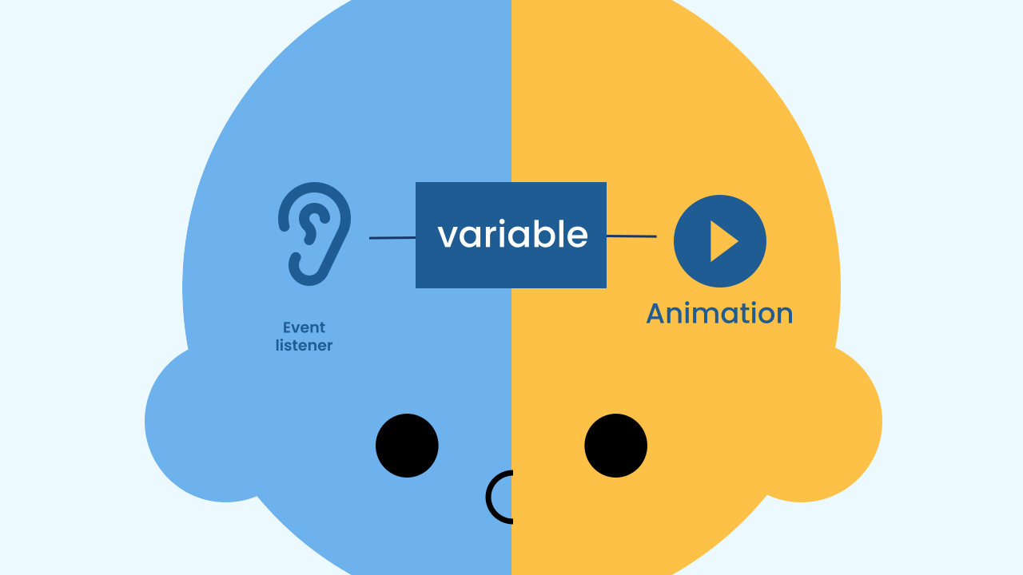
The Architecture of Our Program
Our program has two main parts that work as a team:
The Event Listener: It is always "listening" to the microphone in the background. Its only job is to flip the state of the `candleLit` variable when it detects a puff of air. It doesn't care about the animation.
The Animation Engine (Main Loop): It is always "drawing" on the screen. Its only job is to look at the `candleLit` variable on every cycle and decide: do I draw the flame, or do I leave the screen black? The true branch alternates between two frames — the flame tip at a random spot and the tip at the center — with 200 ms in between. Before each tip, the candle is drawn again: that redraw is what puts out the previous tip. If you remove it to simplify things, the tips pile up and the flame stops flickering. It doesn't care where the change came from.

Slide 7
Create
Let's blow out the candles!
We'll need 2 components: NoiseLevel to detect the 'puff' (a sudden increase in noise) and LEDDraw to show our candle and its flame.
Remember to scan or open both components on your device.

Slide 8

Code Composition
Notice the elegant split of jobs. The event block `when noise level sudden increase` only takes care of changing the `candleLit` variable. Meanwhile, the `main loop` runs non-stop, and its `if... else...` block only takes care of reading that same `candleLit` variable to decide which animation to show on the screen. It's perfect teamwork, and it all happens through one variable!
https://app.protobject.com/generate?eq-flama-vela-con-soplo&en&dynamic&-1

Slide 9
Reflect
Describe the "interactive cycle" in this project. What is the event, what is the state variable, and what is the conditional that reacts?
What exactly does the `set candleLit to (not candleLit)` block do? Why is it more flexible than simply setting the variable to FALSE?
If you wanted the candle to be blown out only once (and never lit again), what would you change in the event block?

