Slide 1

English
This presentation is automatically generated.
You can freely edit it and add any extra content you wish.
Español
Esta presentación se genera automáticamente.
Puedes modificarla a tu criterio y añadir cualquier contenido adicional que desees.
Italiano
Questa presentazione è generata automaticamente.
Puoi modificarla liberamente e aggiungere eventuali contenuti extra che desideri.

Slide 2
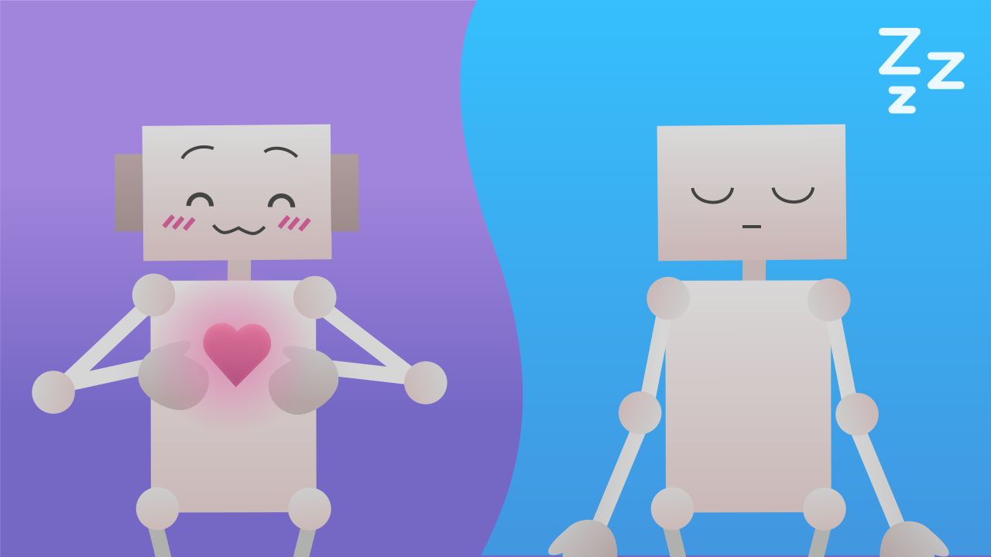
The Heart of My Robot Friend
Use the energy you stored up to give your robot a heart. Learn how to use events to change 'state variables' and reshape your program's behavior in real time.

Slide 3

What will we do?

Slide 4
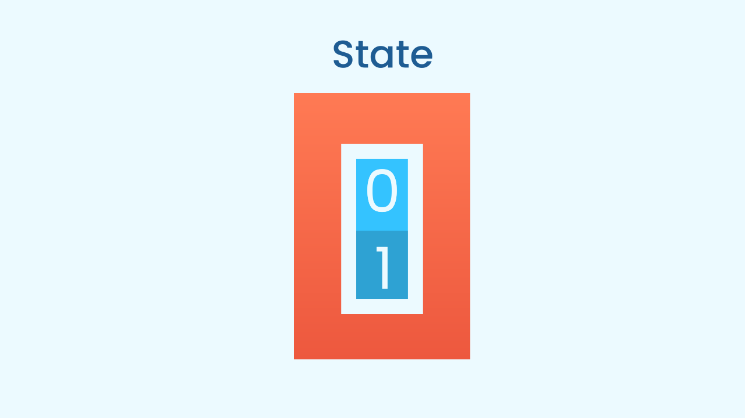
State Variables: The "Mode" of the Program
Up to now, our variable was only good for counting. But a state variable is much more powerful. It doesn't just store a number, it describes the "mode" or "state" the program is currently in.
Think of a video game character. It can be in the "walking", "running" or "jumping" state. In our case, our robot's heart can be in the "sleeping" state or the "awake" one. State variables are the memory that lets a program know how it should behave at any given moment.

Slide 5
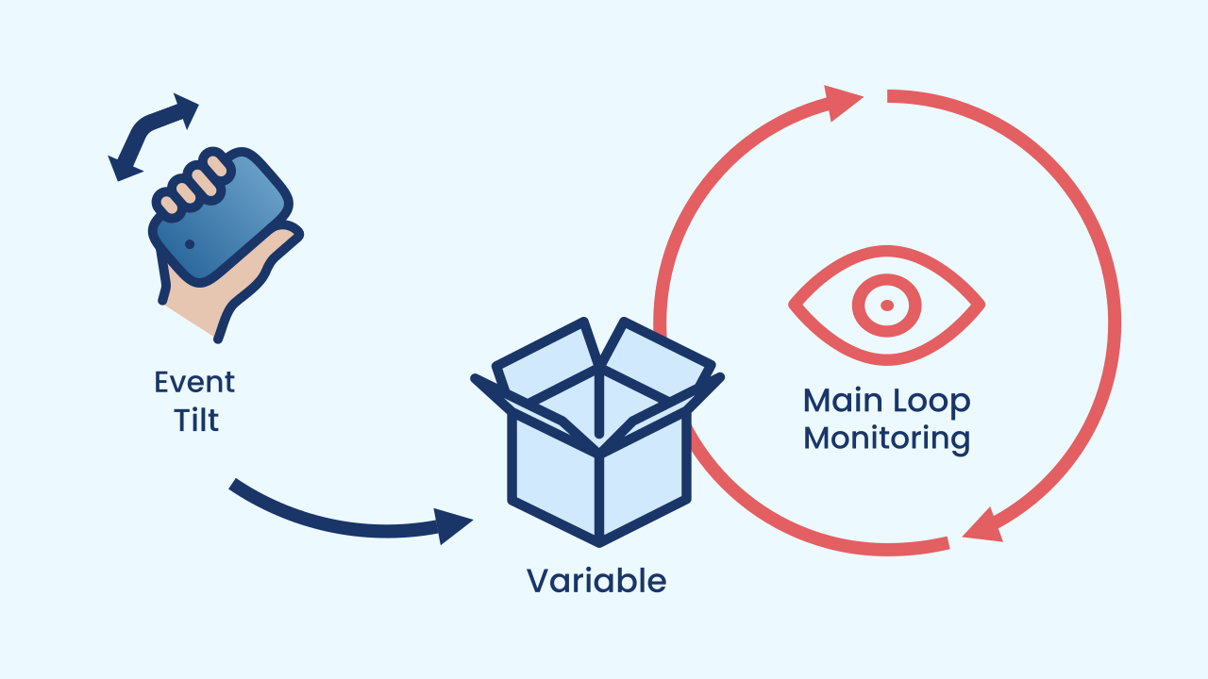
The Pattern: Events That Control a Loop
In this project, two parts of our code will work as a team without ever touching each other. They talk through the variables!
The Main Loop: It's the engine. It takes care of the continuous action: animating the heart. But it doesn't decide the speed on its own; on every cycle it reads `longPause` and `shortPause` to find out how long to wait between one drawing and the next.
The Events: They are the controls. They wait for an action from the user (tilting the device). When one happens, their only job is to write a new value into `longPause` and `shortPause`.
The loop reads, the events write. The variables are the message they pass to each other.

Slide 6
Create
Let's give our robot a heart!
Press Add Device and select LEDDraw for the heart animation.
Also add the MusicalDrum component for the heartbeat sound.
Finally, add Inclination to detect the gestures that will change the state.

Slide 7

Code Composition
`When the program starts`, we set `longPause` and `shortPause` to the "calm" rhythm. Careful: these variables don't store a speed but milliseconds of waiting — the longer the wait, the slower the heart beats. The `main loop` constantly uses these variables to define the pauses in the animation. The two tilt event blocks listen in the background. When you tilt the phone onto its side, the matching event changes the numbers in the variables to smaller values, making the loop (which is always reading them) speed up. The heart races! When you lay the phone flat again, the other event restores the normal speed. And one important detail: the calm rhythm appears twice — in `When the program starts` and in the gesture that brings the calm back. If you change one, change the other too, or the gesture will undo your adjustment.
https://app.protobject.com/generate?eq-corazon-variables-eventos&en&dynamic&-1

Slide 8
Reflect
In this project, variables don't just count, they control behavior. What is a "state variable"?
Explain in your own words how the main loop and the event blocks talk to each other if they are not connected directly.
What other "states" could you give your robot? Maybe a "racing" state where the heart beats very, very fast, as if the robot were running?

