Slide 1

English
This presentation is automatically generated.
You can freely edit it and add any extra content you wish.
Español
Esta presentación se genera automáticamente.
Puedes modificarla a tu criterio y añadir cualquier contenido adicional que desees.
Italiano
Questa presentazione è generata automaticamente.
Puoi modificarla liberamente e aggiungere eventuali contenuti extra che desideri.

Slide 2
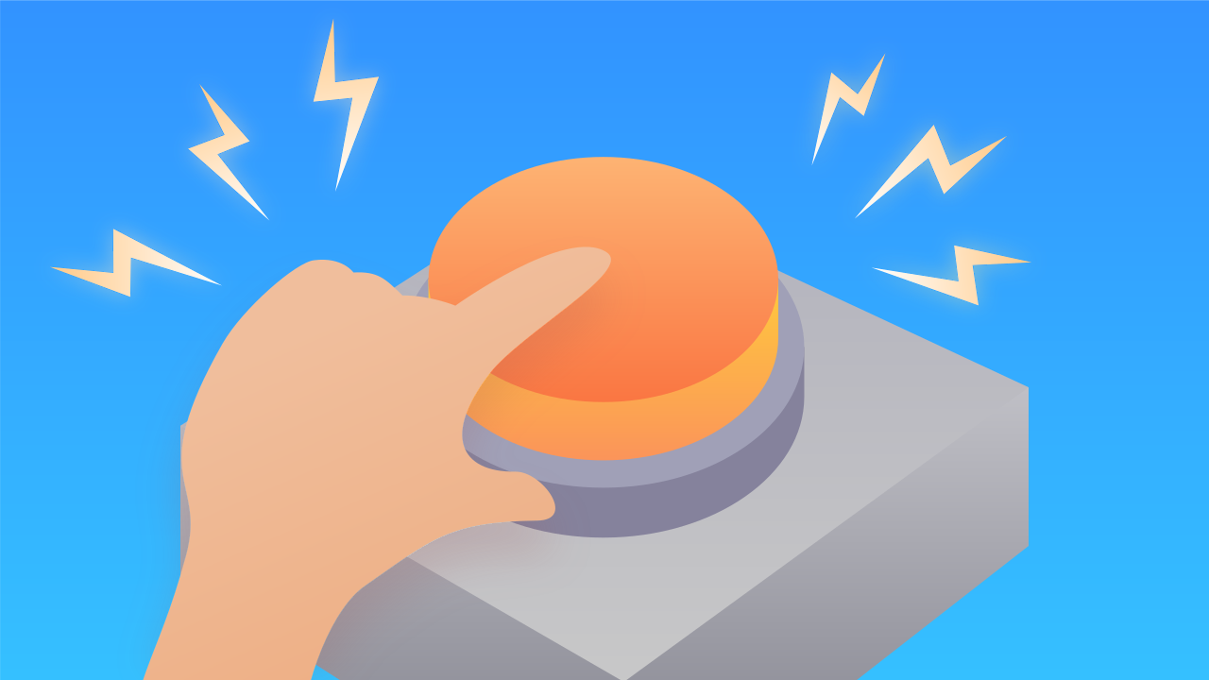
The Robot Activation Challenge!
Give your robot a 'memory'. Learn to use variables to count events and build a fun tapping game that charges your character up with energy.

Slide 3
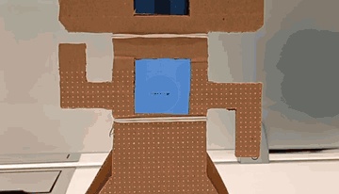
What will we do?

Slide 4
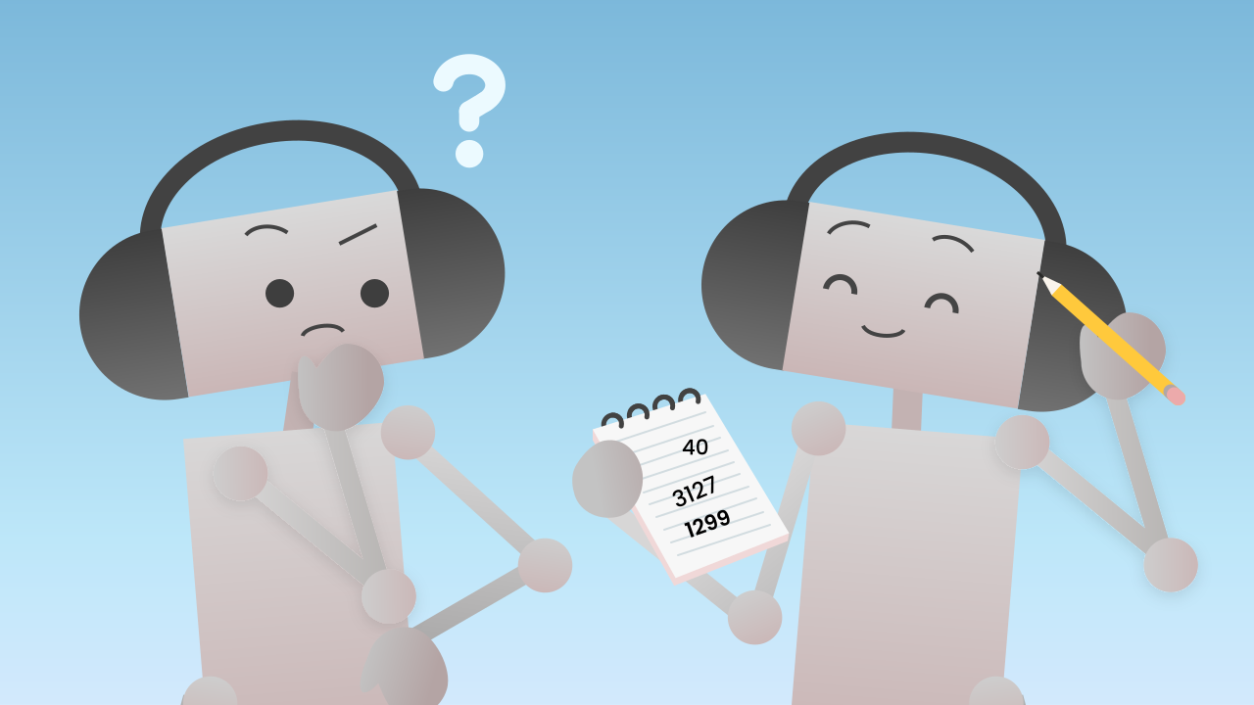
Why Do Programs Need a Memory?
A program that only reacts always responds in exactly the same way: it can't "remember" how many times you have tapped it. To build smarter programs that can change the way they behave, we need a way to store information. We need to give them a memory.

Slide 5
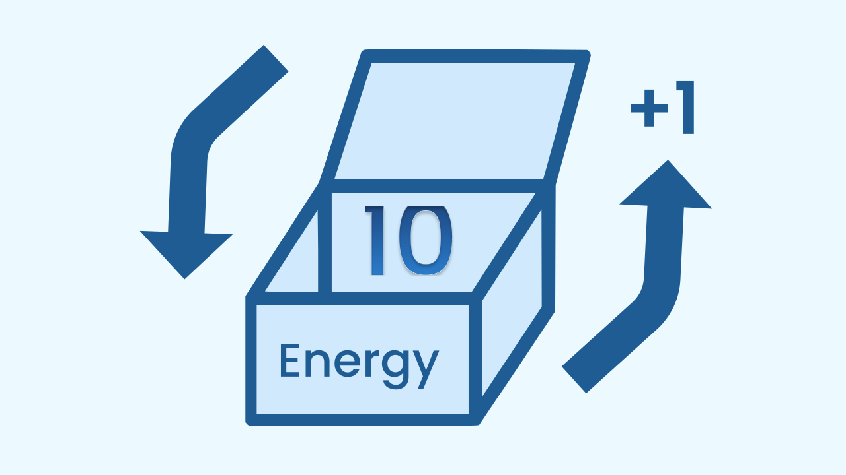
Variables: The Memory Boxes of Code
In programming, that memory is called a variable. Think of a variable as a box with a label on it.
The label is the name of the variable (for example, `energy`).
The contents are the data we keep inside (for example, the number `25`).
The most powerful part is that the contents of the box can change at any moment. We can open it, add 1 to the number, and store the new result.

Slide 6
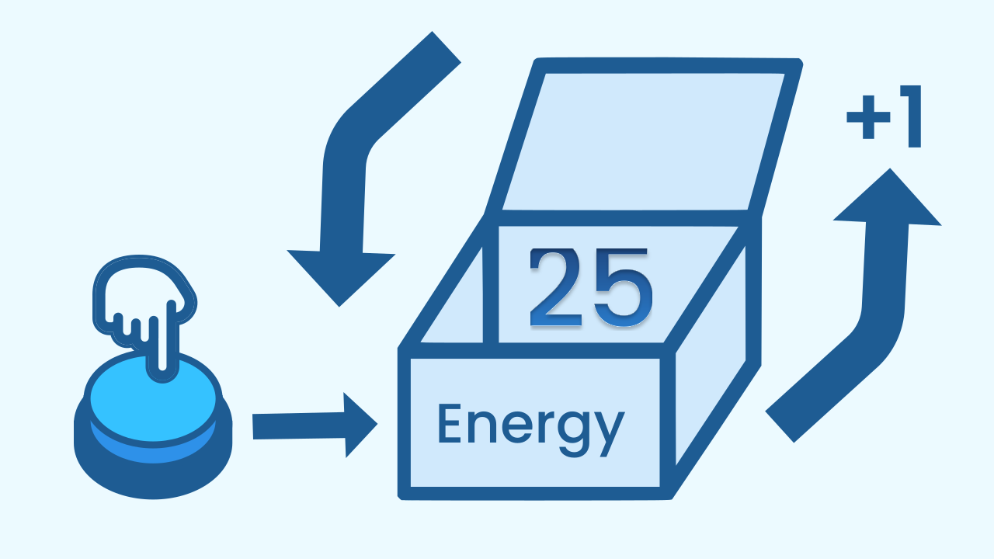
Events That Change the Memory
Now we can put these two ideas together. We are going to use an event (tapping a button) not only to trigger an animation, but to change what is inside our variable.
Every time you tap the chosen button, the event fires and gives the program an order: *"Open the box called `energy`, look at the number inside, add 1 to it, and store the new total back in the same box"*. That is how our program "remembers" and keeps count.

Slide 7
Create
Let's charge the robot up with energy!
Press Add Device and select TouchButton. This will be our energy 'charger'.
Press Add Device again and select LEDDraw so we can see the energy level on the screen.
Finally, press Add Device and select AudioPlayer so we know when the robot has been activated.
Remember to scan or open all the components.

Slide 8

Code Composition
Click on the question mark to see the comments. First, in `when the program starts`, we create our `energy` variable and set it to `0`. That is our starting point. Then the `when ... is touched` event block fires with every tap. Inside it, the `change energy by 1` block updates our "memory". All of this lives inside `repeat forever`. Inside the `if` block, as long as the energy is less than 7, each pass lights up a single line — the one matching the current energy — and since nothing inside that branch ever gets erased, the earlier lines stay lit: that is why you see the bar grow. (The bar climbs six steps: the seventh tap doesn't draw the last one, it jumps straight to the celebration.) Otherwise, the robot activates: the bar is cleared, a happy face appears and the celebration sound plays — and since everything lives inside the loop, the celebration repeats until you restart the program.
https://app.protobject.com/generate?eq-juego-toques&en&dynamic&-1

Slide 9
Reflect
You have just given a program a "memory" for the very first time. What is a variable, and what did we use it for in this challenge?
What role does the event play in this code? Does it trigger an animation, or does it do something more?
If you wanted every tap to add 5 points of energy instead of 1, which block would you change?

