Slide 1

English
This presentation is automatically generated.
You can freely edit it and add any extra content you wish.
Español
Esta presentación se genera automáticamente.
Puedes modificarla a tu criterio y añadir cualquier contenido adicional que desees.
Italiano
Questa presentazione è generata automaticamente.
Puoi modificarla liberamente e aggiungere eventuali contenuti extra che desideri.

Slide 2
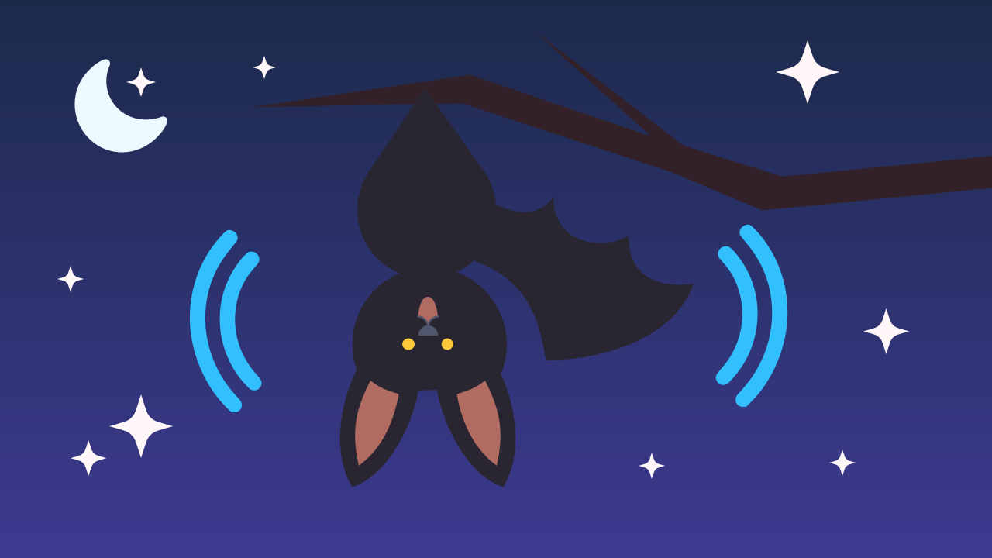
Flight of the Night Bat
Strengthen your command of 'If... Else...' logic by flipping the condition around. Create a virtual bat that only wakes up and takes flight when the room goes dark.

Slide 3
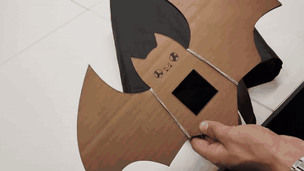
What will we do?

Slide 4
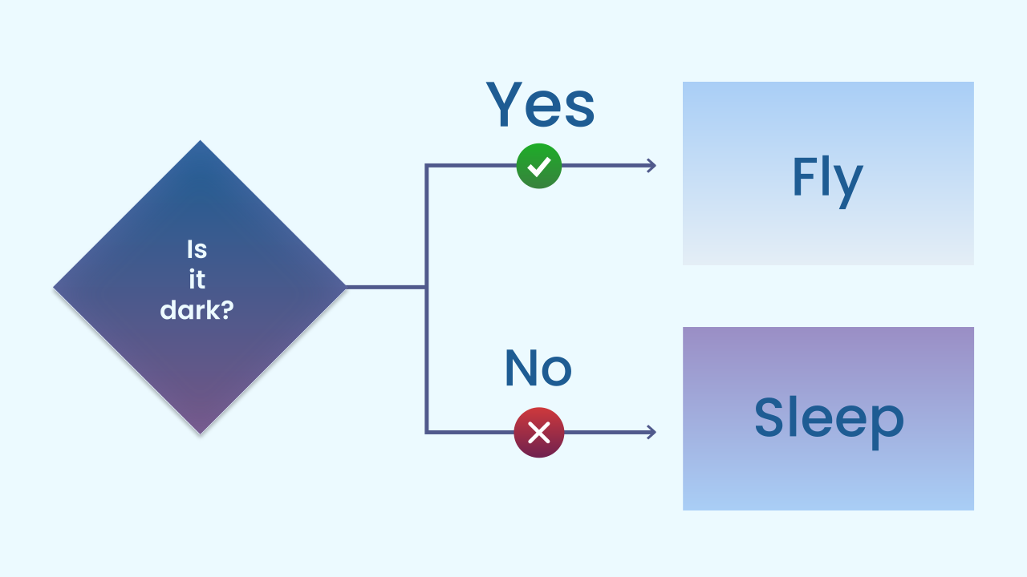
Reinforcing the 'If... Else...'
The best way to master a concept is to practice it. Let's go over the "If... Else..." structure again: it's like a decision the bat makes before it acts.
1. The program reaches a condition (Is there very little light?).
2. If the answer is true, it takes the first path (Time to fly!).
3. If the answer is false, it takes the second path (Keep on sleeping).
Once you master this structure, you can control the behavior of any digital creature.

Slide 5
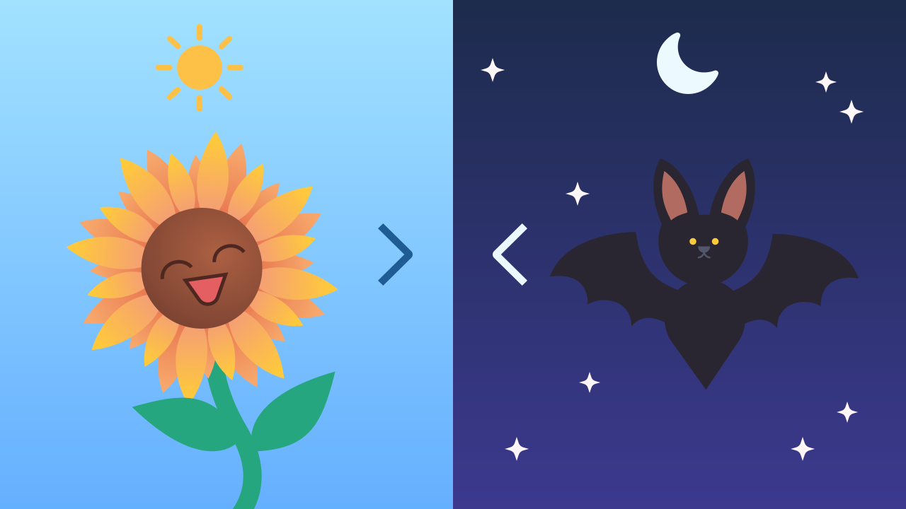
Changing the Question: Comparison Operators
For this project, we'll simply switch the operator to "less than" (`<`). With `light > 50` a program activates in brightness; with `light < 30` it activates in darkness. Same block, opposite question. Now, instead of springing into action when it's bright, our program will be watching for darkness so it can wake the bat up!

Slide 6
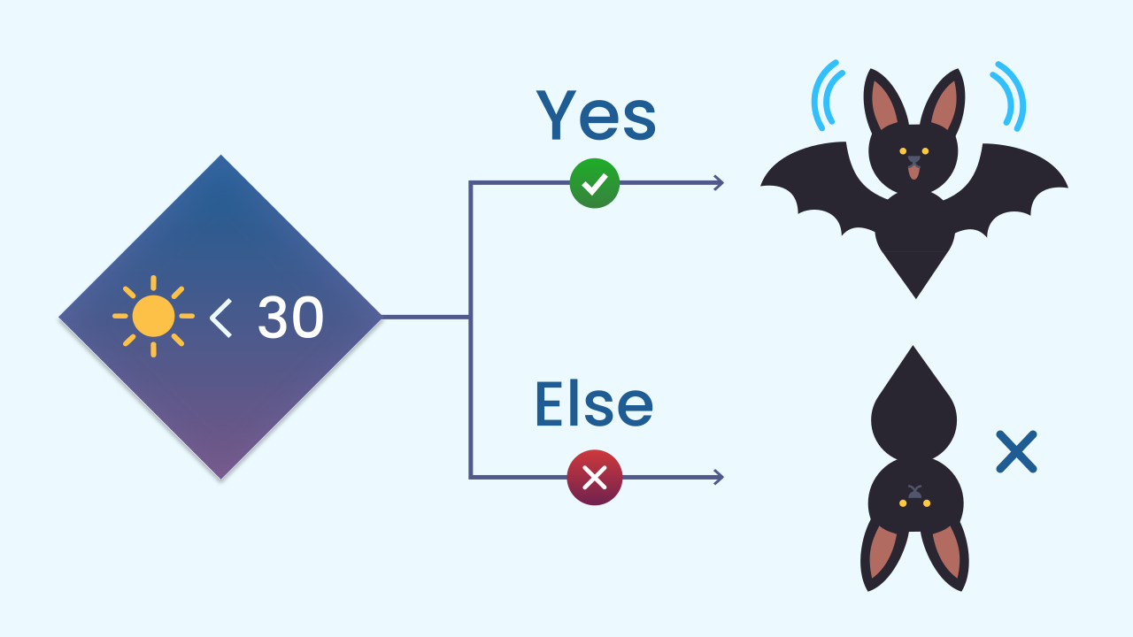
The Bat's Logic
The logic for our bat is a mirror image: where other programs look for light, this one looks for its absence.
Condition: Is the light sensor value less than 30?
IF TRUE (it's dark): The bat wakes up! The flying animation runs.
ELSE (it's FALSE, there's light): The bat "sleeps", which means it disappears from the screen.

Slide 7
Create
Let's program the bat!
We'll need 2 components: LightIntensity to detect the darkness and LEDDraw to animate our bat's flight.
Remember to scan or open both components on your device.

Slide 8

Code Composition
Inside the `main loop`, we use the `if... else...` block. The key is the condition: it checks whether `light intensity < 30`. If that's true (darkness), the bat flies. If it's false (there's light), the bat rests. Inside the true branch there are four drawings that take turns, each followed by a `delay of 200 ms`: that's what creates the flapping. The last pause matters too — without it, the fourth drawing would be wiped right away as the loop starts over: every frame needs its time on screen.
https://app.protobject.com/generate?eq-luces-de-fiesta-al-oscurecer&en&dynamic&-1

Slide 9
Reflect
How do you think this kind of logic helps engineers build streetlights that switch on by themselves?
What if the bat were really shy and you needed it to be *completely* dark before it came out? Would you raise or lower the number 30?
Can you think of any other animal that follows this "If it's dark, then..." logic? (For example: owls, fireflies).

