Slide 1

English
This presentation is automatically generated.
You can freely edit it and add any extra content you wish.
Español
Esta presentación se genera automáticamente.
Puedes modificarla a tu criterio y añadir cualquier contenido adicional que desees.
Italiano
Questa presentazione è generata automaticamente.
Puoi modificarla liberamente e aggiungere eventuali contenuti extra che desideri.

Slide 2

The Sunflower Alarm Clock
Learn to handle two paths with 'If... Else...' logic. Build a smart alarm clock that switches on with the light, like a sunflower waking up with the sun.

Slide 3

What will we do?

Slide 4
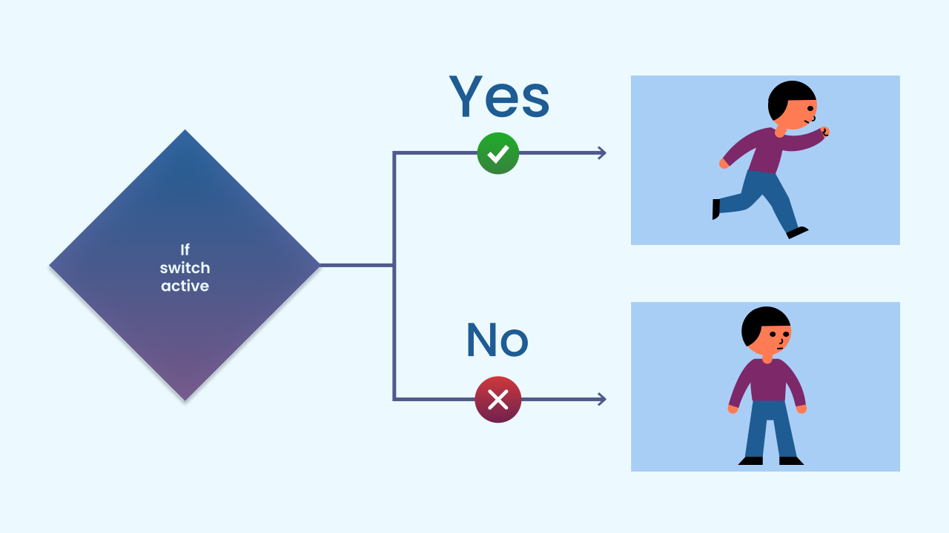
Beyond 'If': The Power of 'Else'
The "if..." block is great, but sometimes we need a Plan B. The "else" block gives us exactly that.
The full "if... else..." structure gives the program a foolproof set of instructions: IF this condition is true, run the first block of code. ELSE (in any other case, that is, if the condition is false), run this second block of code.
The program will always take one of the two paths. Never both, and never neither.

Slide 5
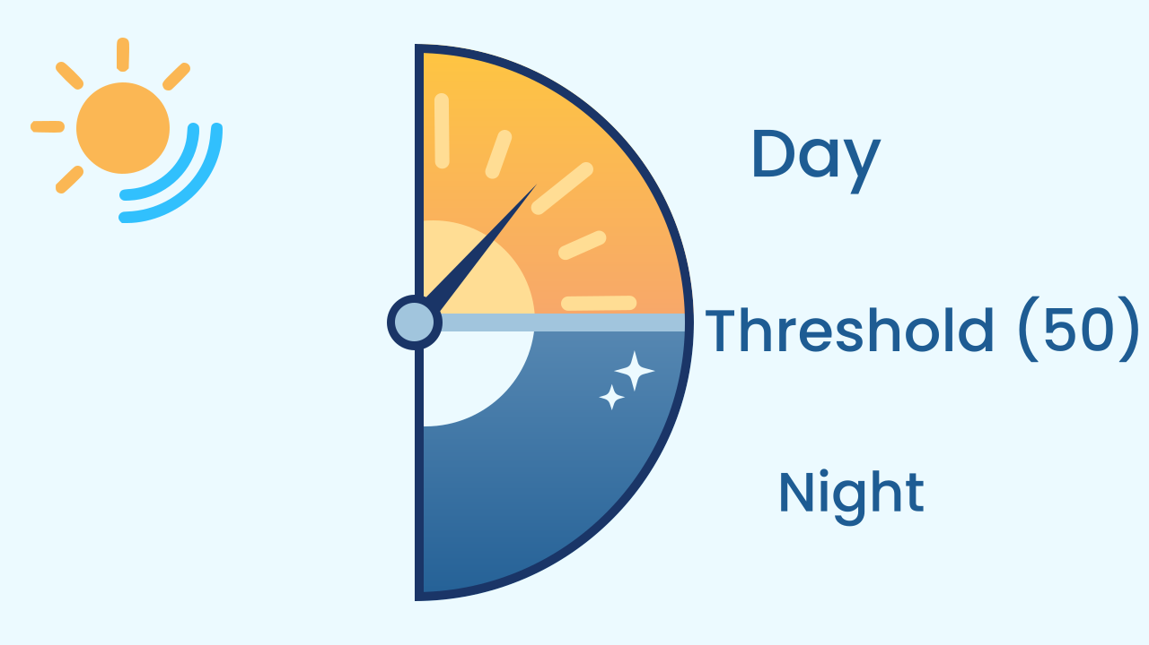
Light Sensors and Thresholds
Your phone has an ambient light sensor that measures how bright your surroundings are and turns it into a number. But how does a program decide whether it is "daytime" or "nighttime"?
That is what a threshold is for: it is simply a "cut-off point." In our project, the threshold will be the number `50`. If the sensor reads a value above 50, our program will consider it "daytime." If it reads a value below it, it will consider it "nighttime."

Slide 6
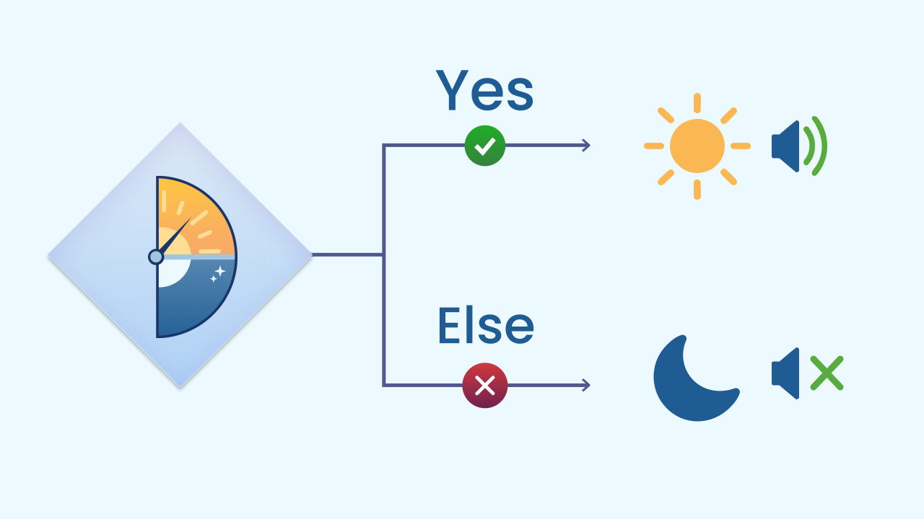
The Sunflower's Logic
Now we can put our ideas together to build the alarm clock:
Condition: Is the light sensor's value greater than 50?
IF TRUE (there is light): Time to wake up! Run the code on the "if" path: play the melody and draw a sun.
ELSE (FALSE, it is dark): Back to sleep! Run the code on the "else" path: stop the music and turn off the screen.

Slide 7
Create
Let's build the sunflower alarm clock!
We will need 3 components on our phone: LightIntensity to 'see' the sunrise, AudioPlayer for the alarm melody, and LEDDraw to show a sun.
Remember to scan all the QR codes on the same device.

Slide 8

Code Composition
Inside the `main loop`, the `if... else...` block takes full control. On every cycle it evaluates the condition `light intensity > 50`. If it is true, the first group of blocks runs (the alarm goes off). If it is false, it skips the first group and runs the second one (the alarm switches off). The program is always choosing one of these two paths, without hesitating.
https://app.protobject.com/generate?eq-despertador-por-la-manana&en&dynamic&-1

Slide 9
Reflect
What is the fundamental difference between an "if" conditional and an "if... else..."? When would you use each one?
What is a "threshold," and why is it so important for programs that make decisions based on sensors?
Our alarm clock is triggered by light. How would you change the condition so that the sun lights up *in the dark*? And what else would you have to change to make it a true night light, and not a nighttime alarm?

