Slide 1

English
This presentation is automatically generated.
You can freely edit it and add any extra content you wish.
Español
Esta presentación se genera automáticamente.
Puedes modificarla a tu criterio y añadir cualquier contenido adicional que desees.
Italiano
Questa presentazione è generata automaticamente.
Puoi modificarla liberamente e aggiungere eventuali contenuti extra che desideri.

Slide 2

Alarm: The Cookie Thief!
Teach your program to 'think'. Learn how to use 'If...' conditionals so your prototype can make decisions and set off an alarm to guard your secret cookie box.

Slide 3
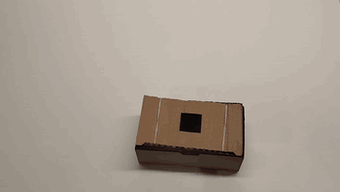
What will we do?

Slide 4
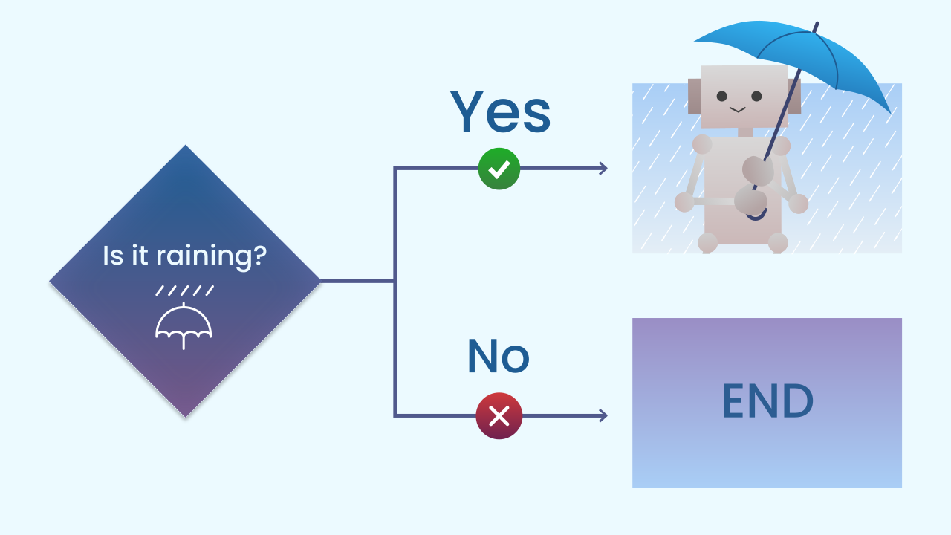
Making Decisions: The 'If...' Block
Programs don't only follow lists of orders, they can also make decisions. The main tool for this is the "If..." conditional. It works just like it does in real life: IF it's raining, THEN I grab an umbrella.
The program checks a condition. If the condition is true, it runs the code inside. If it's false, it simply skips that code and carries on.

Slide 5
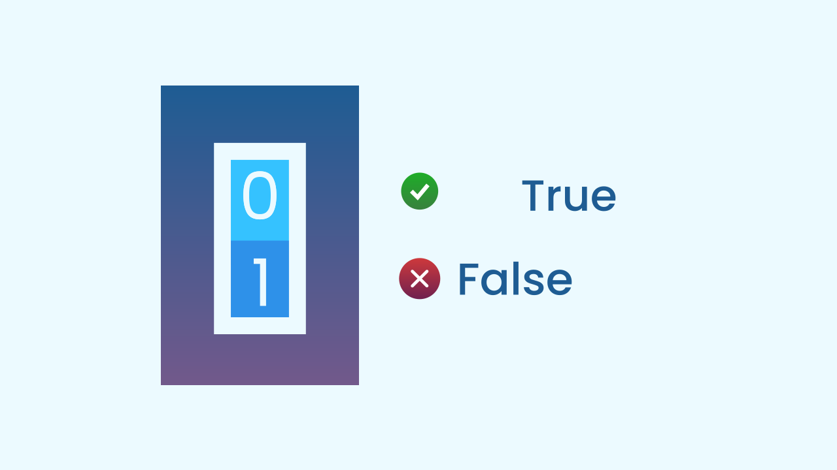
Conditions: True or False Questions
A condition is a question the program asks itself, and the answer can only be TRUE or FALSE. There is nothing in between. For example:
- Is 5 greater than 3? -> TRUE
- Is 10 equal to 2? -> FALSE
- Is the tilt sensor's value greater than 20? -> It can be TRUE or FALSE.
This kind of two-option logic is called boolean logic, and it is the foundation of every decision a computer makes.

Slide 6
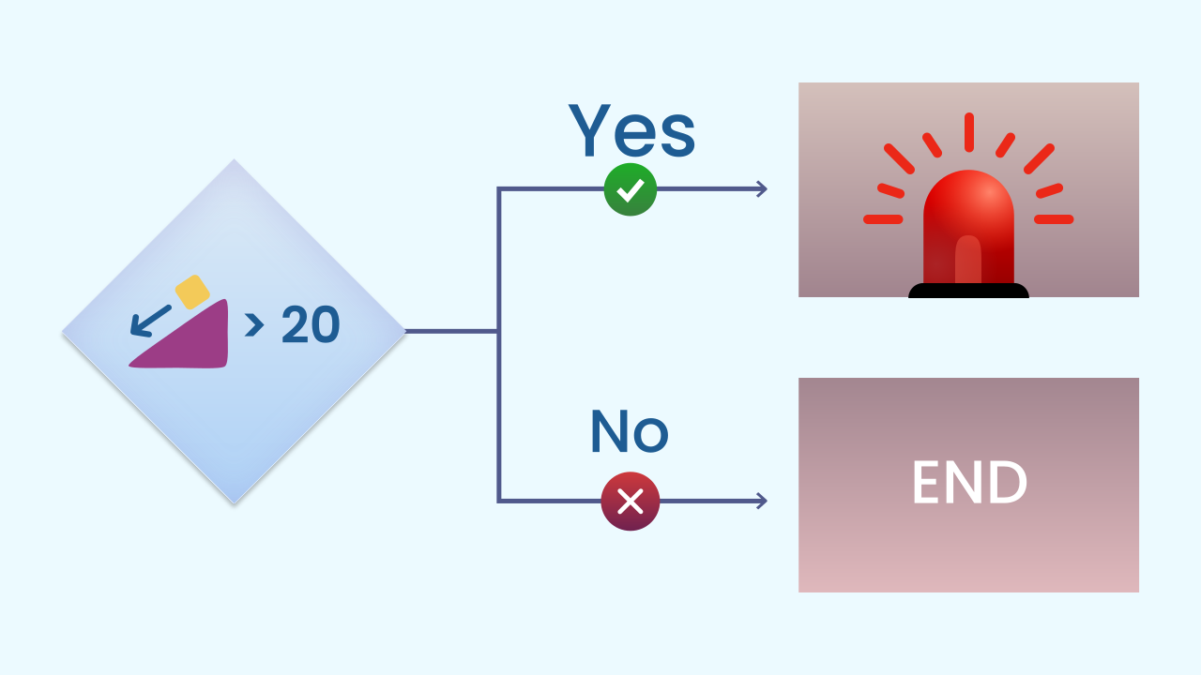
The Logic of Our Alarm
For our anti-thief alarm, the logic is very clear:
The Condition (the question): Is the lid of the box (the device) tilted more than 20 degrees?
If the answer is TRUE: Alert! Someone is opening the box. THEN, trigger the alarm sequence with lights and sound.
If the answer is FALSE: Everything is fine. Do nothing and keep watching.

Slide 7
Create
Protect the cookies!
We will need 3 components on our smartphone: Inclination to detect the lid being opened, LEDDraw for the alarm light, and AudioPlayer for the siren.
Remember to scan all the QR codes on the same device.

Slide 8

Code Composition
The `main loop` runs non-stop, acting like a night watchman. Inside it, the `if` block asks the key question on every cycle: `is the inclination on X greater than 20?`. Most of the time the answer is 'no', and the code inside the `if` is skipped completely. But the moment you tilt the box, the condition becomes 'true', and only then does the alarm sequence inside it run.
https://app.protobject.com/generate?eq-alarma-caja-galletas&en&dynamic&-1

Slide 9
Reflect
You have just programmed your very first decision. What is a conditional, and what is it for?
What is the "condition", the "true or false question", that your program is checking over and over?
The alarm's threshold is set to 20. What would happen if you changed it to 90? Would the alarm be more sensitive or less sensitive?

