Slide 1

English
This presentation is automatically generated.
You can freely edit it and add any extra content you wish.
Español
Esta presentación se genera automáticamente.
Puedes modificarla a tu criterio y añadir cualquier contenido adicional que desees.
Italiano
Questa presentazione è generata automaticamente.
Puoi modificarla liberamente e aggiungere eventuali contenuti extra che desideri.

Slide 2

Build a Fall Detector
Learn how to measure total acceleration with your phone's motion sensor to create a system that can detect a sudden fall.

Slide 3
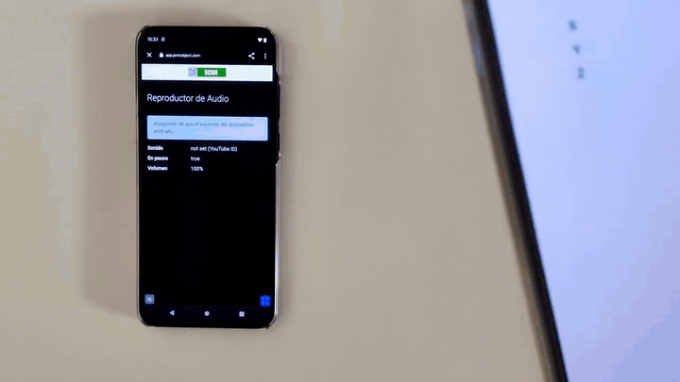
What will we do?

Slide 4
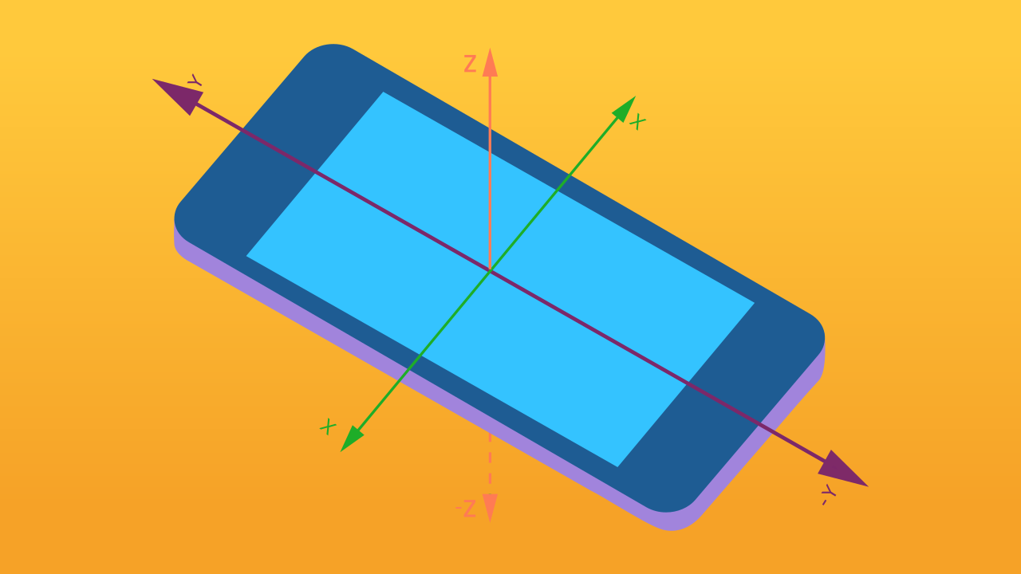
How does the phone detect a fall?
Your phone's accelerometer is a powerful motion sensor. It constantly measures acceleration in three directions or "axes": left-right (X-axis), forward-backward (Y-axis), and up-down (Z-axis).
When a phone is dropped, it experiences a sharp, sudden change in acceleration. To detect a fall, we don't care about the *direction* of the fall, only that it was a powerful jolt. To measure this total jolt, we can take the absolute value (the positive version of the number) of the motion on each axis and add them together. This gives us a single number representing the total magnitude of the motion.

Slide 5

Let's get to work!
Protobject simplifies this process for us with the `generalMotion` variable. This special variable automatically does the math for us: it sums the absolute values of the X, Y, and Z axes in real-time.
All we need to do is set a threshold. We'll tell our program: IF the `generalMotion` value exceeds a certain number (like 150), it means a sharp jolt has occurred, and we should trigger an alarm sound.

Slide 6
Make the Fall Detector
Let’s create a prototype to detect falls.
Press Add device and select Motion.
Click on Add device again and select AudioPlayer.

Slide 7
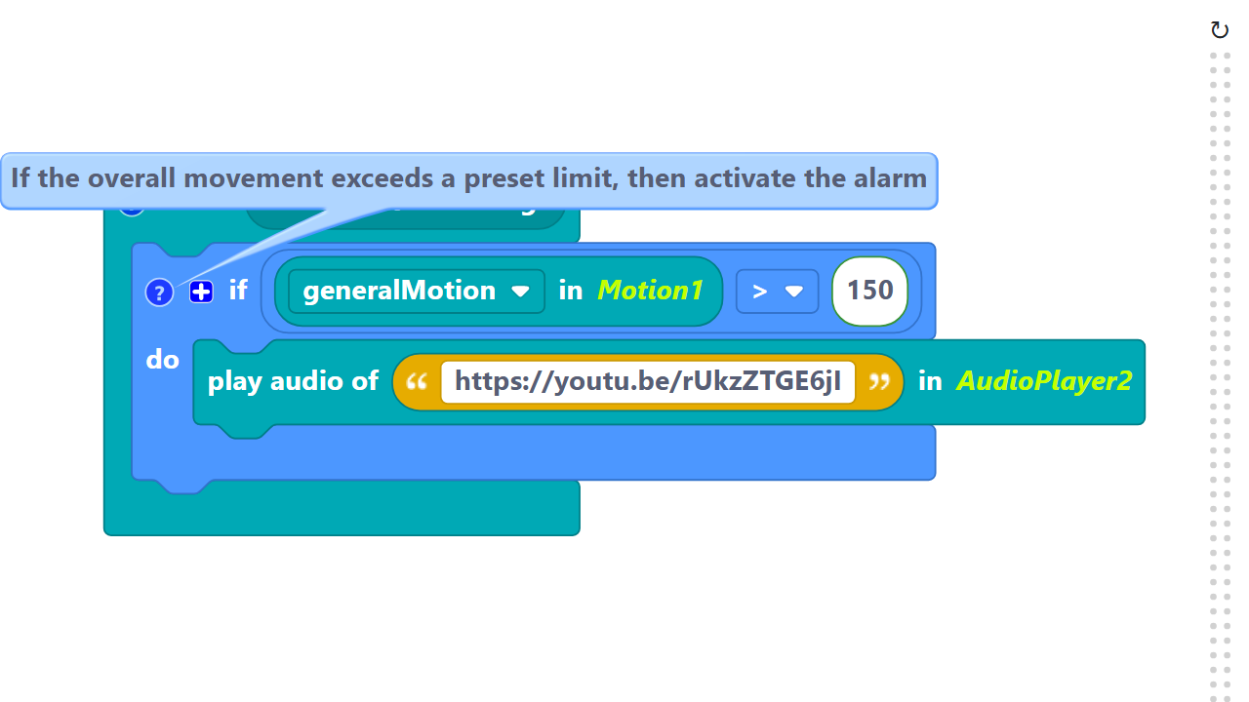
Code Composition
Click on the question mark icon to open the comments that explain the code.
Note: This code uses the `generalMotion` variable. As an extra challenge, try modifying the code to do the math manually by adding the absolute values of the X, Y, and Z axes yourself!
https://app.protobject.com/generate?en-a16-falldetector&en&dynamic&-1

Slide 8
Reflect
★ How reliable do you think this fall detector is? Could a false alarm be triggered just by running, jumping, or putting the phone down too hard?
★ Would you trust this to be used in a real-life situation for an elderly person? What improvements would you need to make first?

