Slide 1

English
This presentation is automatically generated.
You can freely edit it and add any extra content you wish.
Español
Esta presentación se genera automáticamente.
Puedes modificarla a tu criterio y añadir cualquier contenido adicional que desees.
Italiano
Questa presentazione è generata automaticamente.
Puoi modificarla liberamente e aggiungere eventuali contenuti extra che desideri.

Slide 2

The Spirit Level: Is It Straight?
Use your phone's tilt sensor and advanced conditionals ('Else If') to build a tool that tells you if something is perfectly level.

Slide 3
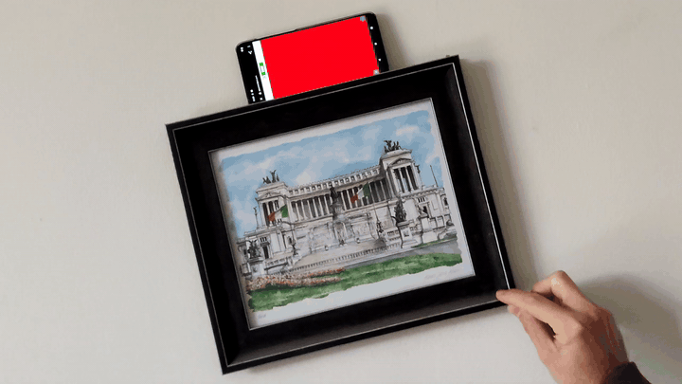
What will we do?

Slide 4
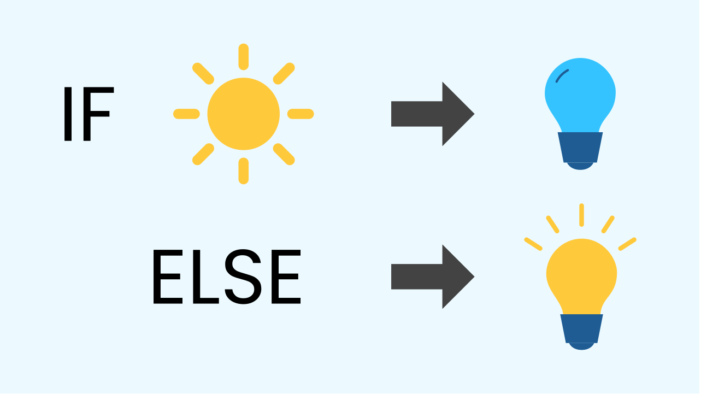
More Than Two Options?
You've seen how conditionals can work with two options: IF a condition is true, do something, ELSE do something different. This is perfect for a simple on/off switch.
But what if you need to check for multiple, different conditions?

Slide 5
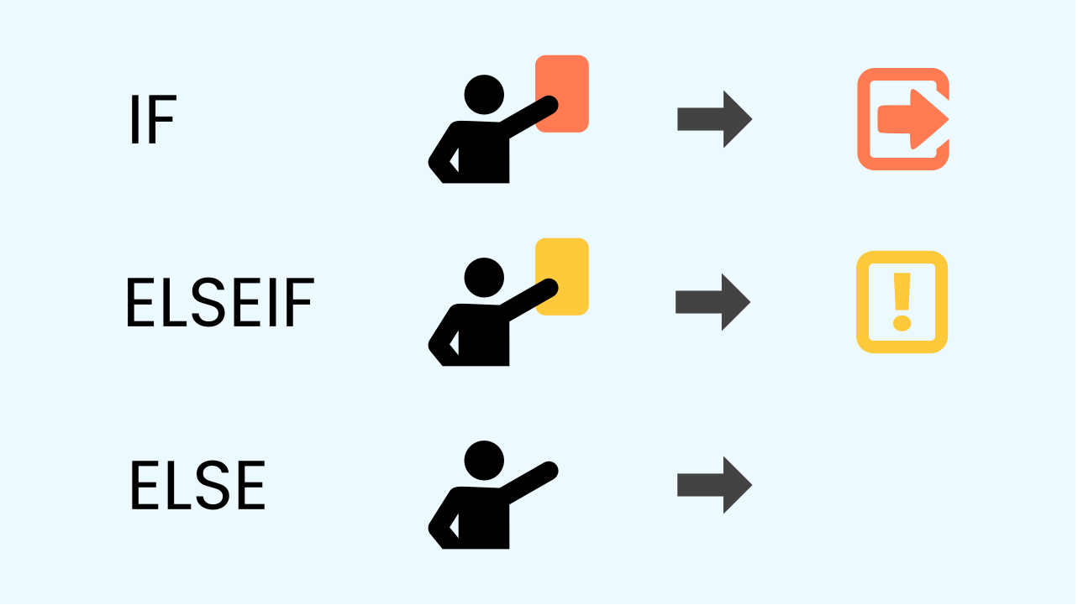
Introducing 'Else If'
The “else if” structure lets you chain multiple checks together in a single, neat block. You can think of it like a referee in a soccer match:
★ IF the foul is very serious, THEN show a red card.
★ ELSE IF the foul is just a warning, THEN show a yellow card.
★ ELSE (if neither of the above is true), THEN it’s just a simple foul.
The program checks each condition in order until it finds one that is true.

Slide 6

ELSE IF: 4 Options for our Spirit Level
We'll use this multi-path logic to program a tilt detector that helps us hang pictures perfectly straight.
The screen will light up with different colors based on the tilt value: green for level, yellow for slightly off, orange for more tilted, and red for very tilted.

Slide 7
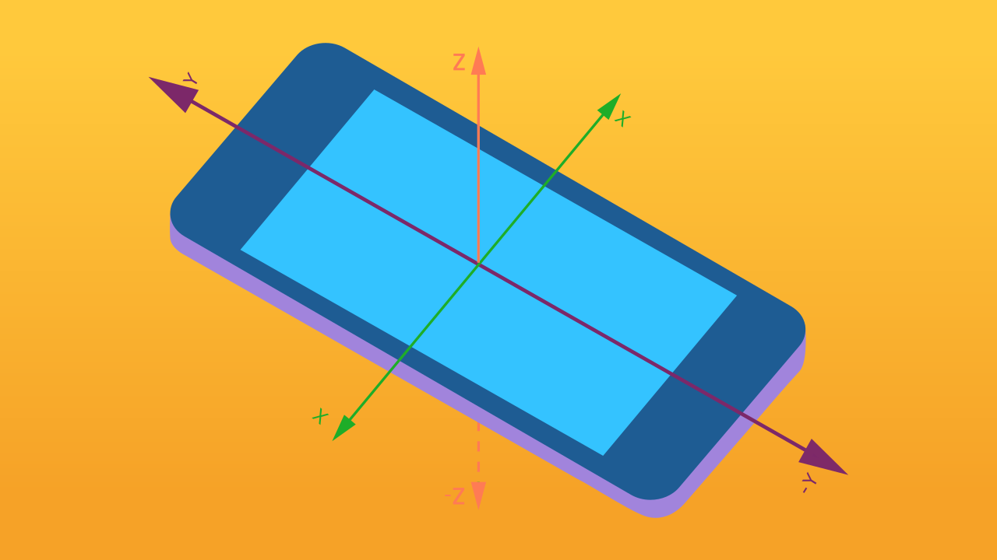
How does the phone detect tilt?
To detect the tilt of a phone, we use a tiny built-in sensor called an accelerometer. This sensor can measure forces like gravity, telling the phone its orientation in space. It measures tilt on three different axes: X (left-right), Y (forward-backward), and Z (up-down). This allows the phone to know if it’s tilted to one side, standing upright, or lying flat.

Slide 8
Make the Tilt Sensor
Let’s create a prototype that helps us detect if a picture frame is tilted.
Click on Add device and select Inclination.
Click on Add device again and select Lamp.
Add both devices to the same smartphone for this project.

Slide 9
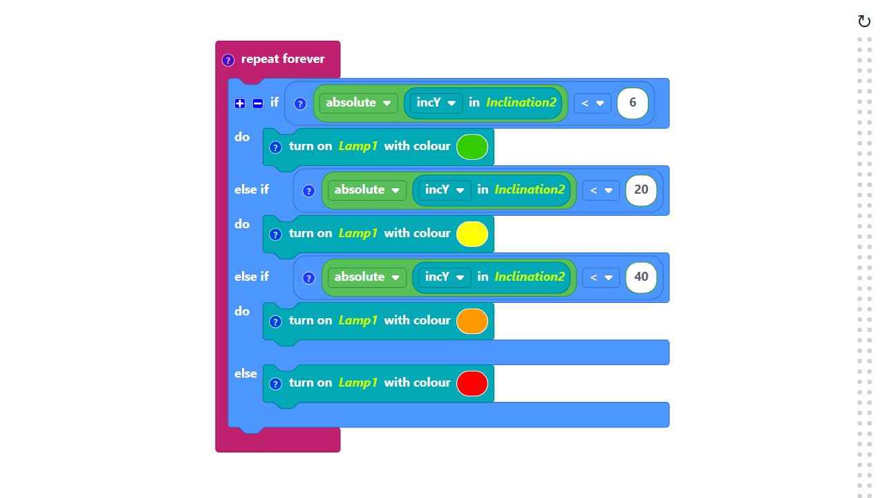
Code Composition
Click on the question mark icon to open the comments that explain the code.
The "absolute" block (which makes a number positive) is located in the Mathematics category, inside the "square root" block's dropdown menu.
https://app.protobject.com/generate?en-a15-inclination&en&dynamic&-1

Slide 10
Reflect
This 'IF / ELSE IF / ELSE' chain is a super powerful tool.
★ Our spirit level used the Y-axis (forward-backward tilt). What do you think would happen if you changed the code to read the X-axis (left-right tilt) instead?
★ What other real-world tool or game could you build using your phone's tilt sensor?

