Slide 1

English
This presentation is automatically generated.
You can freely edit it and add any extra content you wish.
Español
Esta presentación se genera automáticamente.
Puedes modificarla a tu criterio y añadir cualquier contenido adicional que desees.
Italiano
Questa presentazione è generata automaticamente.
Puoi modificarla liberamente e aggiungere eventuali contenuti extra che desideri.

Slide 2
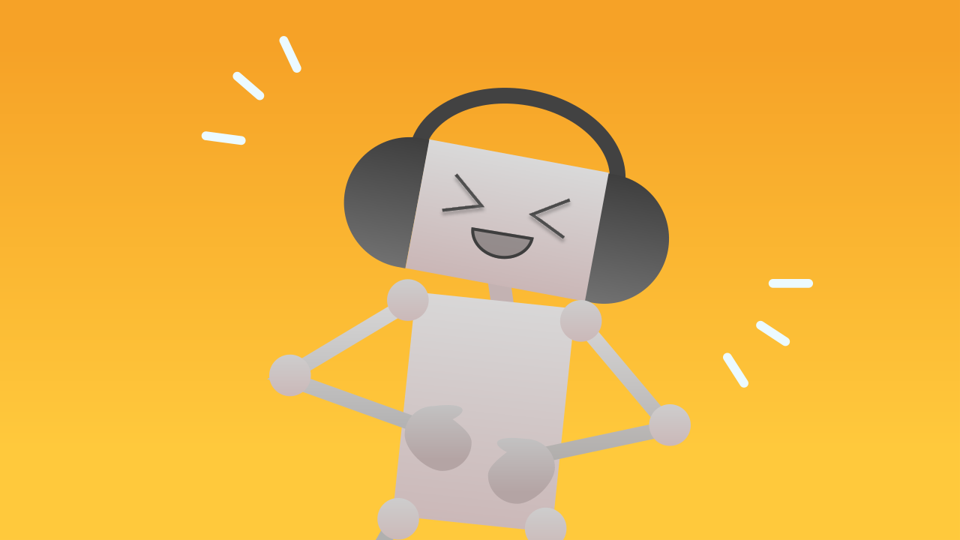
The Ticklish Robot
Bring your first character to life. Learn to use 'events' so your robot reacts instantly with a laugh and an animation when you 'tickle' it with a clap.

Slide 3
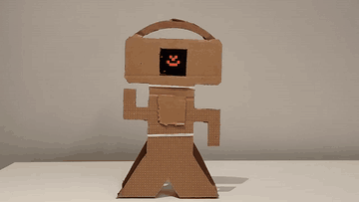
What will we do?

Slide 4
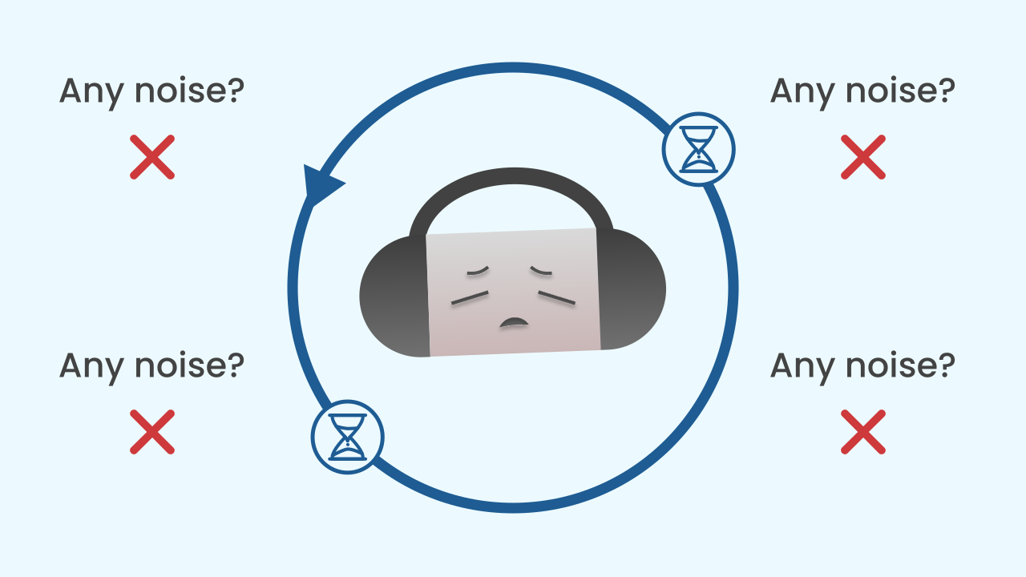
The Problem with Asking Over and Over
Until now, we have used a `repeat forever` loop to read our sensors. This method works, but it is like a kid on a car trip asking "are we there yet? are we there yet? are we there yet?" every single second. The program is constantly working and burning energy just to ask the sensor whether anything has changed, even when nothing at all is happening.

Slide 5
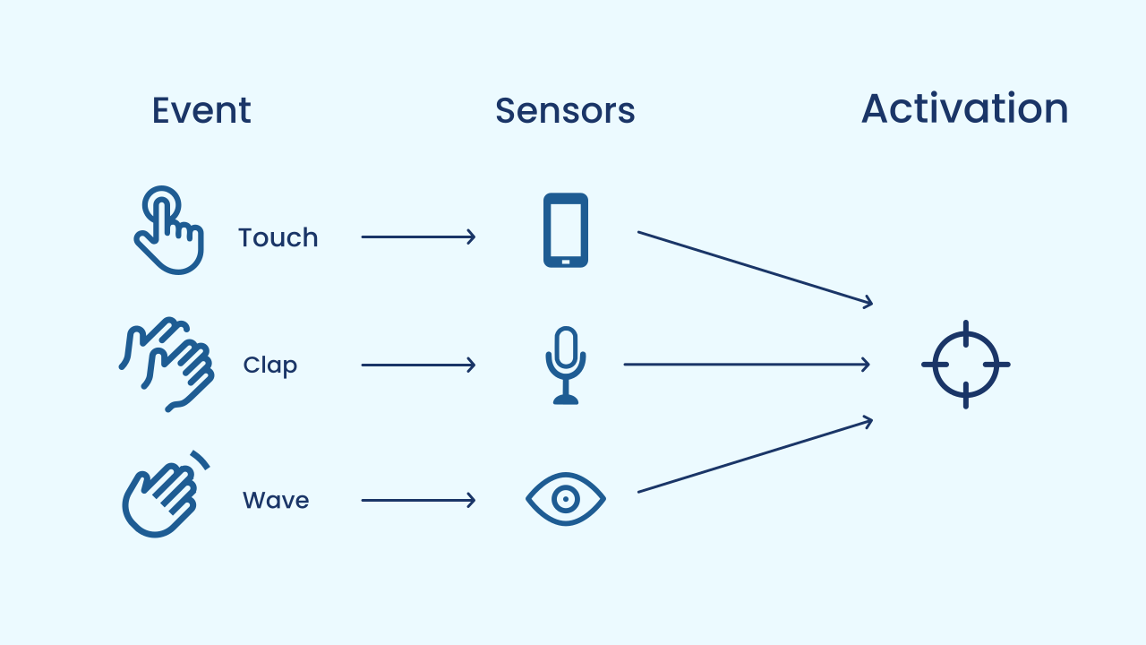
A Smarter Way: Events!
Event-driven programming is far more efficient. Instead of the program asking non-stop, it simply subscribes to a sensor and tells it: "Let me know if something interesting happens". The program can then "sleep", or wait quietly.
When the sensor detects something important (like a clap), it sends a notification, an event, that wakes the program up and says: "Hey, it's time to act!".

Slide 6
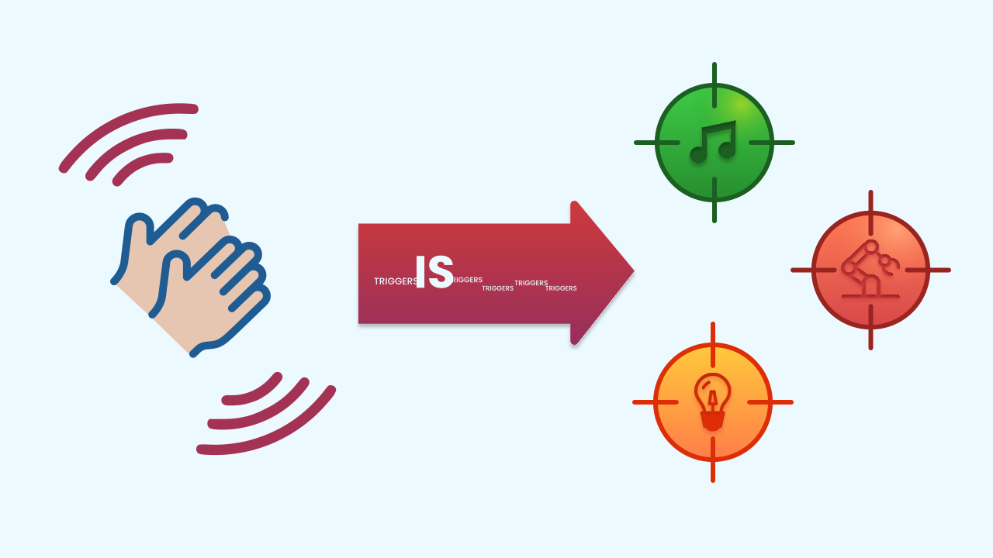
The Event as a Trigger
In our robot, the clap is the event, and this event acts as a trigger. It does not change the robot's behavior forever; it simply "fires off" a sequence of actions we had already prepared: the laughing animation. Once the sequence ends, the robot goes back to waiting quietly, ready for the next "shot".

Slide 7
Create
Let's build our ticklish robot.
Press Add device and select NoiseLevel to detect the claps.
Add the LEDDraw component to show the robot's face.
Finally, add AudioPlayer for the laugh.
Remember that you can scan all the QR codes on the same smartphone.

Slide 8

Code Composition
Take a close look: there is no `repeat forever` loop for the main logic! The `when the program starts` block sets up the robot's static face. All the magic happens in the event block `when Noise Level sudden increase`. When you clap, this block fires, plays the sound, and runs a `repeat 8 times` loop to animate the mouth. Then a `stop sound` block cuts off the laugh if it was still playing, and one final `draw` puts the resting face back — the same one as in `when the program starts`. That is why the robot is ready for the next clap.
https://app.protobject.com/generate?eq-robot-risa-simpatica-al-ruido&en&dynamic&-1

Slide 9
Reflect
This program feels "reactive": it responds instantly. What is the main difference between using an event and using an infinite loop to check a sensor?
The event is the "trigger". What is the "sequence of actions" that gets triggered in this project?
If you wanted the robot's laugh to last longer, which number in the code would you change?

