Slide 1

English
This presentation is automatically generated.
You can freely edit it and add any extra content you wish.
Español
Esta presentación se genera automáticamente.
Puedes modificarla a tu criterio y añadir cualquier contenido adicional que desees.
Italiano
Questa presentazione è generata automaticamente.
Puoi modificarla liberamente e aggiungere eventuali contenuti extra che desideri.

Slide 2
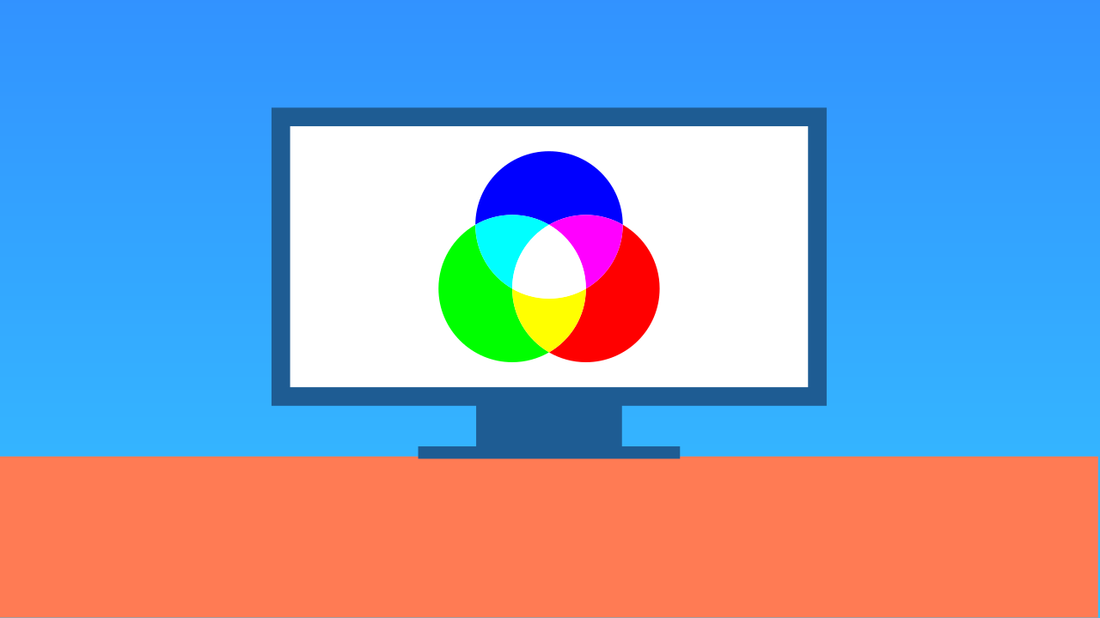
Mixing RGB Colors
Become a digital artist! Use three knobs to control the Red, Green, and Blue channels and mix any color you can imagine.

Slide 3
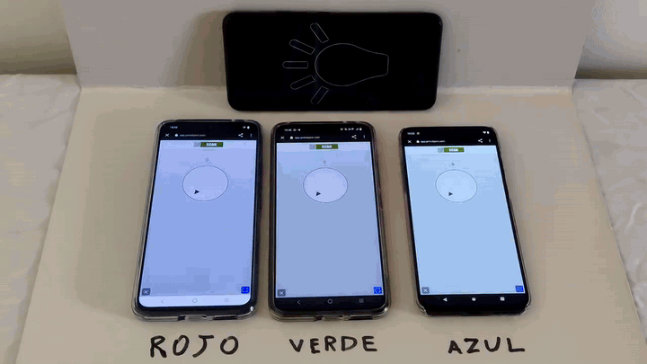
What will we do?

Slide 4
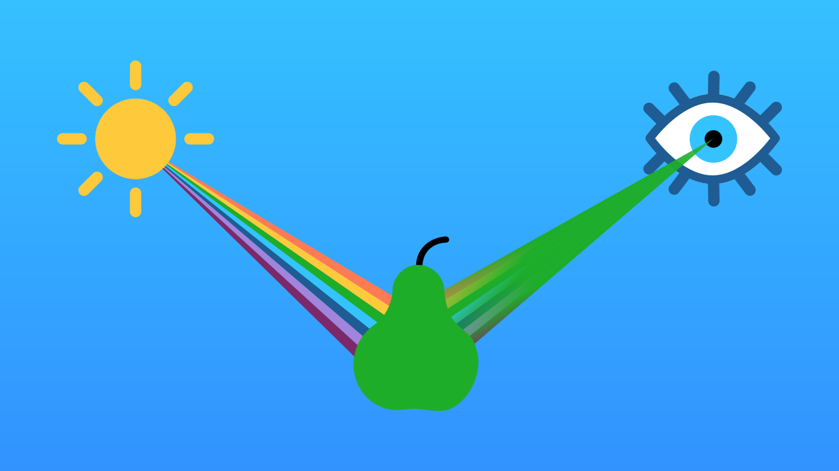
How do we see colors?
When light hits an object, like an apple, the object's surface absorbs most of the light but reflects some of it. Our eyes see this reflected light.
If we see a red apple, it means its skin is absorbing all colors *except* for red. The red light bounces off, reaches our eyes, and our brain says, "That's red!"

Slide 5
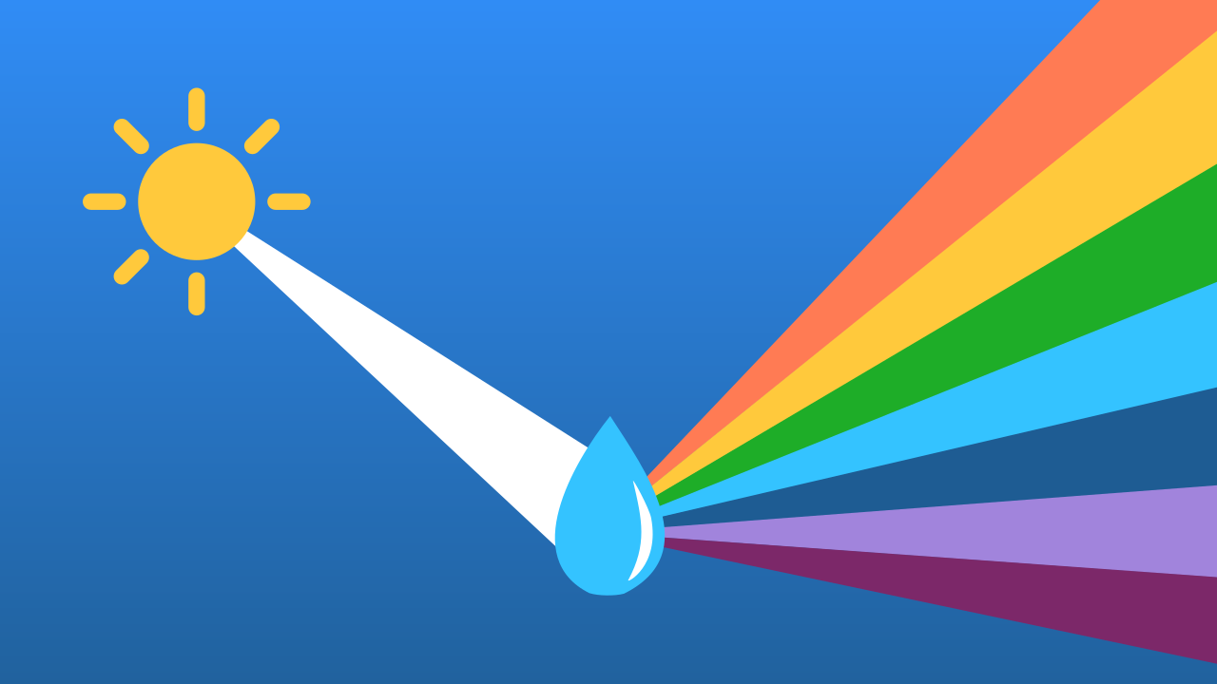
How do we mix colors?
To create colors with light, we have to mix different rays of light. If we mix all the colors of light together, we get pure white light. The total absence of light is black.
You can see this in nature! After it rains, tiny water droplets in the air can act like prisms and separate white sunlight into all its component colors, creating a rainbow!

Slide 6
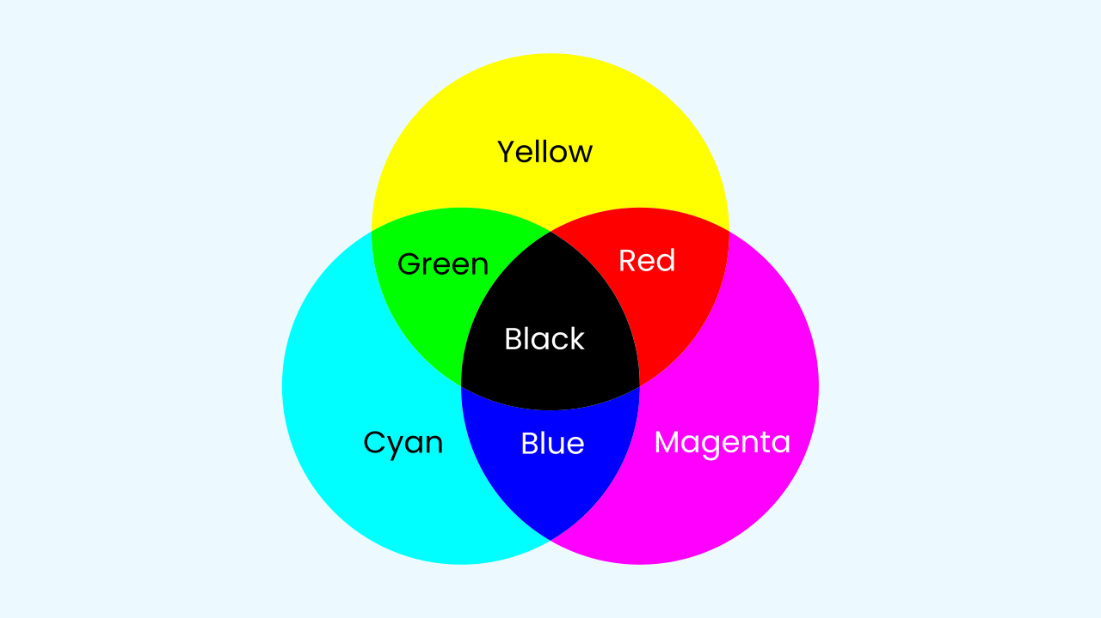
Subtractive Synthesis (Paint & Ink)
In this model, the color of an object depends on the light it reflects. The primary colors are Cyan, Magenta, and Yellow. Because this model works by *subtracting* (absorbing) light, mixing all three colors results in Black. This model is used for things that don't emit their own light, like photo printing, dyes, and paints.

Slide 7
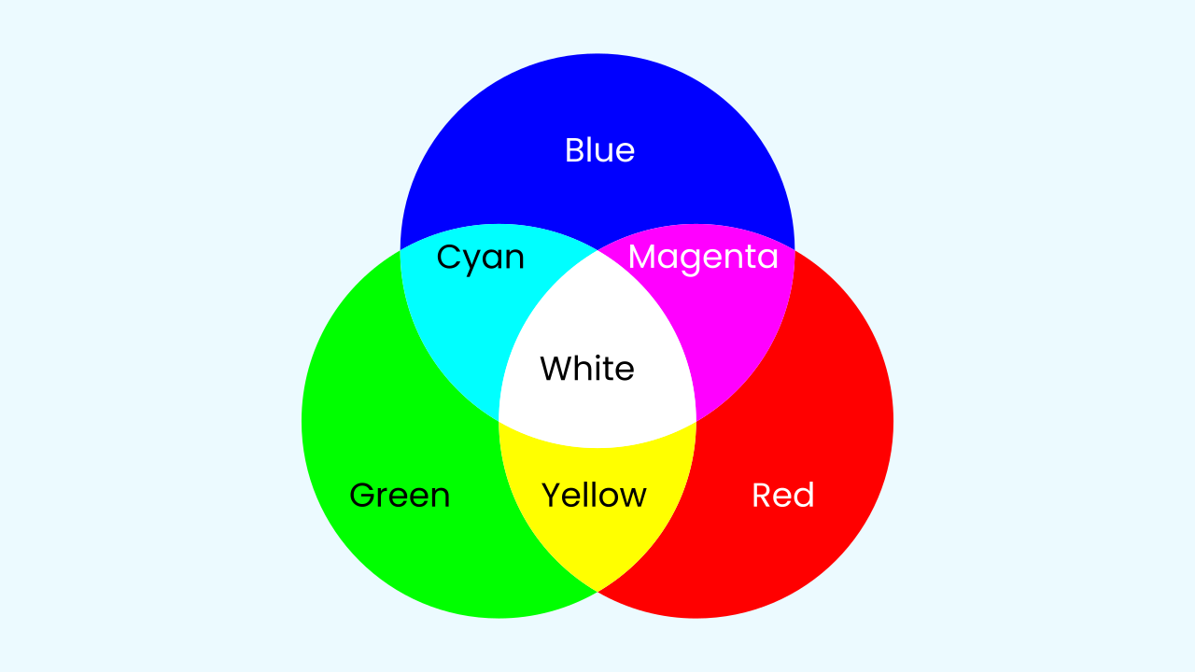
Additive Synthesis (Screens & Light)
In this model, color is created by adding different lights together. The primary colors are Red, Green, and Blue (RGB).
- Red + Green = Yellow
- Green + Blue = Cyan
- Red + Blue = Magenta
Since we are mixing pure light, combining all three at full intensity results in White Light. This model is used for all screens, like TVs, phones, and computer monitors.

Slide 8

How does a monitor use RGB?
Your screen is made of millions of tiny dots called pixels. Each pixel is actually a team of three even tinier LEDs: one Red, one Green, and one Blue.
To create a specific color for that one pixel—say, purple—the screen tells the red and blue LEDs to light up brightly, and the green one to stay dim. Multiply that process by millions of pixels, and you get a full, rich image!

Slide 9
Let's Play with Colors!
Let’s create a prototype that allows us to mix and create any color of light.
Press Add device, select Lamp, and press Open in this window.
Press Add device, select Knob, and scan the QR code with a smartphone to control the red color.
Add two more Knob components on two other smartphones to control the green and blue colors.

Slide 10
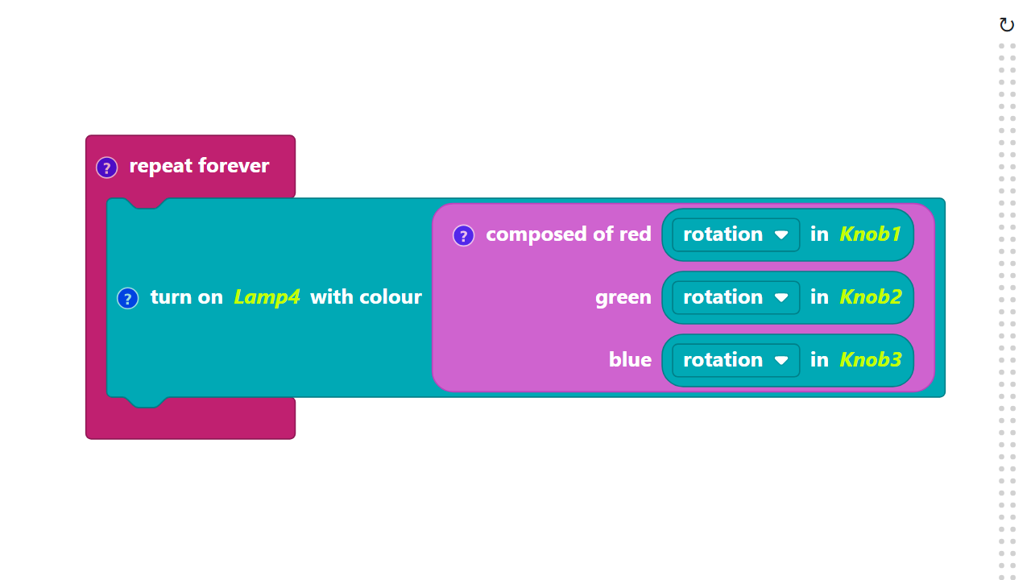
Code Composition
Click on the question mark icon to open the comments that explain the code.
https://app.protobject.com/generate?en-a14-colors&en&dynamic&-1

Slide 11
Reflect
★ What are the RGB 'recipes' for some of your favorite colors, like orange, pink, or teal? Experiment and find out!
★ When you're editing a photo on an app, are you using the Additive or Subtractive color model? What about when you're mixing paint for an art project?

