Slide 1

English
This presentation is automatically generated.
You can freely edit it and add any extra content you wish.
Español
Esta presentación se genera automáticamente.
Puedes modificarla a tu criterio y añadir cualquier contenido adicional que desees.
Italiano
Questa presentazione è generata automaticamente.
Puoi modificarla liberamente e aggiungere eventuali contenuti extra che desideri.

Slide 2

Control Light Intensity
Explore the world of color and light by using a knob to gradually change a lamp's brightness from black to white.

Slide 3
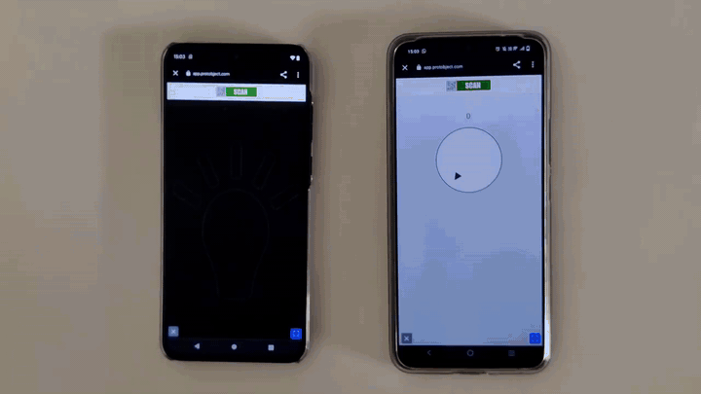
What will we do?

Slide 4
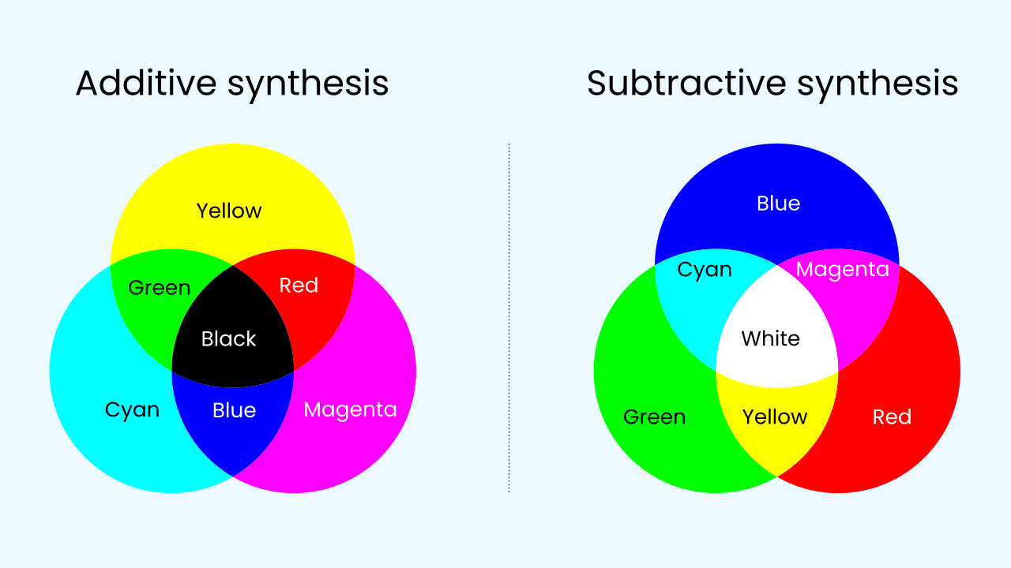
Print vs. Screen Colors
Subtractive color (like ink on paper) starts with a white surface and *subtracts* light. Mixing all the primary ink colors (Cyan, Magenta, Yellow) results in black.
Additive color (like a phone screen) starts with a black surface and *adds* light. The primary colors are Red, Green, and Blue (RGB). Mixing all three at full intensity creates pure white light. This is the model we use in Protobject!

Slide 5

Additive Color and Shades of Gray
In the additive RGB model, we can create different shades of gray by mixing equal amounts of red, green, and blue light.
★ A low intensity of all three colors results in a dark gray.
★ A high intensity of all three results in a light gray.
★ Black is the total absence of light (all colors off), while white is all three colors at their maximum intensity.

Slide 6

Using a Potentiometer to Control Intensity
To control the brightness of our light, we need an analog input. The potentiometer is the perfect tool for this! It's a component, usually controlled with a knob, that provides a smooth range of values.
We can use the value from the potentiometer to set the brightness for the red, green, and blue pixels on the screen all at once. By turning the knob, we can make the screen display any shade from black all the way to white.

Slide 7

Let's get to work!
We will use the potentiometer to modify the intensity of our lamp. As we turn the knob, our program will read its value and convert that into a brightness level for the lamp, adjusting it in real-time.

Slide 8
Make the Variable Lamp
Let’s create the prototype to control the light's intensity.
Press Add Device, select Lamp, and press Open in This Window.
Press Add Device again, select Knob, and scan the QR code with your smartphone.

Slide 9
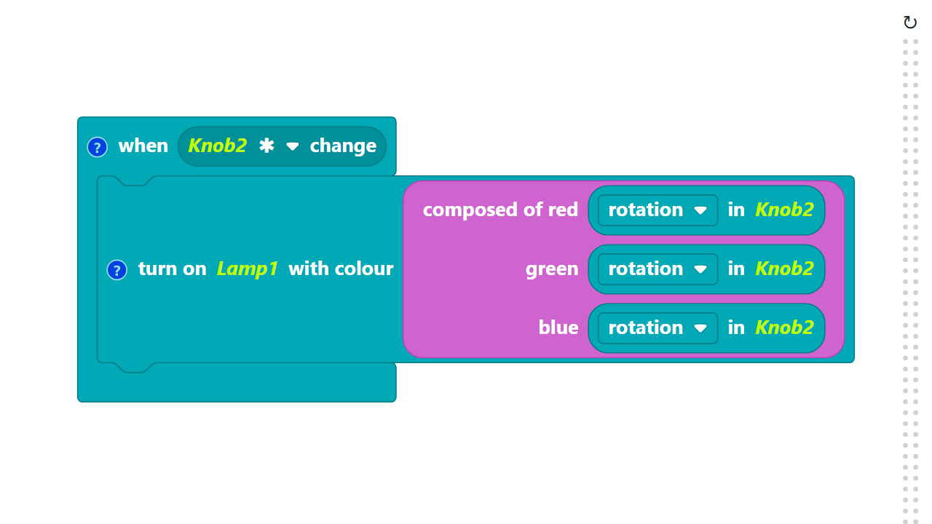
Code Composition
Click on the question mark icon to open the comments that explain the code.
The color blocks can be found in the Color category.
Remember: You can build this using an event (more efficient) or a main loop.
https://app.protobject.com/generate?en-a13.knobluz&en&dynamic&-1

Slide 10
Reflect
You did this by sending the *same* value from the knob to the Red, Green, and Blue channels.
*But what if you sent *different* values? How would you program the knob to only adjust the intensity of the red light, while green and blue stay off?*

