Slide 1
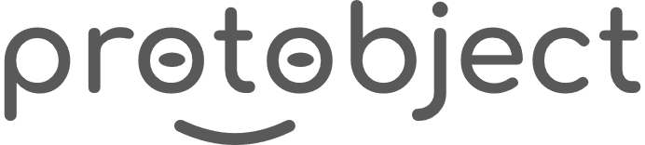
English
This presentation is automatically generated.
You can freely edit it and add any extra content you wish.
Español
Esta presentación se genera automáticamente.
Puedes modificarla a tu criterio y añadir cualquier contenido adicional que desees.
Italiano
Questa presentazione è generata automaticamente.
Puoi modificarla liberamente e aggiungere eventuali contenuti extra che desideri.

Slide 2
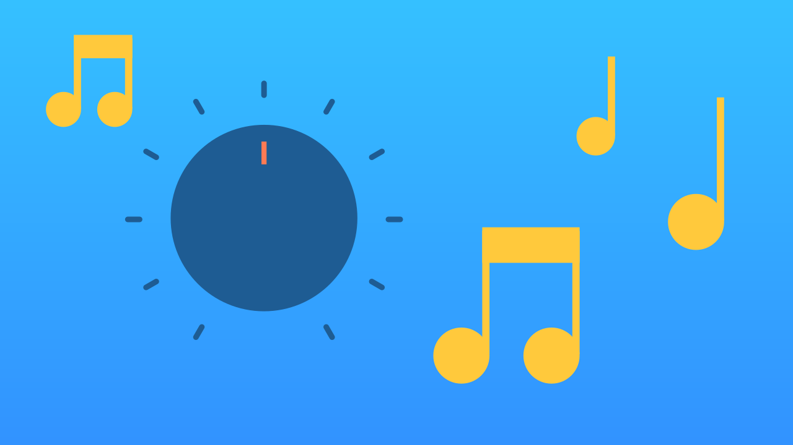
The Volume Control
Learn to read continuous input from a virtual knob (potentiometer) to control the volume of a song in real-time.

Slide 3
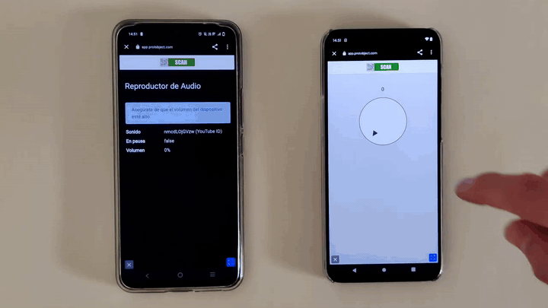
What will we do?

Slide 4
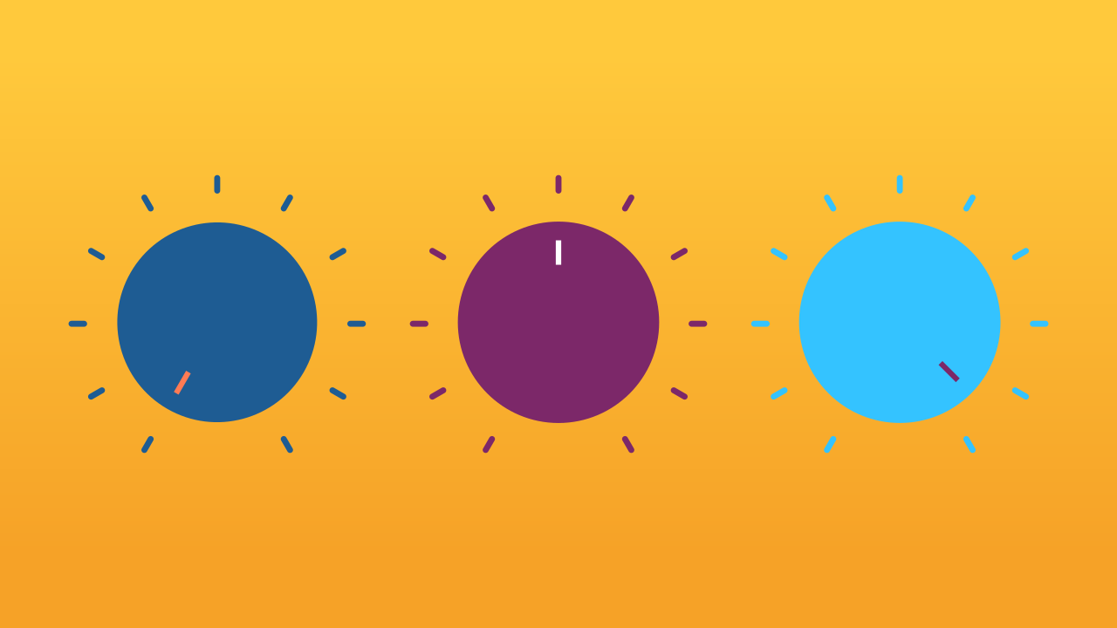
What is a potentiometer?
Have you ever adjusted the volume of a radio? Or changed the brightness of a lamp using a dimmer? If so, you’ve probably used a potentiometer.
It's the technology behind any control that isn't just on or off, but allows for a smooth range of values in between. Usually, you control it with a knob!

Slide 5

How does it work?
A potentiometer works by changing its electrical resistance as you turn it. Think of it like a faucet for electricity. By turning the knob, you can gradually change how much electrical current flows through it.
In the case of a speaker, adjusting the current allows you to smoothly increase or decrease the volume.

Slide 6
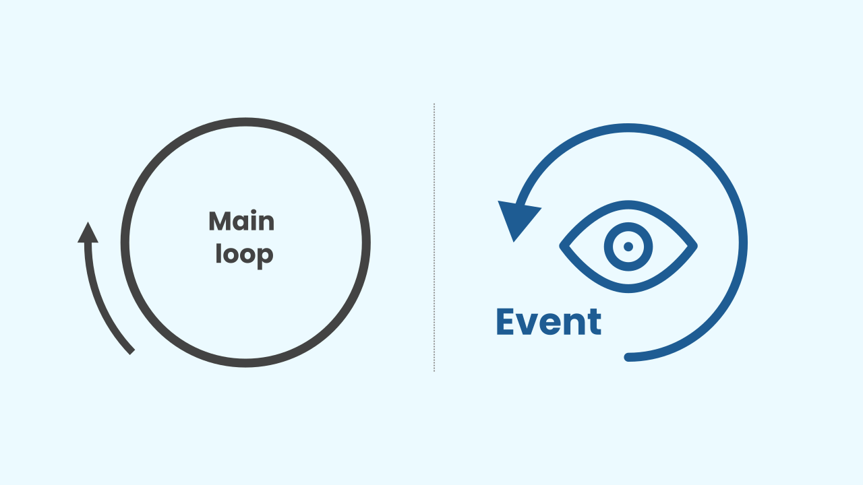
How do we program it?
To make our volume knob work, our program needs to know its current position. We have two great ways to do this:
★ The Main Loop: We can put our code inside a "repeat forever" loop. The program will constantly check the knob's value and update the volume, over and over.
★ Events: A more efficient way! We can use an event that triggers *only when the knob is turned*. The program waits quietly until it gets a signal, then updates the volume.
In programming, there are often different solutions to the same problem!

Slide 7
Let's get to work!
We are going to create a prototype that lets us control a song's volume with a potentiometer.
Press Add Device and select Knob.
Press Add Device again and select AudioPlayer.
Remember that if you don’t have a smartphone to scan the QR codes, you can press Open in this window.

Slide 8
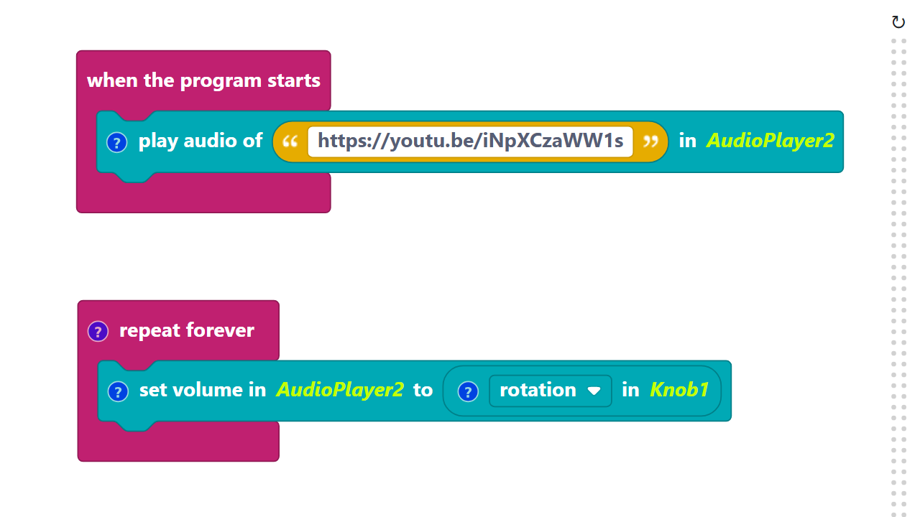
Code Composition
Click on the question mark icon to open the comments that explain the code.
Remember: You can build this using a main loop or, for a more efficient approach, use the event that triggers when the knob is turned.
https://app.protobject.com/generate?en-a12-knobvolume&en&dynamic&-1

Slide 9
Reflect
Simple ON/OFF is fine, but gradual control opens up a whole new world of possibilities.
*What other things in a game or an app would you want to control smoothly with a knob or slider? (Think character speed, screen brightness, or the brush size in a drawing app).*

