Slide 1

English
This presentation is automatically generated.
You can freely edit it and add any extra content you wish.
Español
Esta presentación se genera automáticamente.
Puedes modificarla a tu criterio y añadir cualquier contenido adicional que desees.
Italiano
Questa presentazione è generata automaticamente.
Puoi modificarla liberamente e aggiungere eventuali contenuti extra che desideri.

Slide 2
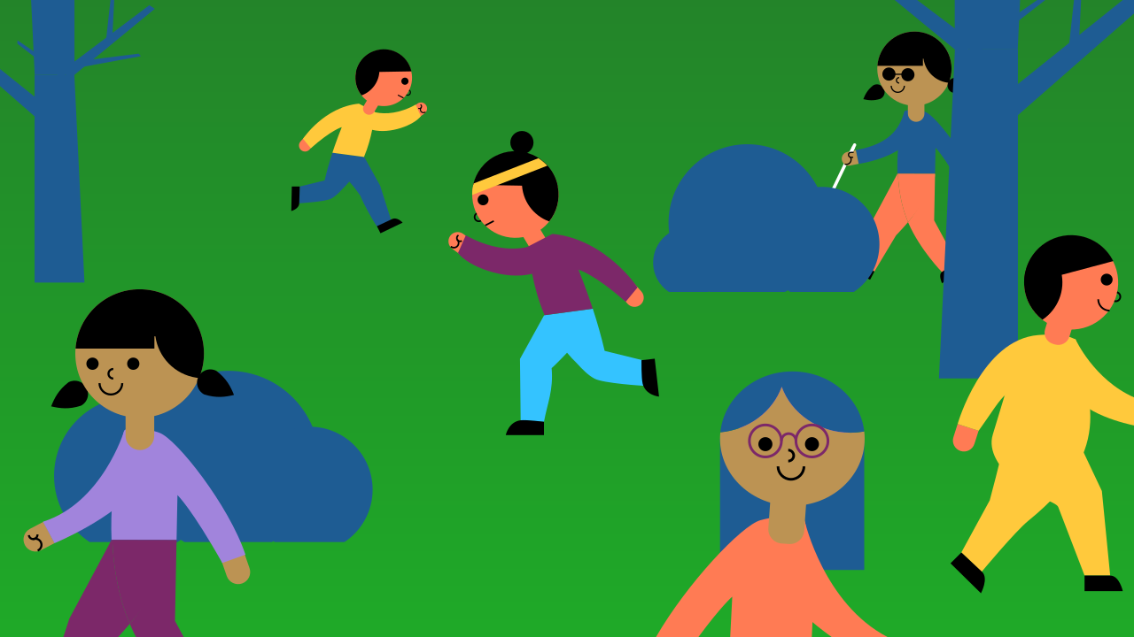
Create a People Counter
Use events and variables to build a practical tool for counting people, just like at a real concert or store.

Slide 3
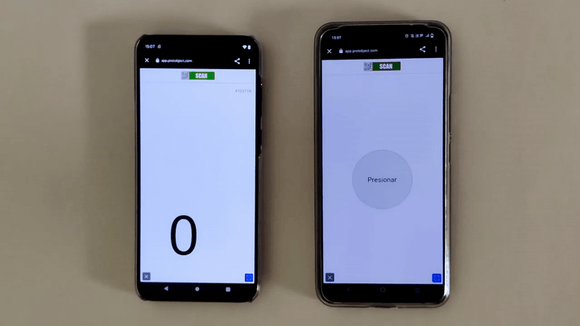
What will we do?

Slide 4
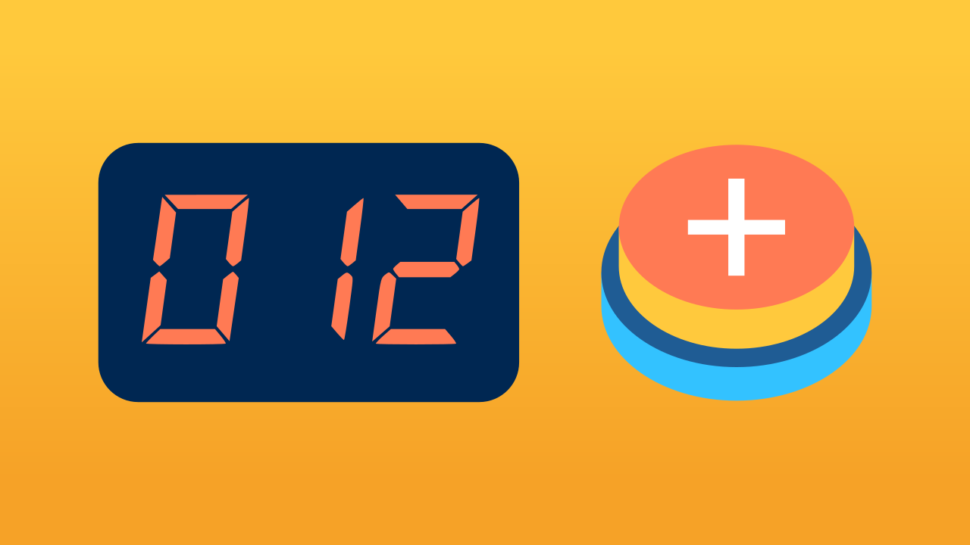
What is a counting device?
A counting device, or "clicker," is a simple tool used to keep track of a quantity. It could be used to count products in a warehouse, laps in a race, or in our case, people entering a venue.
Each time someone enters, you press a button, and the counter on the display increases by one. It's a simple and effective way to keep an accurate count.

Slide 5
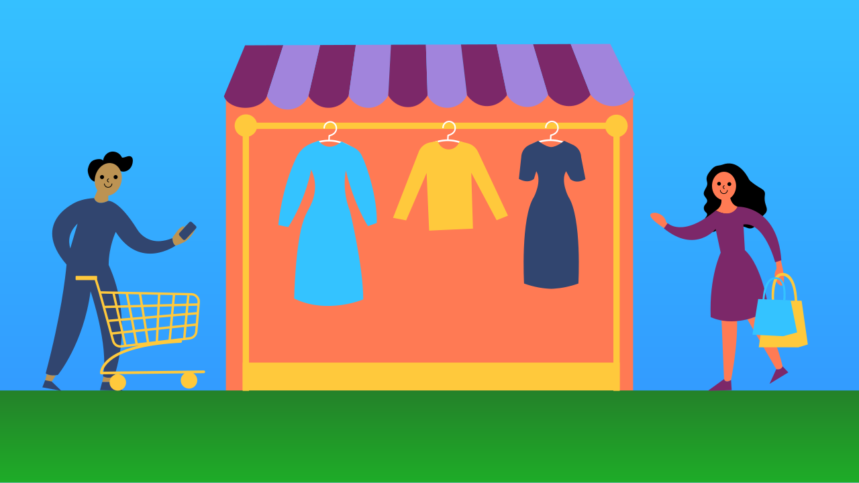

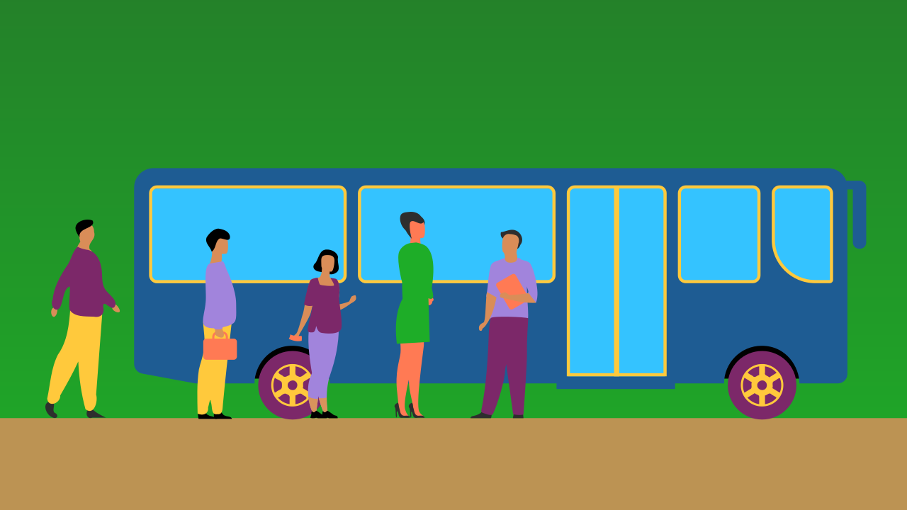
What is the purpose of a people counter?
People counters are surprisingly useful in many situations. Stores use them to track customer flow, event organizers use them to control venue capacity for safety, and public transport can use the data to improve service. It's a simple tool that helps make systems safer and more efficient.

Slide 6
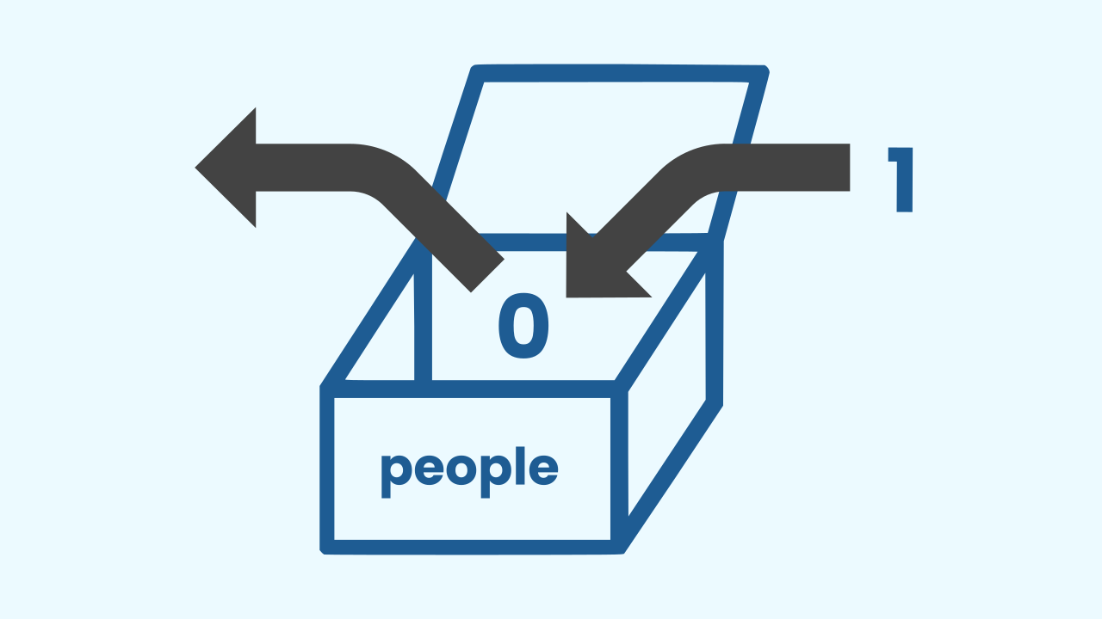
We use a variable to keep track
Remember variables? They're like labeled boxes for storing information. For our people counter, a variable is the perfect tool to act as our digital scoreboard. We will create a variable to store the current count, and we can update the value inside it whenever a new person enters.

Slide 7

And how do we know when to count?
How do we know *when* to update our variable? We use an event!
Instead of constantly asking "Is the button pressed?", the program just listens. When you press the button, it sends a signal—an event—to our code. That event is the trigger that tells our program: 'Okay, time to add 1 to the counter variable!' It's an efficient and smart way to program.

Slide 8
Let's build the counter
We are going to create a prototype that allows us to count people entering a place.
Press Add device and select WriteDraw, the device where we will display the number.
Press Add device again and select TouchButton to create the button.
Remember that if you don’t have a smartphone, you can press Open in this window.

Slide 9
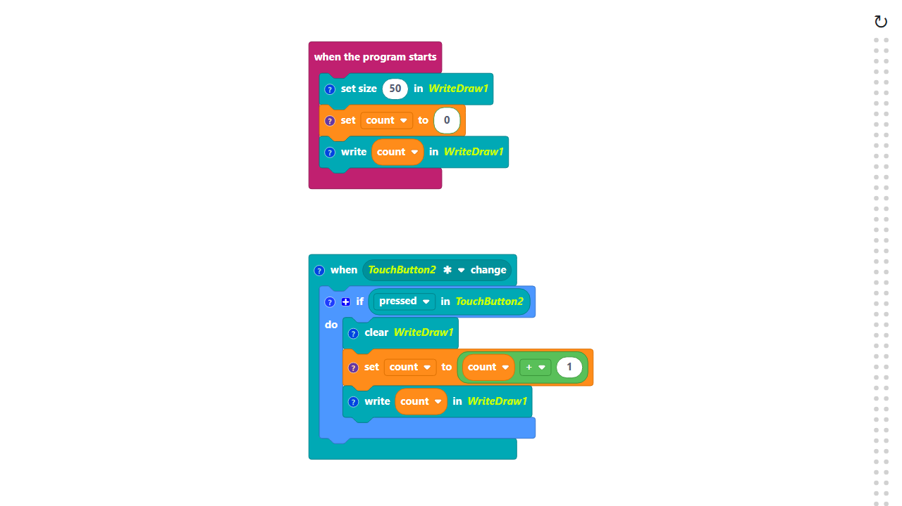
Code Composition
Click on the question mark icon to open the comments that explain the code.
https://app.protobject.com/generate?en-a11-peoplecounter&en&dynamic&-1

Slide 10
Reflect
You built this counter using an event, which is super efficient. But could you build it with a main loop? Take a look at the code below. What's the main difference? What do you think would happen if you held the button down in the loop version versus the event version?

Slide 11
Challenge
A real counter needs a way to subtract! Your challenge is to add a second button to your prototype that decreases the count by one every time it's pressed.

