Slide 1

English
This presentation is automatically generated.
You can freely edit it and add any extra content you wish.
Español
Esta presentación se genera automáticamente.
Puedes modificarla a tu criterio y añadir cualquier contenido adicional que desees.
Italiano
Questa presentazione è generata automaticamente.
Puoi modificarla liberamente e aggiungere eventuali contenuti extra che desideri.

Slide 2

The Anti-Theft Alarm
Make your code smart! Use conditionals ('If-Then') to make decisions and build an alarm that reacts to movement.

Slide 3
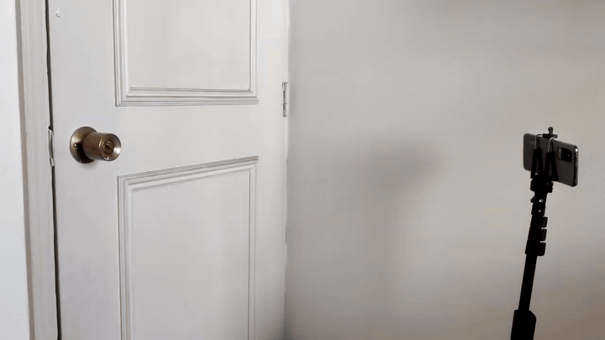
What will we do?

Slide 4

Have you ever heard of motion sensors?
Motion sensors are smart devices that can detect when someone or something moves near them.
Some, like those in automatic doors, work with infrared (a type of light we can't see) or ultrasound (a sound we can't hear). They sense changes when their signals bounce off a moving object.

Slide 5

Using a Camera as a Motion Sensor
There are also motion sensors based on cameras, which is what we will use in this activity.
A program can watch the video feed from a camera and detect changes between frames. If a large part of the image suddenly changes, the program knows that something is moving.

Slide 6
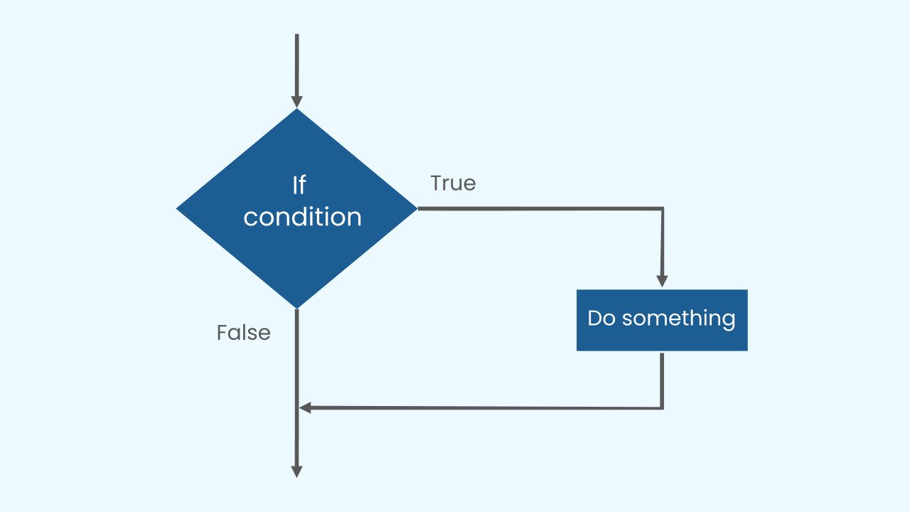
IF There’s Motion, THEN Sound the Alarm
To make our program smart, we need to teach it how to make decisions. The simplest way to do this is with a conditional statement: IF a condition is true, THEN an action happens.
This "IF... THEN..." structure is a core building block of all programming, from simple games to complex artificial intelligence.

Slide 7
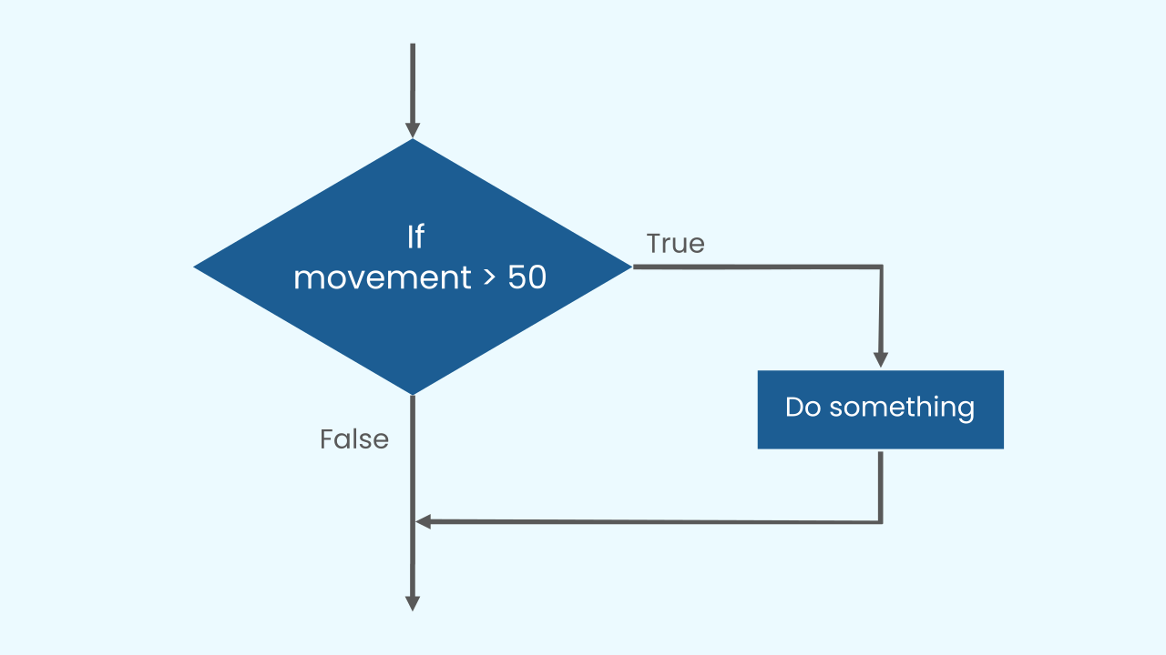
A Practical Example
Let’s see how to use a conditional to activate our alarm.
We'll tell the program: IF the amount of motion detected by the camera is greater than a certain number (like 40), THEN play the alarm sound.
But how do we make the program check for motion *continuously*? We can't just check once! This is where a main loop is essential. By placing our 'IF motion' check inside a 'repeat forever' loop, we create a system that is always watching.

Slide 8
Let's create our anti-theft alarm!
Let’s build the prototype for our alarm.
Add the component CameraMotion which detects motion through the phone's camera.
Add the component AudioPlayer to play the sound of an alarm.
Remember that if you don’t have a smartphone to scan the QR codes, you can click on Open in this window.

Slide 9
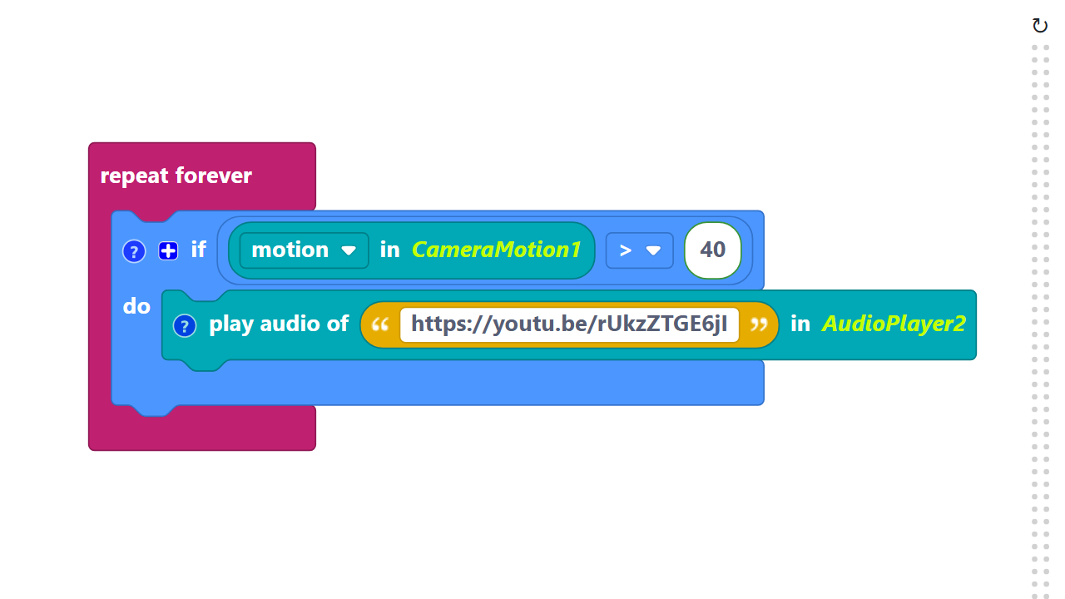
Code Composition
Click on the question mark icon to open the comments that explain the code.
Conditional blocks are found in the Logic category.
https://app.protobject.com/generate?en-a08-alarm&en&dynamic&-1

Slide 10
Reflect
★ What would happen if a thief entered at night with all the lights off? Would a camera-based sensor still work?
★ How reliable is this alarm? What might accidentally trigger a false alarm (like a pet running by)?

