Slide 1

English
This presentation is automatically generated.
You can freely edit it and add any extra content you wish.
Español
Esta presentación se genera automáticamente.
Puedes modificarla a tu criterio y añadir cualquier contenido adicional que desees.
Italiano
Questa presentazione è generata automaticamente.
Puoi modificarla liberamente e aggiungere eventuali contenuti extra che desideri.

Slide 2
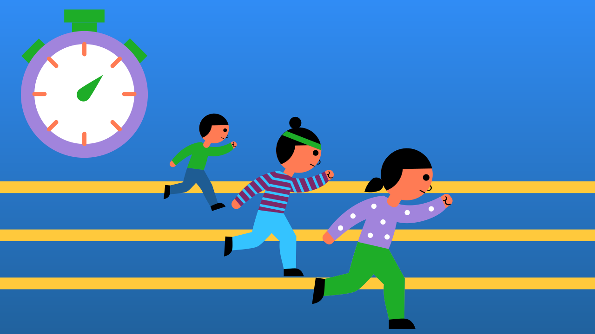
Build Your Own Stopwatch
Master the use of variables and loops to build a functional stopwatch that counts seconds on the screen.

Slide 3
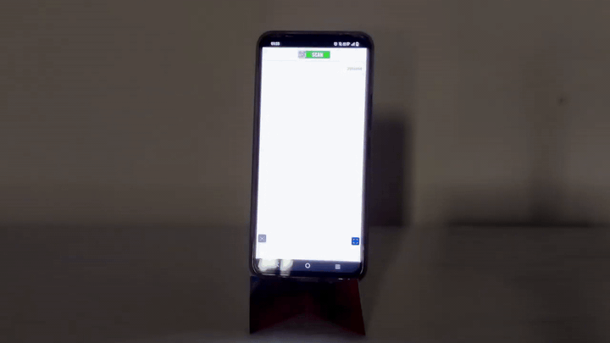
What will we do?

Slide 4
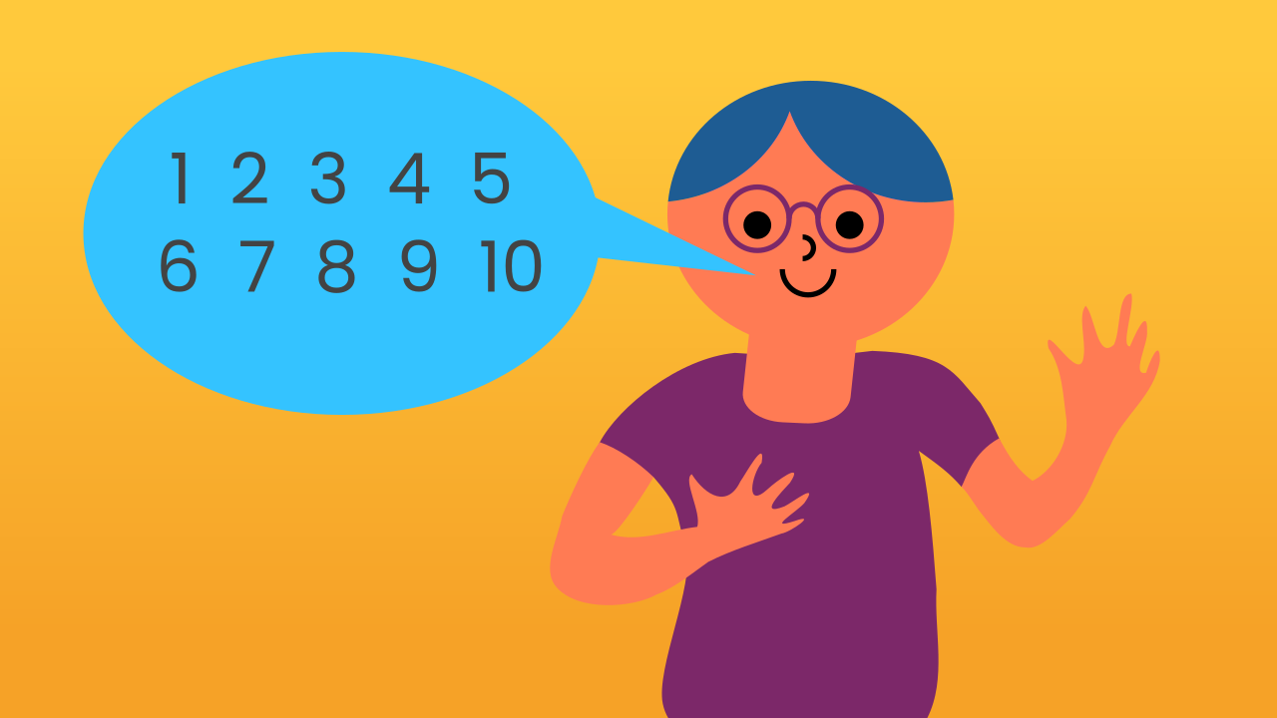
How does a stopwatch work?
A stopwatch has a simple job: count the passing seconds. Every second, it essentially says: "Hey, another second went by. I'll add 1 to the total number of seconds I've already counted."
So, if the stopwatch is at 9 seconds, after one more second passes, it calculates 9 + 1 = 10 seconds. This process repeats over and over... It's a perfect job for a loop!

Slide 5
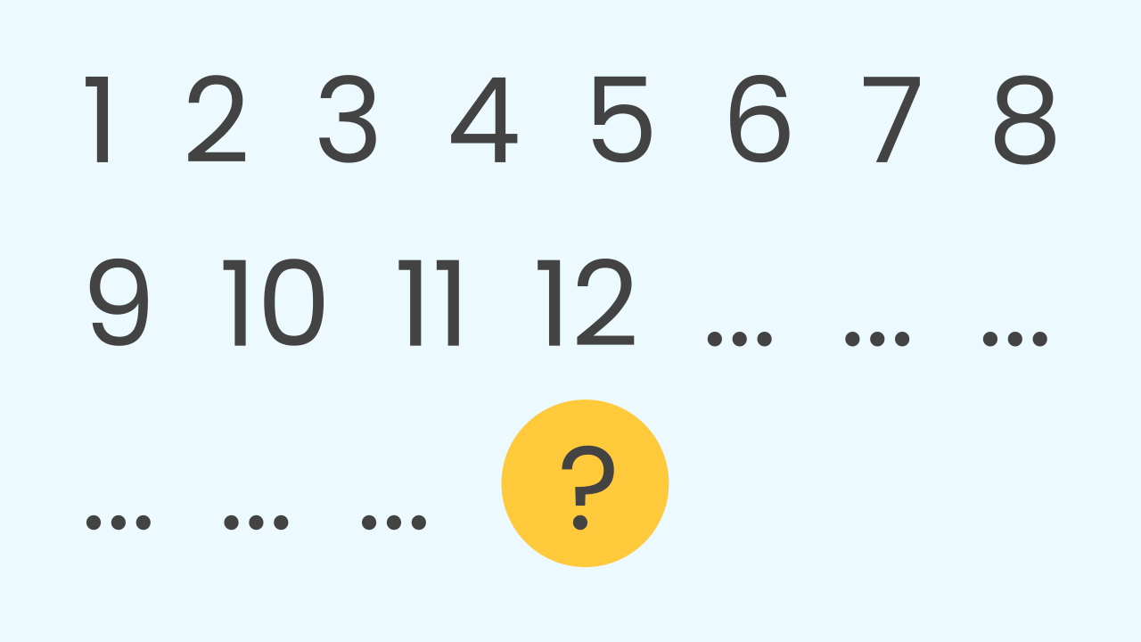
What if we lose count?
Have you ever been counting something and forgotten the last number you were on? You have to start all over again! A computer can have the same problem.
To prevent this, you'd probably write the number down. Then, to continue counting, you'd just look at the number, add 1, and write down the new total. You're storing a value that changes over time!

Slide 6
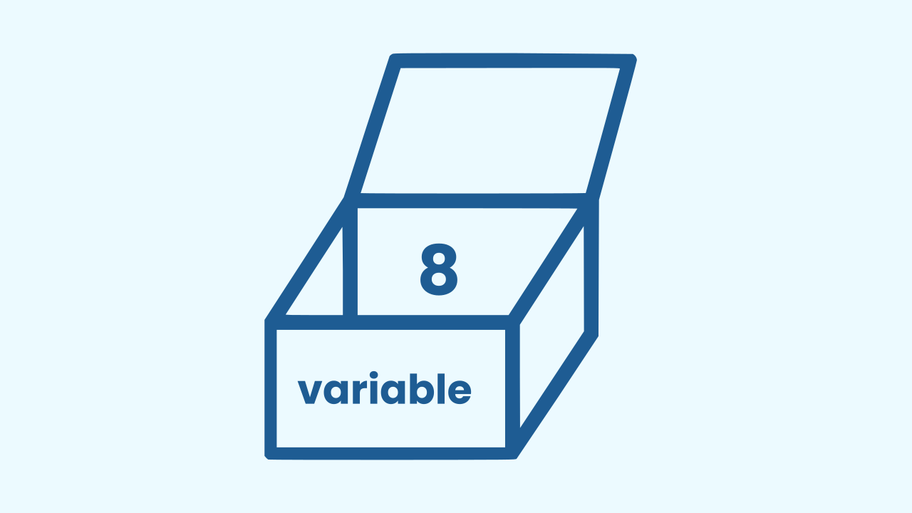
How does the computer 'write it down'?
To solve this memory problem, we use a fundamental programming tool: a Variable.
Think of a variable as a small box inside the computer's memory where you can store something. To keep things organized and remember what's inside, you give the box a name.
By using a variable, we can make our computer keep count without ever forgetting which number it's on.

Slide 7
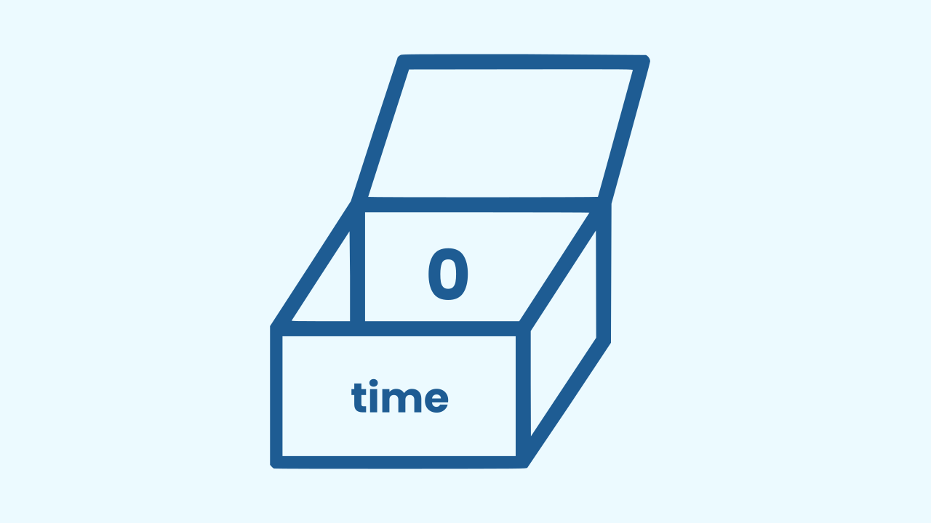
How do we use it?
First, we need to create our variable and give it a name so we know what it's for. In this case, let's call it "time."
Next, we need to give it a starting value. Since a stopwatch starts counting from 0, at the very beginning of our program, we will set the "time" variable to be equal to 0.

Slide 8
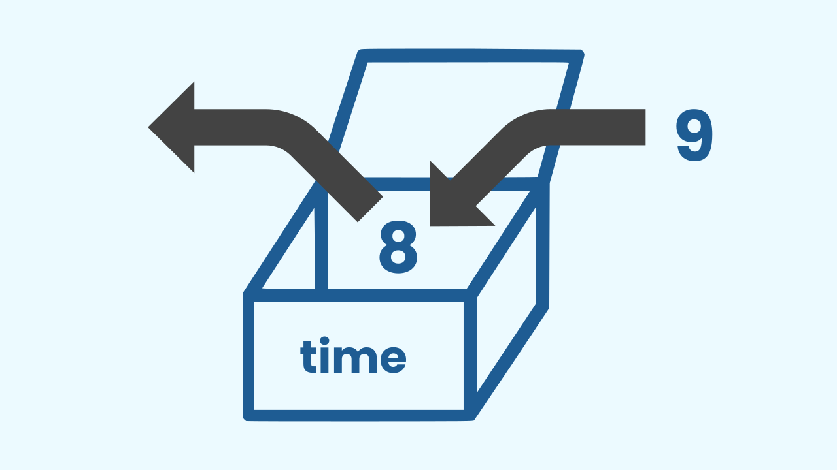
Variables... They Vary!
As the name suggests, the value inside a variable can change, or "vary." We can take the value out, change it, and then save the new value back into the same variable.
For our stopwatch, every time our main loop runs, we'll tell the program to add 1 to the value of the "time" variable. And just like that, we're counting!

Slide 9

Let's get to work!
To build our stopwatch, we'll start by creating a variable named "time" and setting its initial value to 0. Then, we will create a loop that runs over and over. Inside the loop, we will increase the value of our "time" variable by 1 and then wait for one second.

Slide 10
Create
Now we will build our own stopwatch.
Press Add device and select the WriteDraw component. Let's name it Stopwatch so we can write the numbers on the screen.
Scan the QR code.
Remember that if you don't have a smartphone to scan the QR codes, you can press Open in this window to open the components on the same computer.

Slide 11
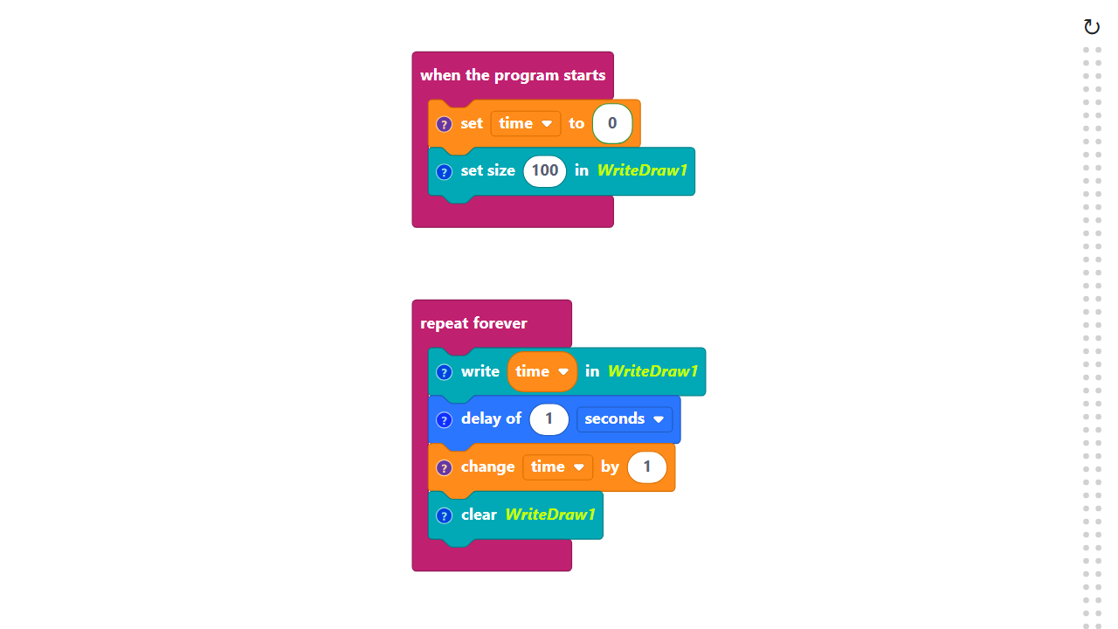
Code Composition
Click on the question mark symbol to open the comments that explain the code.
Variables are managed in the Variables category.
https://app.protobject.com/generate?en-a07-stopwatch&en&dynamic&-1

Slide 12
What else can we invent?
★ Besides numbers, what other kinds of information could we store in a variable?
★ What other prototypes could you build now that you know how to make a counter?
★ How could we make our stopwatch count minutes as well as seconds?

