Slide 1

English
This presentation is automatically generated.
You can freely edit it and add any extra content you wish.
Español
Esta presentación se genera automáticamente.
Puedes modificarla a tu criterio y añadir cualquier contenido adicional que desees.
Italiano
Questa presentazione è generata automaticamente.
Puoi modificarla liberamente e aggiungere eventuali contenuti extra che desideri.

Slide 2

A Flashing Warning
Dive deeper into automation by nesting loops to create a realistic, flashing yellow traffic light.

Slide 3
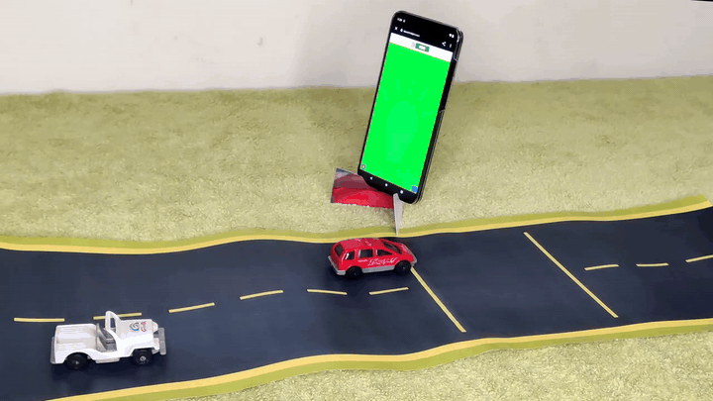
What will we do?

Slide 4

How can we program a flashing light?
Imagine we've built an automated traffic light that cycles through its colors inside a "repeat forever" loop. It's a great start, but we can make it more realistic.
What if we wanted the yellow light to flash a few times before turning red? This would be a much better and safer warning for drivers.

Slide 5
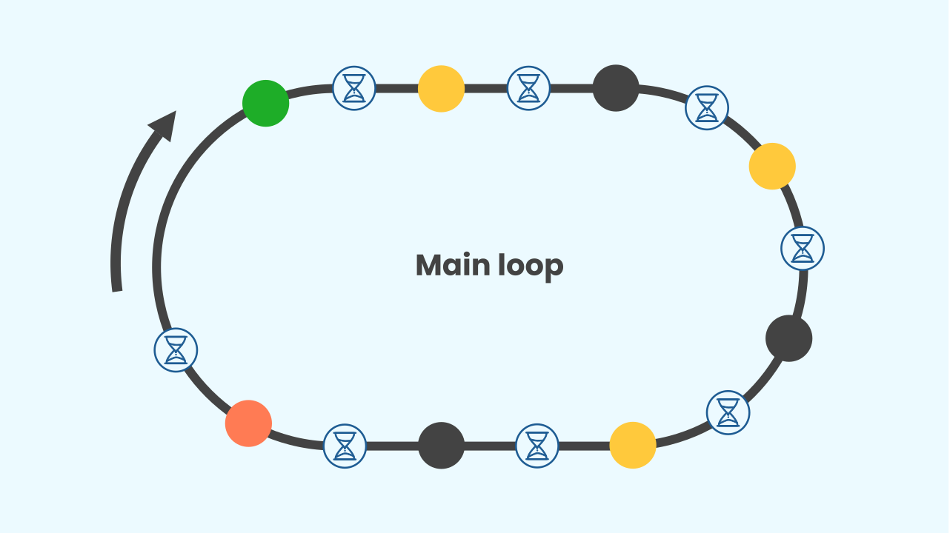
So, do we just add more blocks?
To make the light flash, we'd need to add a sequence like this to our main loop:
Green → Yellow ON → OFF → Yellow ON → OFF → Yellow ON → OFF → Red
This works, but it's just repeating the “Yellow ON → OFF” sequence. Once again, our code would become very long and repetitive! There must be a smarter way.

Slide 6

Why Not Another 'Forever' Loop?
You can't have two captains on one ship, and you can't have more than one "repeat forever" (Main Loop) in a program! If you did, the computer wouldn’t know which one is the main program or what to run. It would get confused!

Slide 7
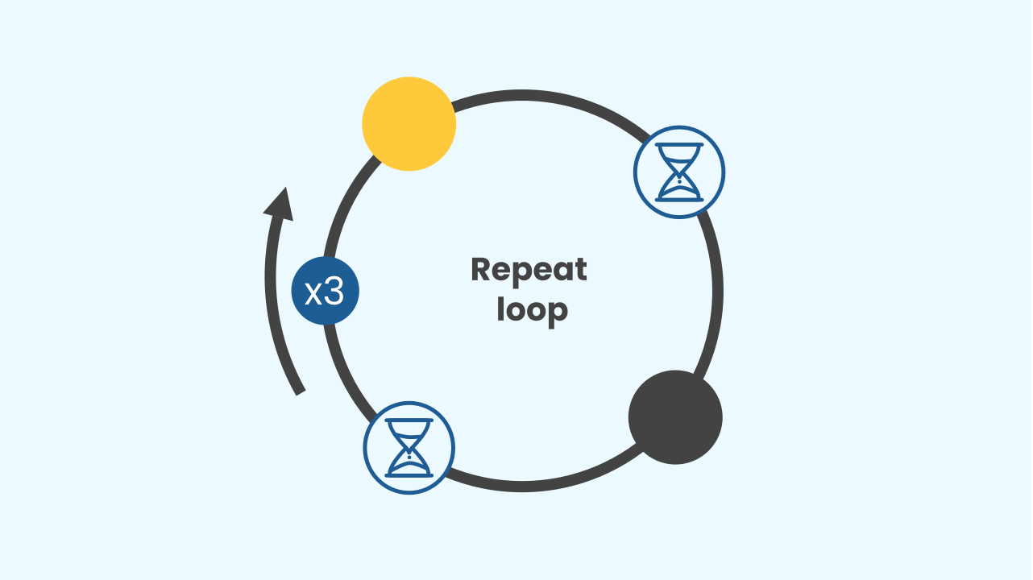
The Solution: A Loop Inside a Loop!
This is where a different kind of loop comes in handy! We can use a loop that repeats a specific number of times (in the image, 3 times). This is perfect for the flashing part.
Even better, we can nest loops. This means putting one loop *inside* another. Repetitions within repetitions!

Slide 8
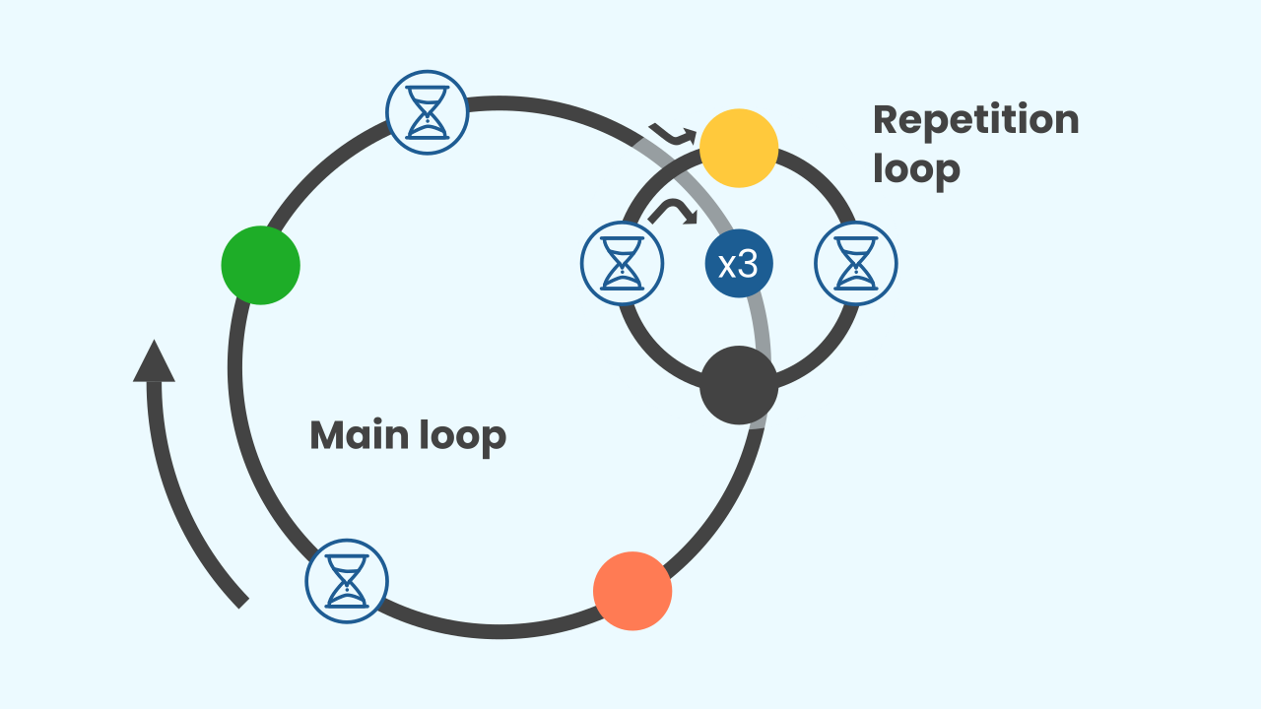
Flashing Yellow: A Nested Loop
By using a numbered loop, we can repeat the “Yellow ON → OFF” blocks as many times as we need. By putting this smaller loop *inside* our main "forever" loop, we create a powerful and efficient program:
Main Loop ( Green → *Inner Loop* ( Yellow ON → OFF [x4] ) → Red )

Slide 9
Let's build our flashing traffic light!
Let’s create our advanced traffic light.
Press Add Device and select Lamp.
Scan the QR code.
Remember that if you don’t have a smartphone, you can press Open in this window.

Slide 10
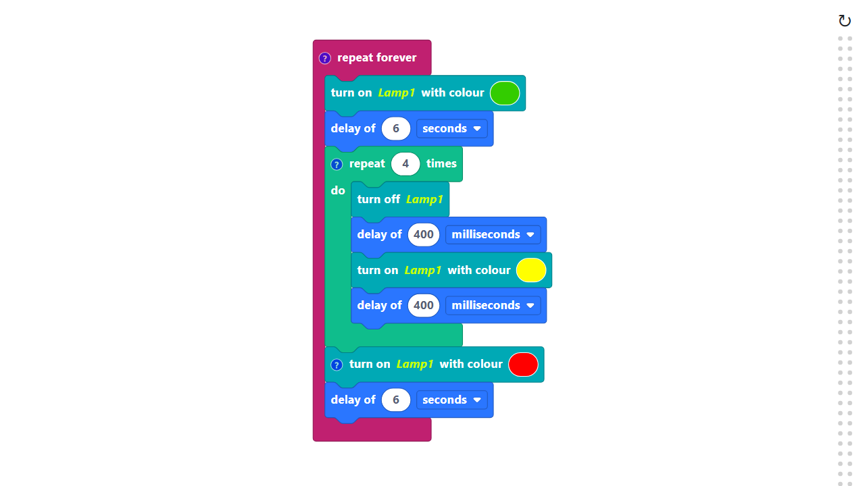
Code Composition
Click on the question mark icon to open the comments that explain the code.
The “repeat forever” and the numbered loop blocks are both located in the Basic category.
https://app.protobject.com/generate?en-a06-trafficlighflashing&en&dynamic&-1

Slide 11
Reflect
★ Loops aren't just for code; they're everywhere. Where can you see repeating patterns or cycles in everyday life (think music, daily routines, nature)?
★ What other cool prototype could you build using a loop inside a loop?

