Slide 1

English
This presentation is automatically generated.
You can freely edit it and add any extra content you wish.
Español
Esta presentación se genera automáticamente.
Puedes modificarla a tu criterio y añadir cualquier contenido adicional que desees.
Italiano
Questa presentazione è generata automaticamente.
Puoi modificarla liberamente e aggiungere eventuali contenuti extra che desideri.

Slide 2
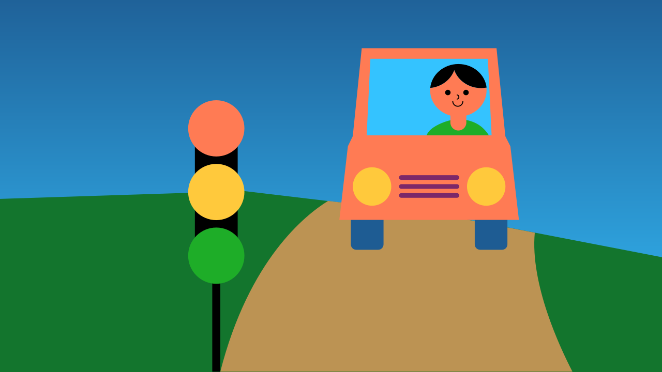
The Traffic Light
Say goodbye to repetitive code! Learn how to use infinite loops to automate a classic traffic light sequence.

Slide 3
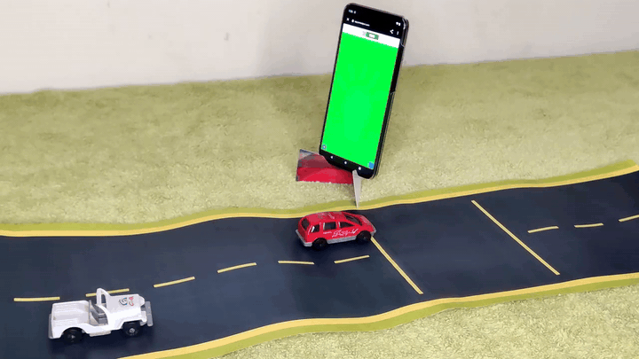
What will we do?

Slide 4
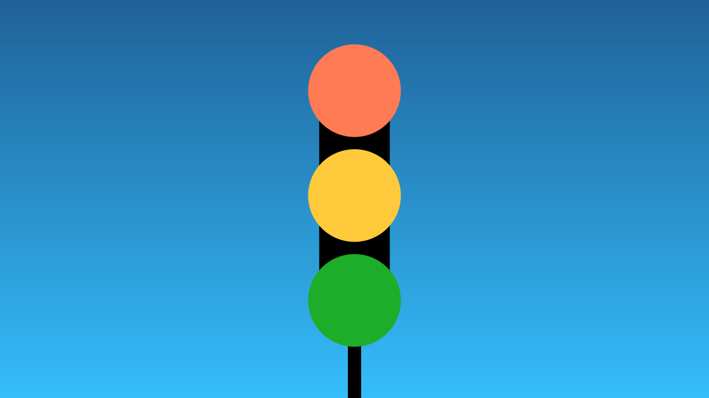
What can we do with an LED lamp?
If we program an LED lamp to change from green, to yellow, and then to red in a timed sequence... we've created a traffic light!
To do this, we just need to program the right timing and the right colors.

Slide 5
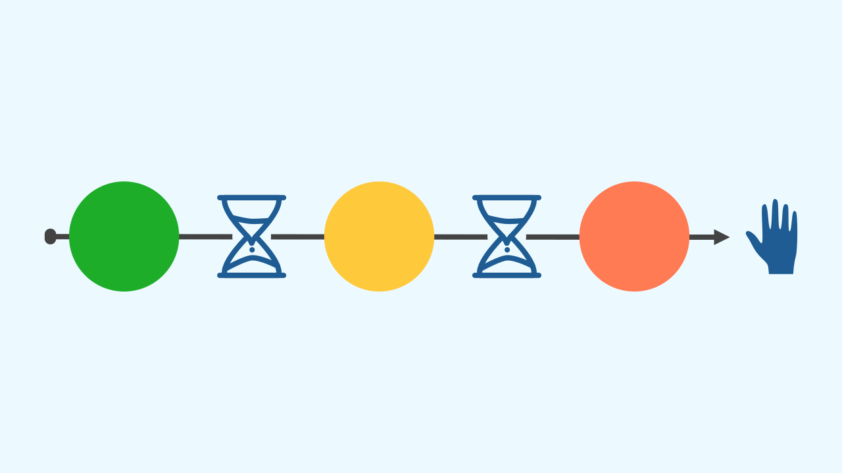
The Problem: The Code Stops!
If you just code one cycle—green, yellow, red—the program will run it once and then stop. To make it repeat, you could copy and paste the blocks over and over again.
But what if you wanted the traffic light to run for an hour? You'd end up with an enormous amount of repeated code! That's inefficient and impossible to manage.

Slide 6
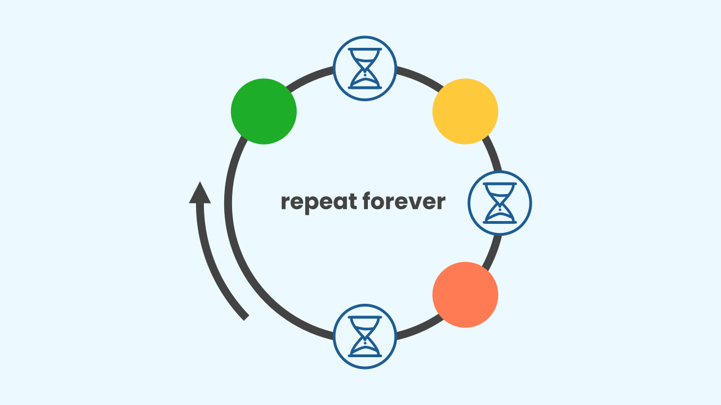
The Solution: The 'Repeat Forever' Loop
How do we make it repeat on its own? We use a loop!
The "repeat forever" block is a fundamental tool in programming. This concept, also known as the Main Loop, tells the computer to repeat all the code inside it over and over again, until the user manually stops the program.
By placing our traffic light sequence inside this loop, we can keep it running indefinitely!

Slide 7

Let's get to work!
We are going to create our traffic light prototype by placing the color and timing code inside the “repeat forever” loop. We'll program the light to be green for 6 seconds, yellow for 1 second, and red for 6 seconds, creating a realistic cycle.

Slide 8
Make our Traffic Light!
Let’s build our traffic light!
Press Add Device and select Lamp.
Scan the QR code.
Remember that if you don’t have a smartphone, you can press Open in this window to open the components on the same computer.

Slide 9
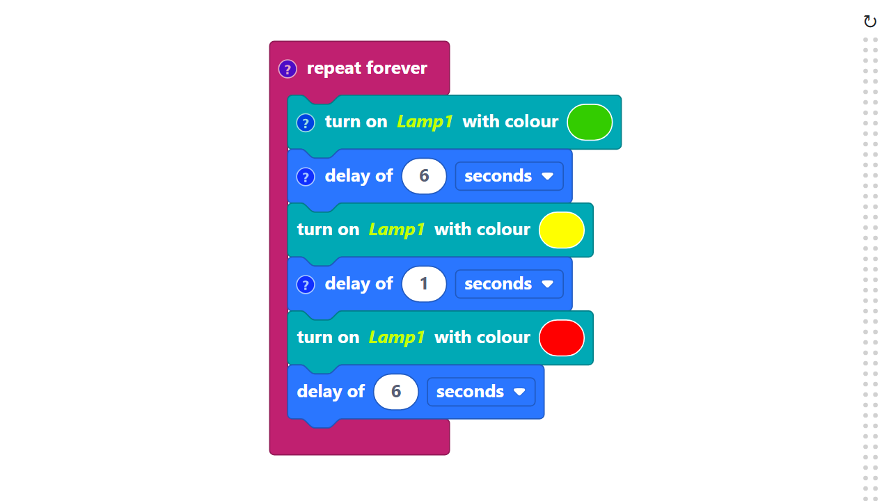
Code Composition
Click on the question mark icon to open the comments that explain the code.
The "repeat forever" block is located in the Basic category.
https://app.protobject.com/generate?en-a05-trafficlight&en&dynamic&-1

Slide 10
Reflect
★ How do real traffic lights work? Are they all alone, or do they work in teams?
★ How many traffic lights are usually needed to control a single intersection?
★ What is the most important purpose of a traffic light in our communities?

