Slide 1

English
This presentation is automatically generated.
You can freely edit it and add any extra content you wish.
Español
Esta presentación se genera automáticamente.
Puedes modificarla a tu criterio y añadir cualquier contenido adicional que desees.
Italiano
Questa presentazione è generata automaticamente.
Puoi modificarla liberamente e aggiungere eventuali contenuti extra che desideri.

Slide 2
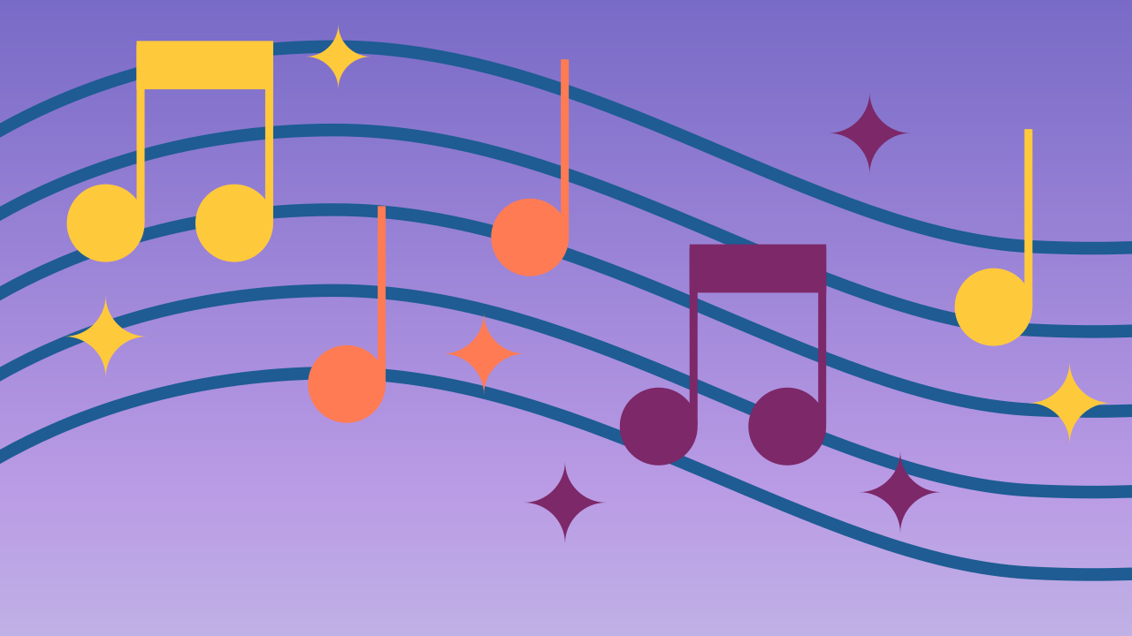
Light and Sound Show
Combine lights and music in perfect sync and learn how to use variables to easily control your code's speed.

Slide 3
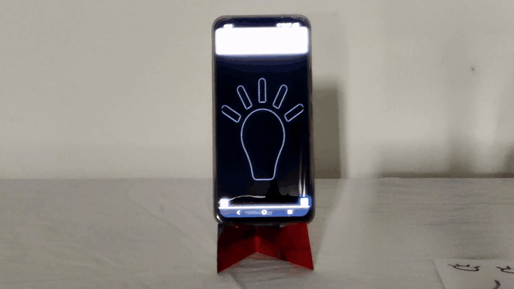
What will we do?

Slide 4
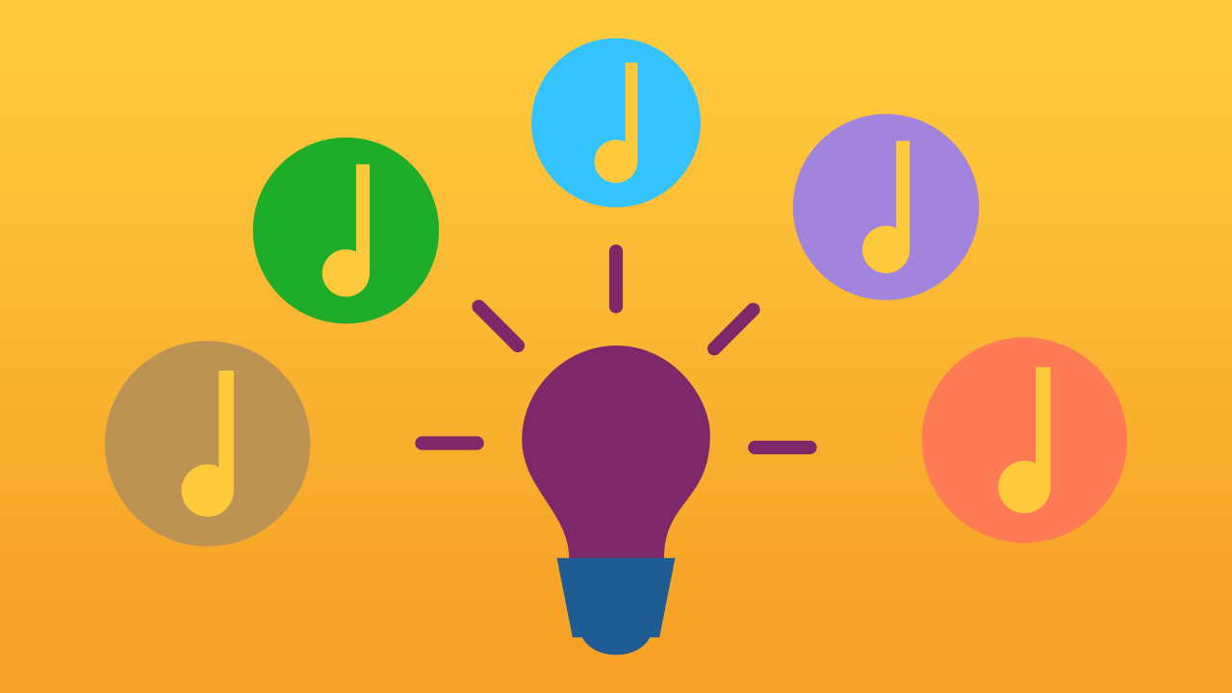
The Challenge: Sync and Speed
The first goal of a good light show is synchronization—making sure every light flash happens at the exact same moment as a musical note. This creates a professional and exciting effect.
But there's a second, bigger challenge: control. Imagine you build your whole sequence, but then decide you want it to run faster. You would have to go back and manually change the delay value for *every single note* and *every single light*. For a long song, that could be hundreds of changes! This is slow and a recipe for mistakes.

Slide 5
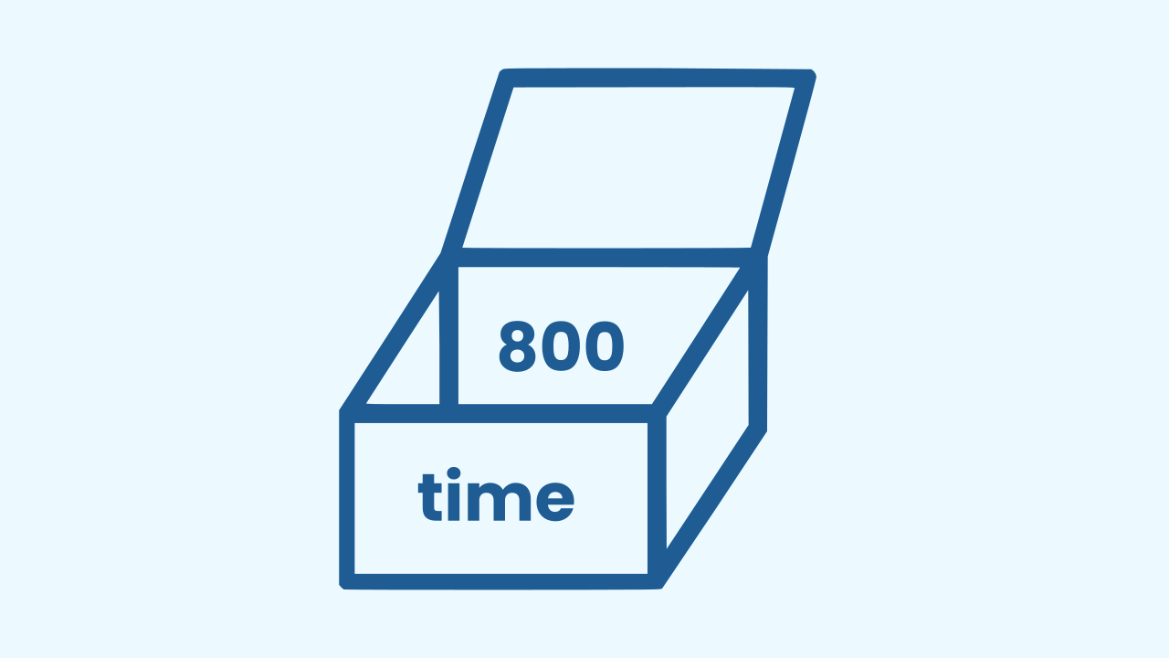
The Solution: A Variable as Master Control
To solve the problem of having to change many values at once, programmers use variables!
A variable is like a box with a label on it. You can store a single piece of information—like a number—inside this box. The powerful part is that you can then use this box in many places throughout your code.
If you want to change the number, you only have to change it inside the box one time. Everywhere you used the box, the value will update automatically. It's like a master control for your code!

Slide 6
Make a Musical Light Show
Let’s create a prototype that plays ♪ Happy Birthday ♪ with perfectly synchronized—and adjustable—lights.
Press Add Device and select MusicalKeyboard.
Press Add Device again and select Lamp.
Remember that if you don’t have smartphones to scan the QR codes, you can press Open in this window.

Slide 7
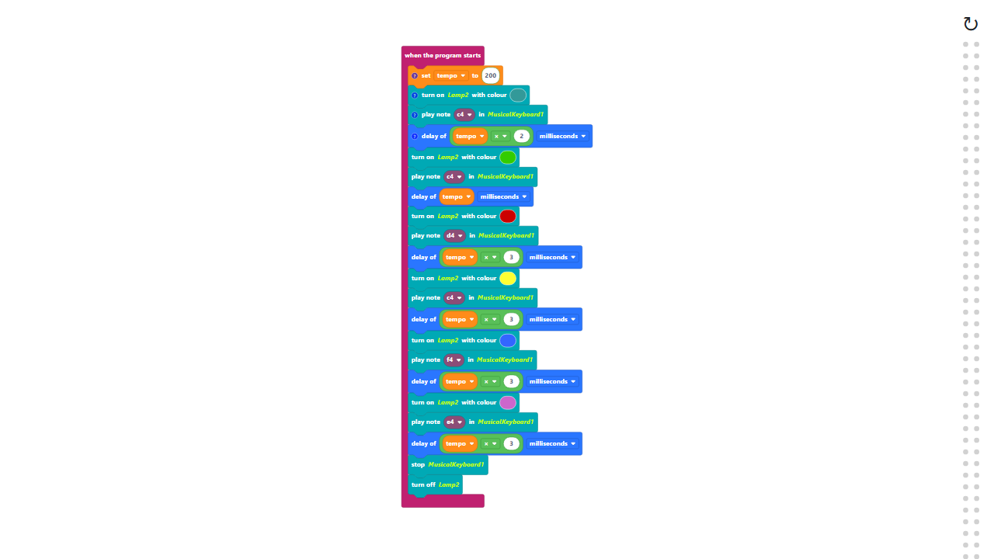
Code Composition
Click on the question mark icon to open the comments that explain the code. Notice how the `time` variable is defined once at the beginning and then used for all the delays. The multiplication blocks are in the Mathematics category.
https://app.protobject.com/generate?en-a04-melody-light&en&dynamic&-1

Slide 8
Reflect
You've seen how powerful a single variable can be. What if you wanted to make your show even bigger? How would you add a second lamp that flashes along with the music, maybe on a different phone or with a different color?

