Slide 1

English
This presentation is automatically generated.
You can freely edit it and add any extra content you wish.
Español
Esta presentación se genera automáticamente.
Puedes modificarla a tu criterio y añadir cualquier contenido adicional que desees.
Italiano
Questa presentazione è generata automaticamente.
Puoi modificarla liberamente e aggiungere eventuali contenuti extra che desideri.

Slide 2

The Music Visualizer
Turn the noise around you into moving light. Generalize the idea of mapping data by using the microphone to control the position of a light in real time.

Slide 3
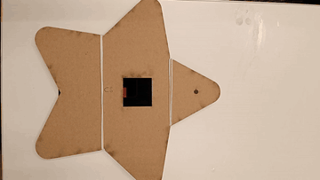
What will we do?

Slide 4
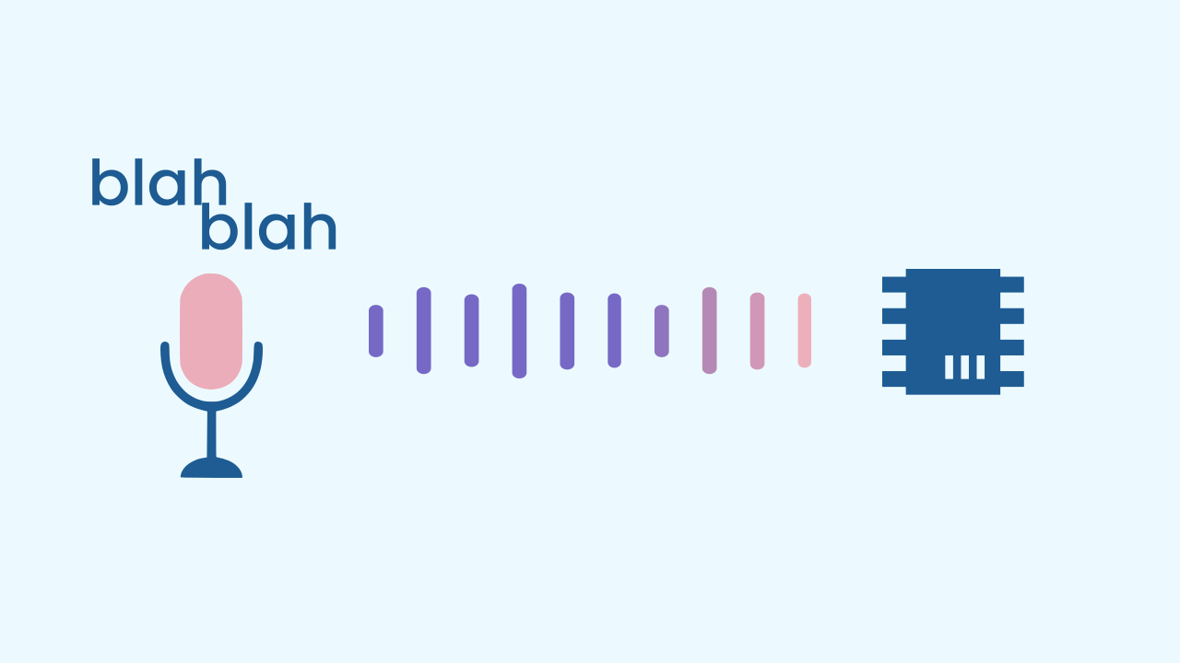
The Microphone: The Device's Ears
Your device's microphone is a sensor built to "listen." It turns the sound waves traveling through the air into an electrical signal. Your program can read that signal as a number that represents how loud the sound is. We call this the noise level. The louder the sound, the bigger the number the sensor gives us.

Slide 5
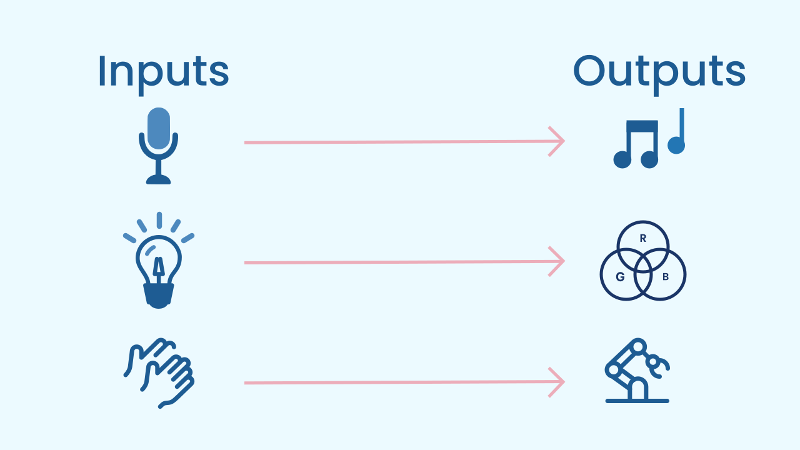
Generalizing data mapping: a universal principle
The most important thing we will learn today is that mapping data does not depend on one specific sensor. It is a fundamental principle of programming that follows a simple formula: Input → Processing → Output.
You can map *any* input (tilt, noise, light level) to *any* output (sound, color, position, vibration). By using a microphone instead of a motion sensor, we are showing that mapping data is a universal tool for creating interactions.

Slide 6
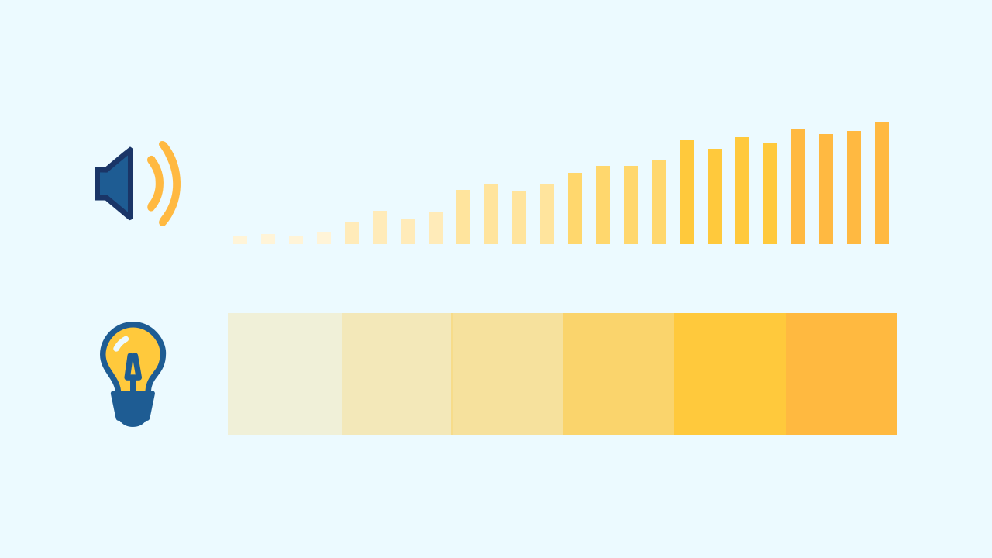
Controlling the position of the light with Data
The screen is a grid of LEDs, and every position is identified by two coordinates: the column (X) and the row (Y). In this visualizer the columns stay fixed, and what the noise controls is the row. For our visualizer, we will take the number the noise level sensor gives us and use it to decide which row the LEDs light up in (we will have to limit this to the number of rows the screen actually has). Since that number can get very big, we divide it to fit the height of the screen.
The result: the louder the sound, the higher the light moves up the screen!

Slide 7
Create
Let's build the music visualizer.
Press Add Device and select NoiseLevel to use the microphone.
Press Add Device again and select LEDDraw to be our screen of lights.
Remember to scan or open the components. You can put them both on the same device.

Slide 8

Code Composition
Press the question mark symbol to open the comments. Inside a `repeat forever` loop, the program first clears the drawing — so the previous light does not stay on — and then reads the `noise level` and uses that number to decide the row where the LEDs light up (we divide it to fit the height of the screen and limit it between 1 and 7 so it does not go off the screen, subtracting it from 7 so it can grow from the bottom upwards). More noise means the light moves higher up!
https://app.protobject.com/generate?eq-luci-discoteca-ruido&en&dynamic&-1

Slide 9
Reflect
You have shown that mapping is a universal principle. Which sensor did we use as the input, and which property did we control in the output?
Think about the other sensors in your phone (like the ambient light sensor). What data could you map with it? What would you create?

