Slide 1
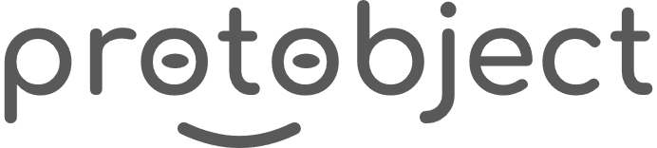
English
This presentation is automatically generated.
You can freely edit it and add any extra content you wish.
Español
Esta presentación se genera automáticamente.
Puedes modificarla a tu criterio y añadir cualquier contenido adicional que desees.
Italiano
Questa presentazione è generata automaticamente.
Puoi modificarla liberamente e aggiungere eventuali contenuti extra che desideri.

Slide 2
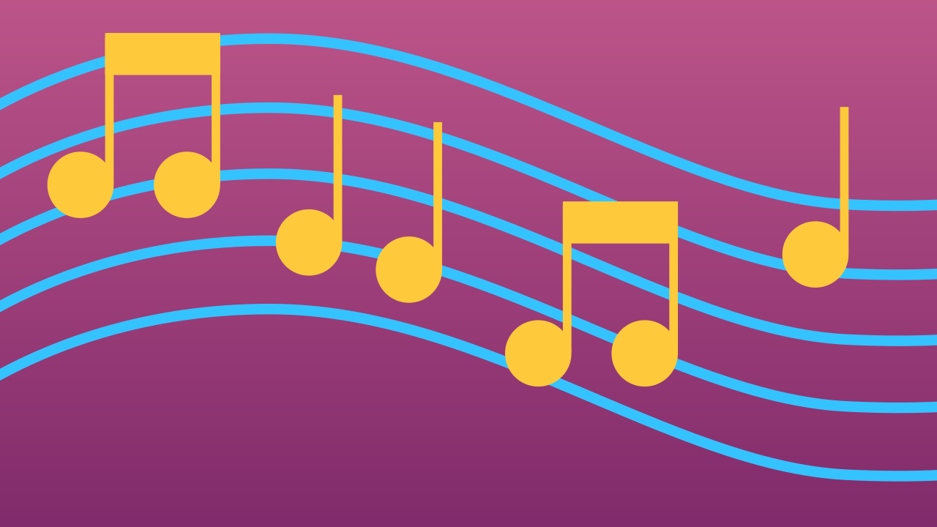
Play a Song
Turn your device into a musical instrument! Learn to sequence notes and control their timing to play a familiar tune.

Slide 3
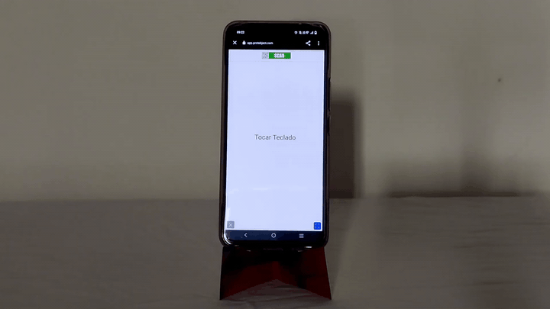
What will we do?

Slide 4
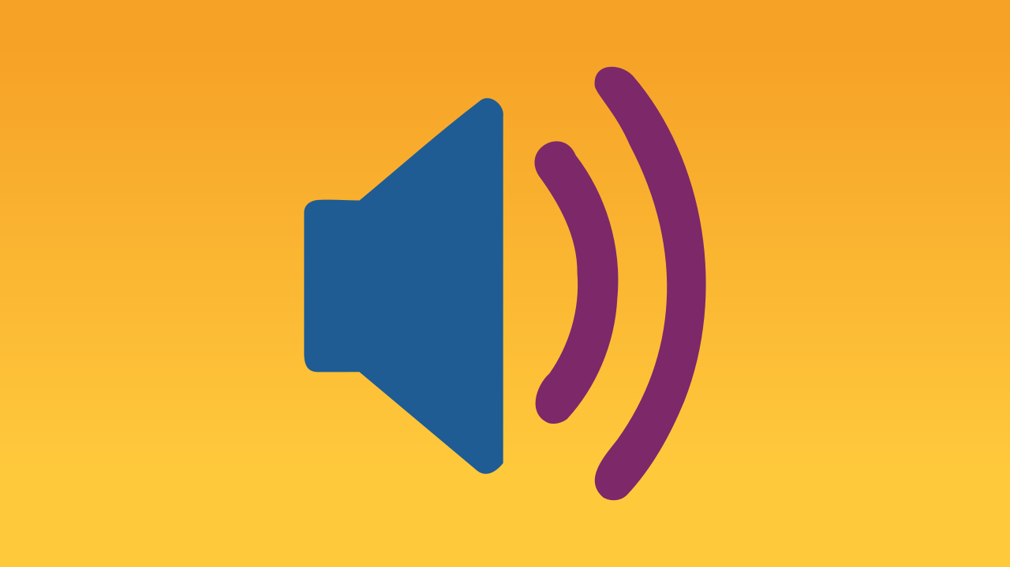
How do devices produce sound?
Ever wonder how your phone can blast your favorite tunes? The magic happens in a tiny component called a speaker. Think of it as a device that converts electrical signals into sound waves. A magnet and a coil inside move when electricity passes through them, causing a cone to vibrate. These vibrations create the sound waves that travel through the air to our ears.
Our brain interprets these waves as music, voices, or sound effects, allowing us to enjoy a movie or sing along to a song.

Slide 5
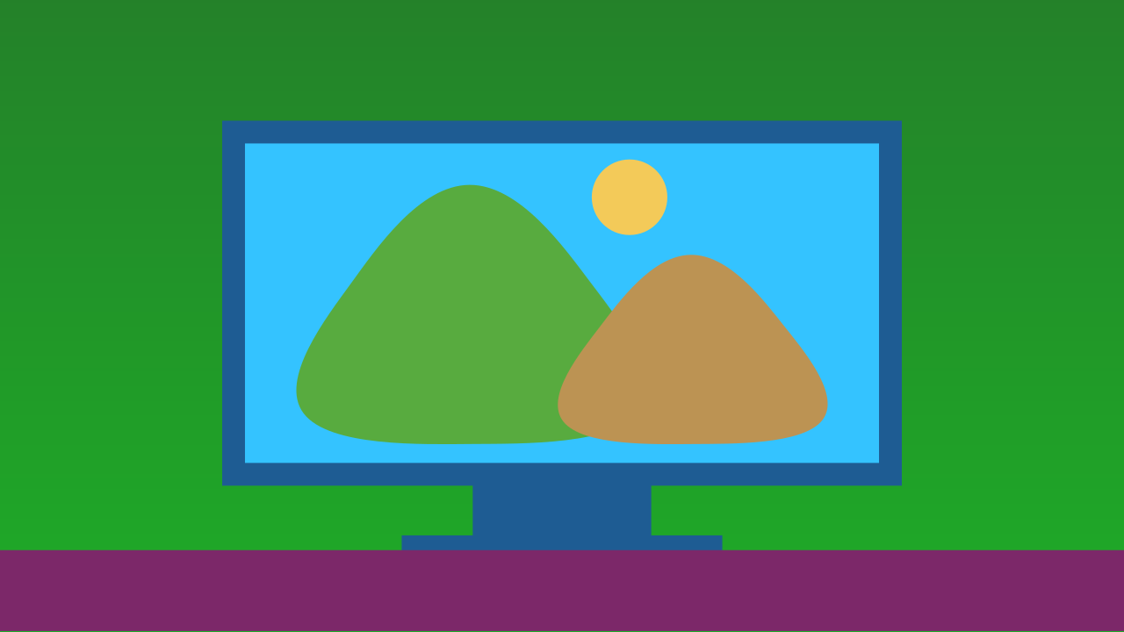
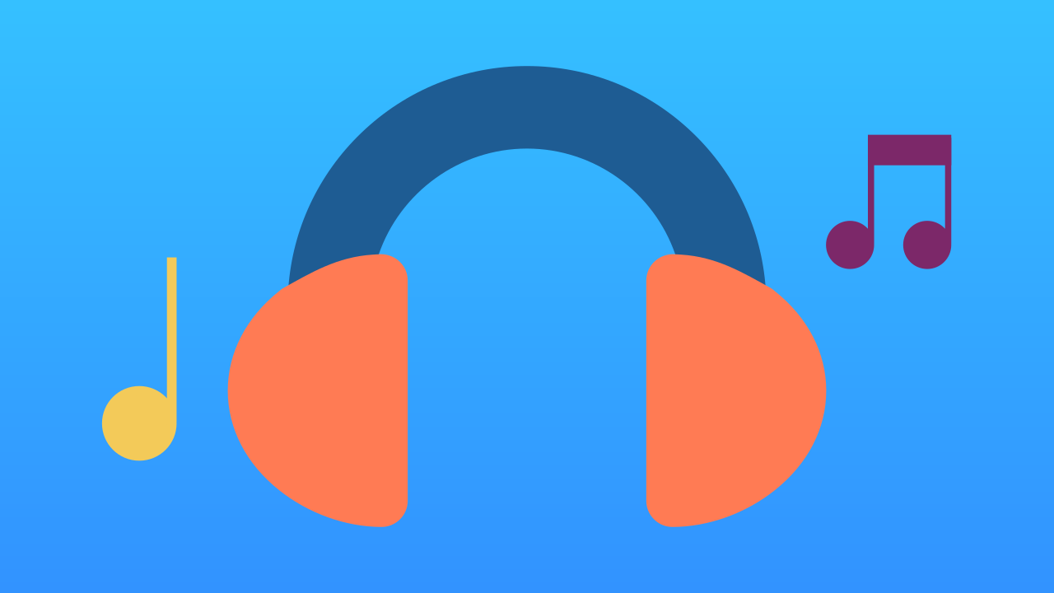
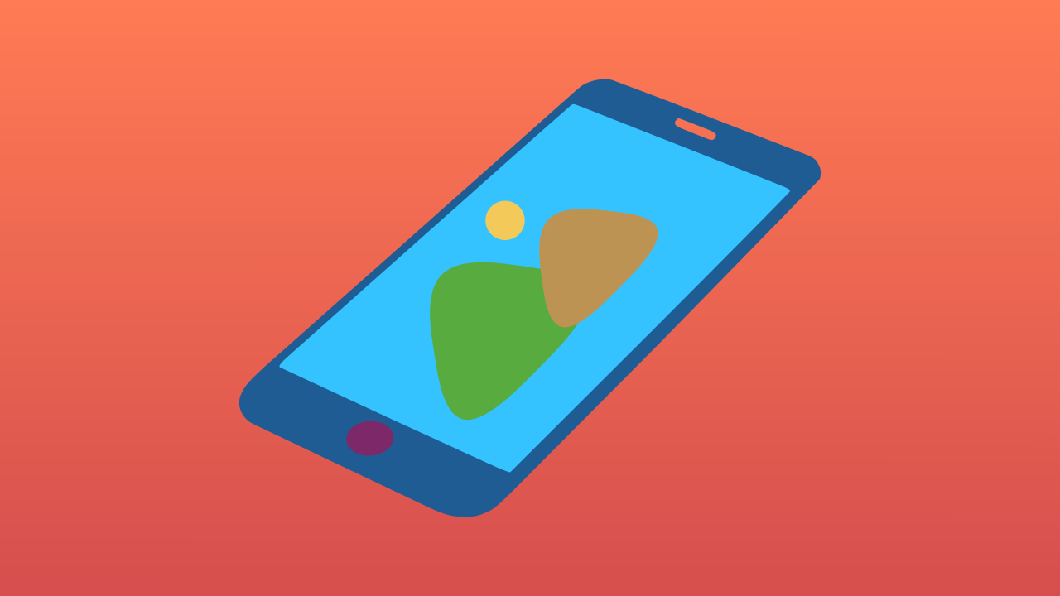
Speakers are everywhere!
You can find speakers in all sorts of devices! They're in your TV, inside your headphones, and of course, in your smartphone. If you've ever watched a video or listened to music on your phone, you've heard its speakers in action.

Slide 6
Let's Play a Song
We're going to create a prototype that plays 'Happy Birthday' on the phone. First, let's connect our device.
Click on Add device on the left sidebar.
Select the component MusicalKeyboard to play notes on the smartphone.
Scan the QR code with your smartphone or press Open in this window.

Slide 7
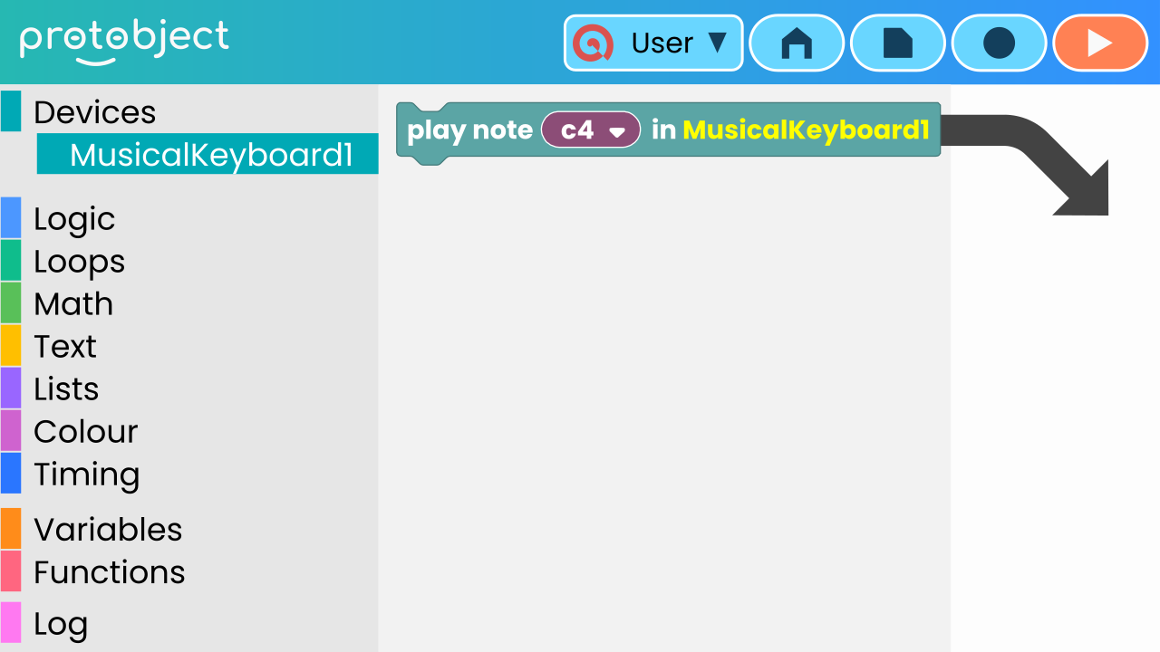
Drag the notes!
To build a melody, you need to drag the note blocks into the workspace in the correct sequence.

Slide 8
How to control the duration of a note?
We use delays!
A melody isn't just about notes; it's also about rhythm. To control how long a note plays, you need to add a pause before the next one starts.
For example:
★ play a note
★ wait 400 milliseconds
★ play the next note
★ wait 200 milliseconds
★ … and so on.

Slide 9
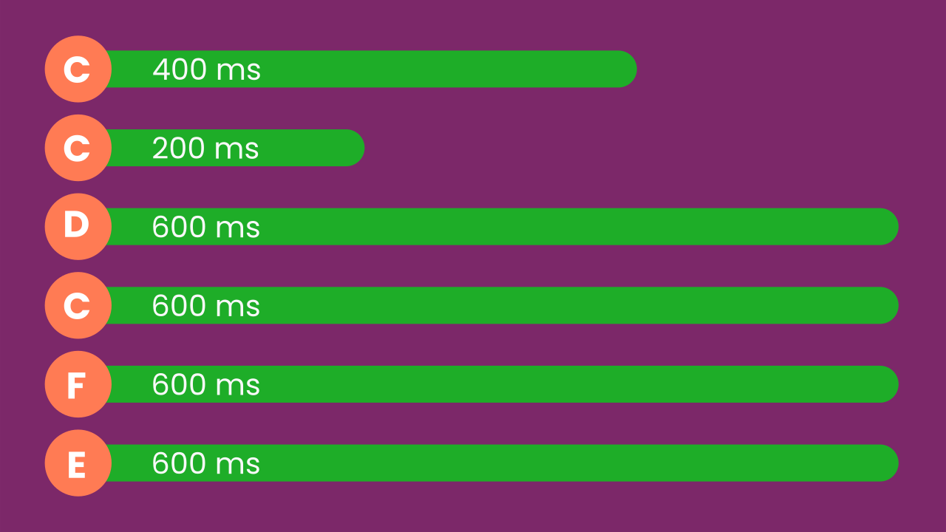
What is the sequence of notes and delays?
The main part of “Happy Birthday” has this sequence of notes with their respective delays, measured in milliseconds (ms).

Slide 10
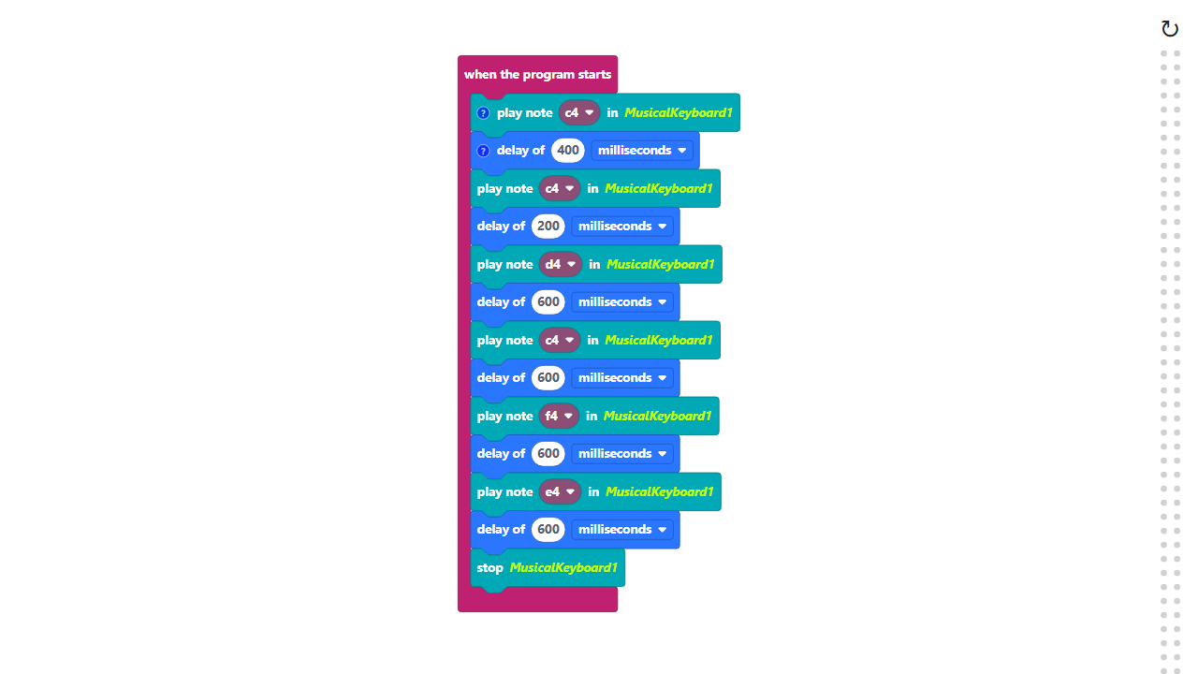
Code Composition
Click on the question mark icon to open the comments that explain the code.
https://app.protobject.com/generate?en-a03-melody&en&dynamic&-1

Slide 11
Reflect
To change the tempo, you need to adjust the delays. Right now, your song uses pauses of 200, 400, and 600 milliseconds.
What if you wanted to play it twice as fast? You'd have to go back and change *every single delay block* by hand. That sounds like a lot of work! Is there a smarter, more efficient way to control the speed?

