Slide 1

English
This presentation is automatically generated.
You can freely edit it and add any extra content you wish.
Español
Esta presentación se genera automáticamente.
Puedes modificarla a tu criterio y añadir cualquier contenido adicional que desees.
Italiano
Questa presentazione è generata automaticamente.
Puoi modificarla liberamente e aggiungere eventuali contenuti extra che desideri.

Slide 2

The Xylophone of the Future (with LEDs)
Upgrade your magic instrument. Learn how to map the tilt sensor's data to the position of the light we are about to add!

Slide 3
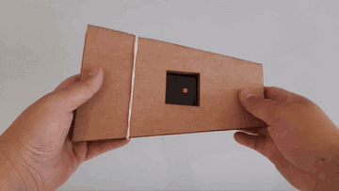
What will we do?

Slide 4
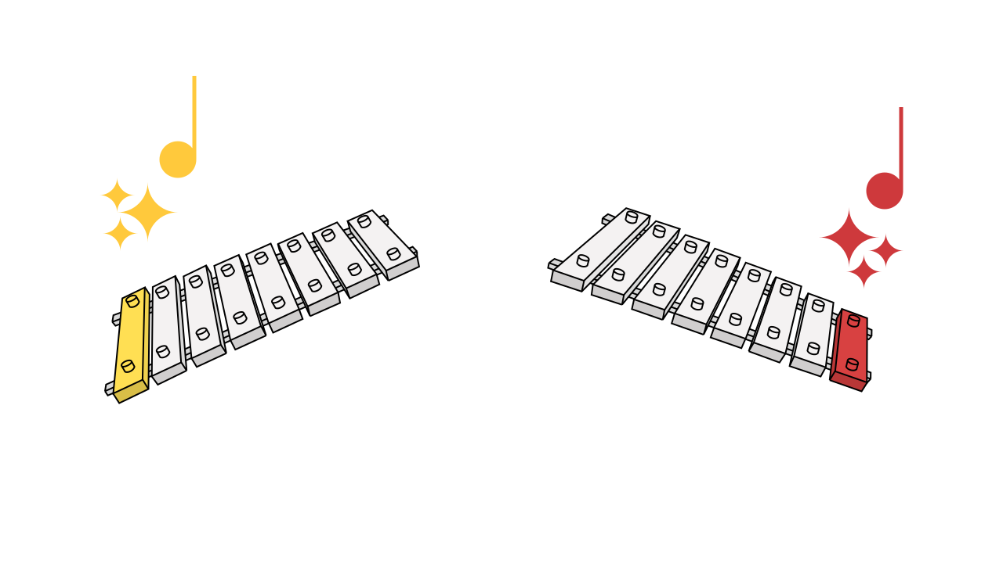
Beyond Sound: Visual Feedback
When you press a key on a real piano, you don't just hear it, you also see it move. That visual confirmation is called feedback. It makes the whole experience much more intuitive! In our digital projects, we can do exactly the same thing. By adding a light that moves along with the sound, we give the user instant visual feedback. It doesn't just look great, it also helps them understand the connection between the movement and the result.

Slide 5
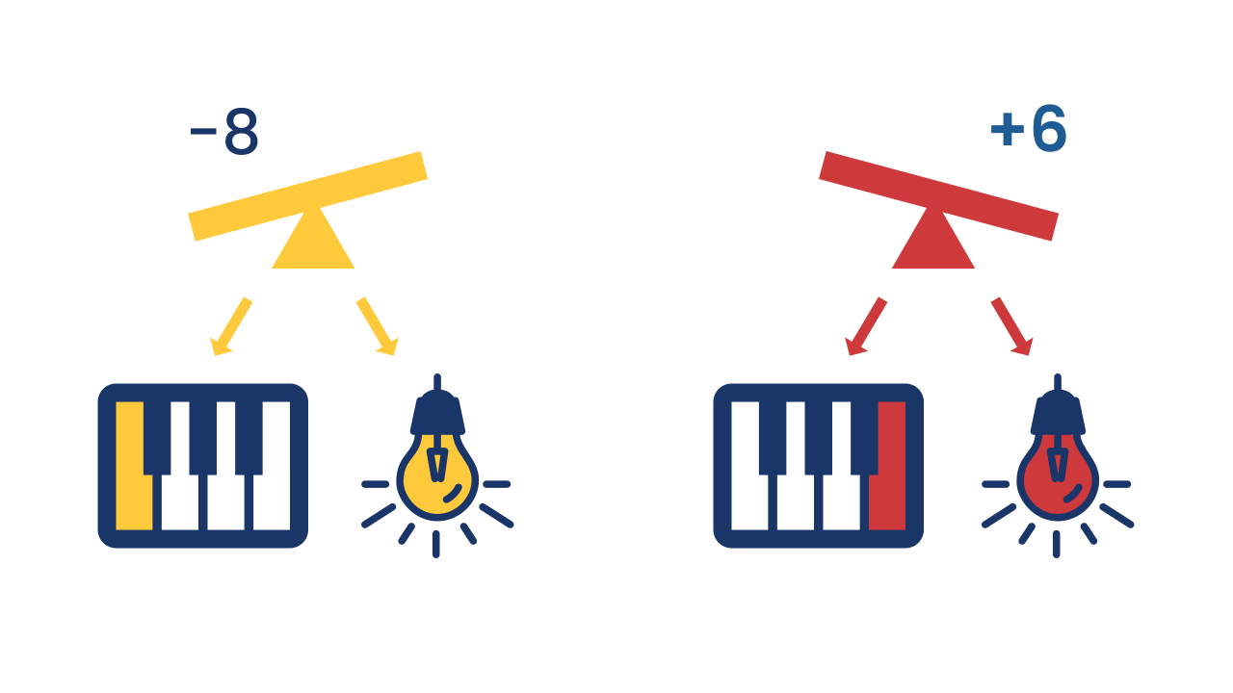
Connecting to Multiple Outputs
This is where programming gets really powerful. Mapping to Multiple Outputs means using the information from a single sensor to control two or more different things at the same time.
Imagine you're an orchestra conductor. With a single wave of your baton (the tilt), you tell the violinists which note to play (the sound) AND the lighting technician which spotlight to switch on (the LED). One gesture, several synchronized results!

Slide 6
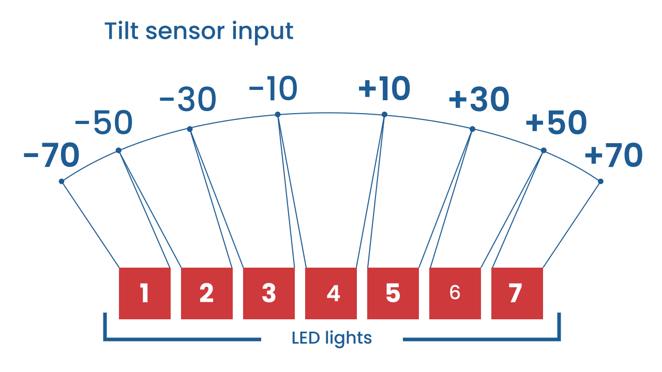
Adapting the Data: The Magic Division
The tilt sensor gives us a pretty wide range of numbers. But our LED screen is small (only 7 LEDs tall), and the musical scale we want to use is limited too. If we used the sensor's number directly, the dot of light would shoot off the screen in an instant!
To solve this, we need to scale the data, or adapt it. Using a simple mathematical operation like division, we can shrink the sensor's range of numbers so that it fits our screen perfectly. But dividing isn't enough: the result stays centered on zero, with negative numbers that would fall off the screen. That's why we also add 4 —the center LED— and round the result, because the screen only understands whole positions. With the phone held still, the dot sits right in the middle.

Slide 7
Create
Let's build the xylophone of the future.
Press Add device and select MusicalKeyboard for the sound.
Also add the Inclination component to read the movement.
Finally, add LEDDraw for our visual output.
Remember to scan or open all of the components. For this project, you can put them all on the same smartphone!

Slide 8

Code Composition
Click on the question mark to open the comments. The key to this code is that the tilt is read twice, and both formulas have the same shape: a resting value plus the deviation. For the sound, `60 + inclination`. For the light, `4 + inclination ÷ 15`. One piece of data, two scales, the same idea — that's why the light and the sound never fall out of sync!
https://app.protobject.com/generate?eq-xilofono-inclinacion-con-nota-led&en&dynamic&-1

Slide 9
Reflect
Which part of the code makes sure the light and the sound never fall out of sync?
Why did we have to divide the sensor value before using it to calculate the LED's position? What would happen if we removed the division block?

