Slide 1

English
This presentation is automatically generated.
You can freely edit it and add any extra content you wish.
Español
Esta presentación se genera automáticamente.
Puedes modificarla a tu criterio y añadir cualquier contenido adicional que desees.
Italiano
Questa presentazione è generata automaticamente.
Puoi modificarla liberamente e aggiungere eventuali contenuti extra che desideri.

Slide 2

The Magic Tilting Xylophone
Turn movement into music. Learn how to 'map' the data from a tilt sensor to create a magic instrument that you control by turning your device.

Slide 3

What will we do?

Slide 4
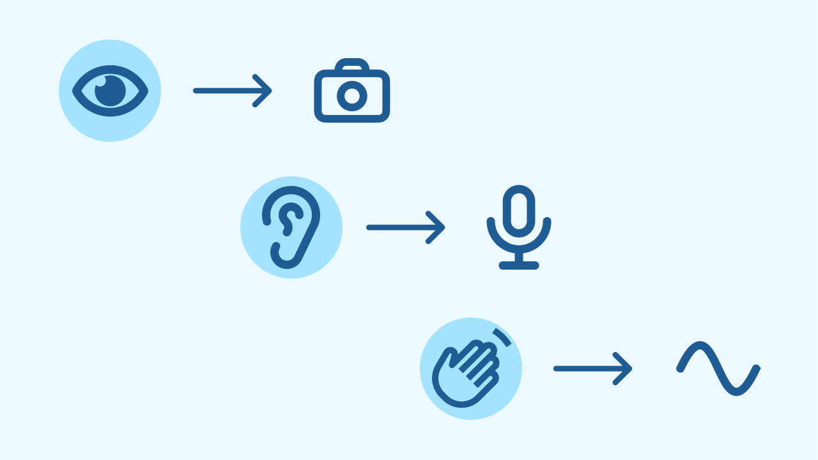
How Do Programs 'Feel'?
Just as we have senses (sight, hearing, touch) to understand the world, electronic devices have sensors. A camera is like an eye, a microphone is like an ear, and to feel movement they use an accelerometer! These sensors give the program information about the physical world around it.

Slide 5
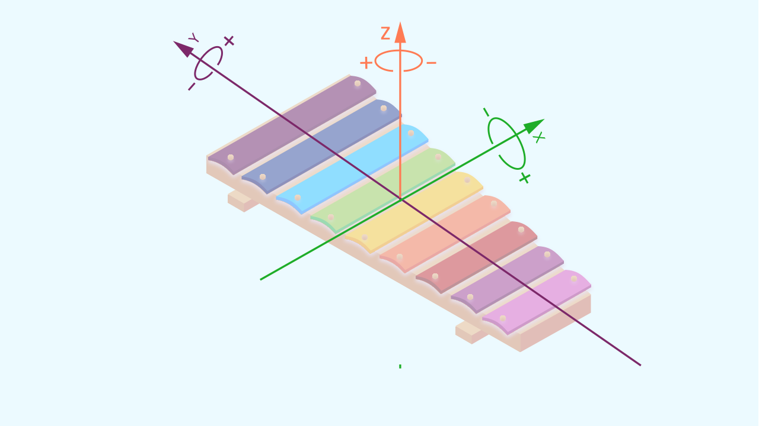
The Accelerometer: A Sense of Balance
The accelerometer is a tiny sensor inside your phone that measures acceleration and feels the force of gravity. Thanks to it, the phone knows whether you are tilting it forward, backward, left, or right. It measures this tilt on three axes: X (left-right), Y (forward-backward), and Z (up-down). For our xylophone, we'll use the Y axis to control the notes!

Slide 6
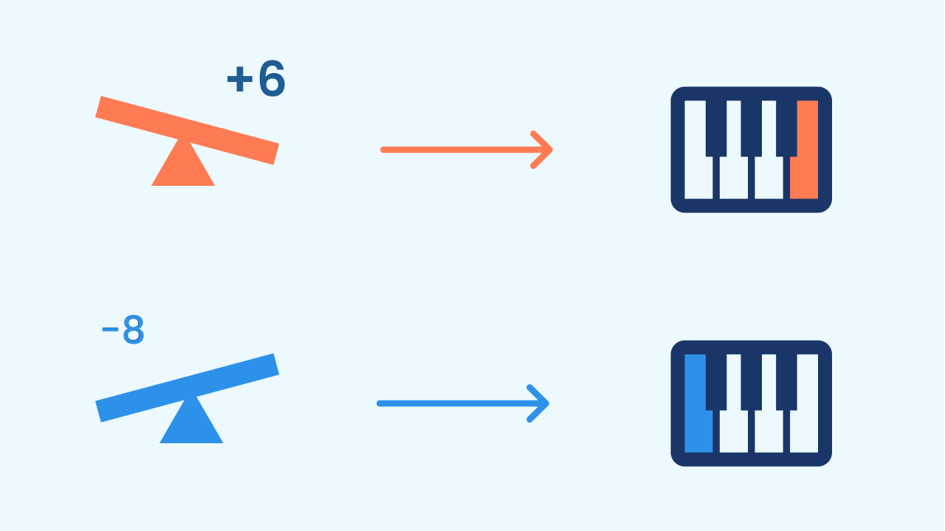
What Is Direct Mapping?
Direct Mapping sounds complicated, but it's like an instant translation! It means taking the number a sensor gives us and using it *directly* to control an output.
In our case:
- The Input is the number for the phone's tilt.
- The Output is the musical note we hear.
Tilt it a little and you get one note. Tilt it a lot and you get another. The movement is "mapped" straight onto the sound!

Slide 7
Create
Let's build our magic xylophone.
Press Add device and select MusicalKeyboard to produce the sound.
Press Add device again and select Inclination to read the device's movement.
Remember to scan both QR codes with the same phone, or to open them in the same window.

Slide 8

Code Composition
Click on the question mark to open the comments that explain the code. The program is very simple: inside a `repeat forever` loop, we read the tilt value on the Y axis. Then we take that number, add it to a base note (60, which is middle C) and play the result. That shift also does a second job: the musical keyboard only accepts positive numbers and the tilt can be negative — adding 60 makes sure the note always exists. That way, every tilt angle produces a different note!
https://app.protobject.com/generate?eq-xilofono-inclinacion&en&dynamic&-1

Slide 9
Reflect
You have just created a musical instrument with no keys. What is the relationship between the data in this project?
The code uses the Y axis (forward/backward tilt). What do you think would happen if you changed it to read the X axis (left/right tilt) instead?
Besides musical notes, what else could you control with the tilt sensor? The loudness of the sound? Lighting up a specific number of LEDs? The type of sound?

