Slide 1

English
This presentation is automatically generated.
You can freely edit it and add any extra content you wish.
Español
Esta presentación se genera automáticamente.
Puedes modificarla a tu criterio y añadir cualquier contenido adicional que desees.
Italiano
Questa presentazione è generata automaticamente.
Puoi modificarla liberamente e aggiungere eventuali contenuti extra che desideri.

Slide 2

The Glowing Heart Keychain
Create your first customizable gadget: a heart-shaped keychain that beats and makes sound. Learn the basics of computational thinking by combining sequences and loops.

Slide 3

What will we do?

Slide 4
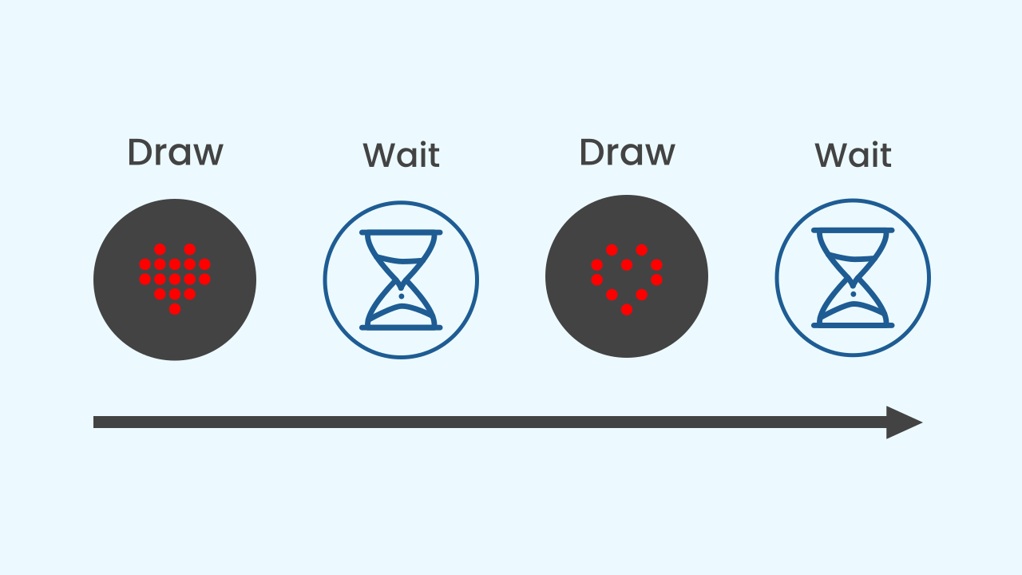
What Is a Sequence?
In programming, a sequence is simply a series of instructions that run one after another, in a strict order. It's like following a recipe: first you mix the ingredients, then you bake them. You can't bake them before you mix them. The computer follows your blocks from top to bottom, exactly as you have placed them.

Slide 5
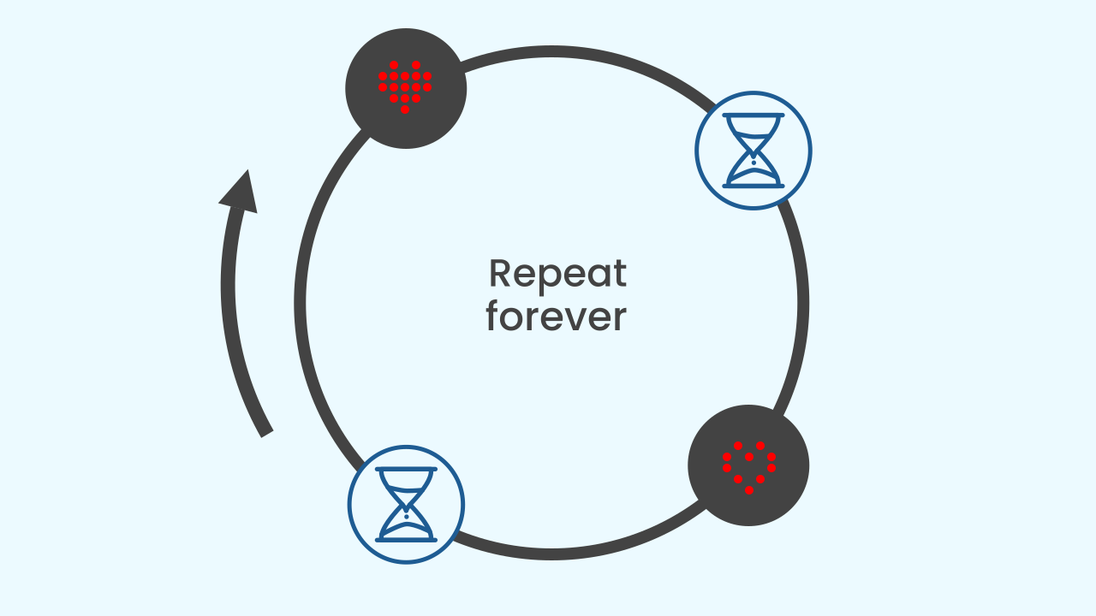
The Infinite Loop: Repeat Forever!
What if you want an action to repeat forever without ever stopping? That's exactly what an infinite loop is for! The `repeat forever` block is like the engine of our program. Everything you put inside it runs again and again, creating a non-stop cycle. It's perfect for our heartbeat animation, because we want it to keep beating for as long as the program is running!

Slide 6
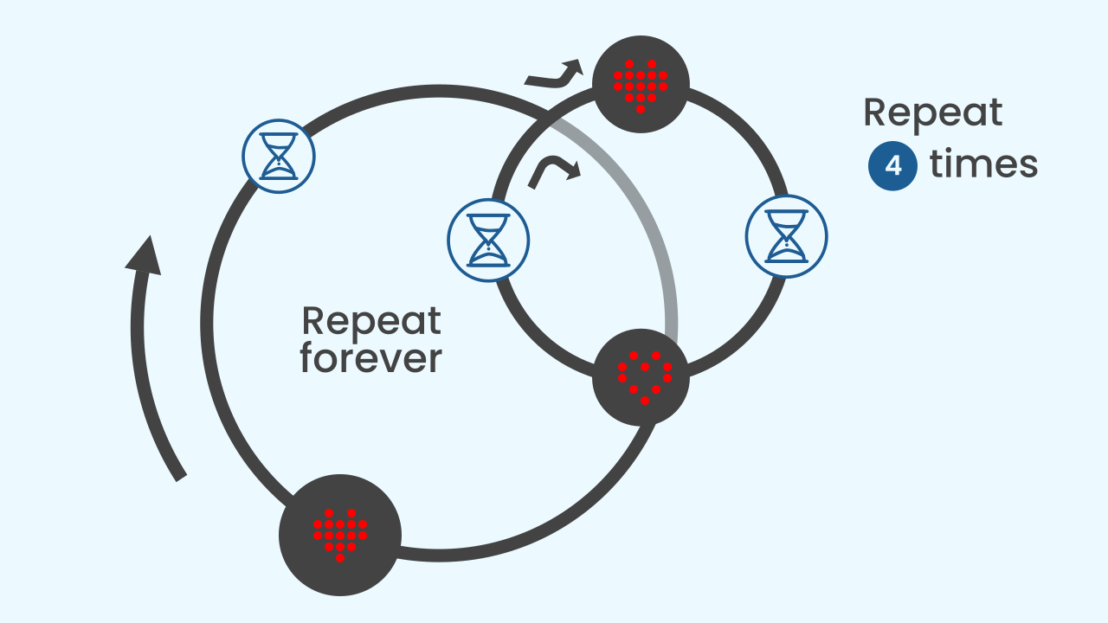
Nested Loops: A Rhythm Inside the Rhythm
We can make our animations even more interesting by putting one loop *inside* another. We call these nested loops. In our project, the `repeat forever` loop creates the main, steady heartbeat. Inside each beat, we'll use a smaller, faster `repeat 4 times` loop to create a brand new beating rhythm. It's like having a fast rhythm inside a slower one!

Slide 7
Create
Let's build our heart keychain.
Press Add device and select the LEDDraw component, which is where the animation will be shown.
Press Add device again and select MusicalDrum to add the sound of the heartbeat.
Remember that if you don't have a smartphone to scan the QR codes, you can press Open in this window to open the components on the same computer.

Slide 8

Code Composition
Click on the question mark symbol to open the comments that explain the code. Notice how the `repeat forever` loop wraps around everything, and inside it there is a `repeat 4 times` loop for the pulsing animation.
https://app.protobject.com/generate?eq-corazon-forever-loop&en&dynamic&-1

Slide 9
Reflect
You have just created your first animation. Which part of the code makes the heart beat non-stop?
And which part creates the fast rhythm effect after the main beat?
What would happen if you changed the number in the nested loop from 4 to 10? And what if you changed the time pauses?

