Slide 1

English
This presentation is automatically generated.
You can freely edit it and add any extra content you wish.
Español
Esta presentación se genera automáticamente.
Puedes modificarla a tu criterio y añadir cualquier contenido adicional que desees.
Italiano
Questa presentazione è generata automaticamente.
Puoi modificarla liberamente e aggiungere eventuali contenuti extra che desideri.

Slide 2

Create a Flashing Beacon
Discover how to control the speed of your code by programming a blinking light sequence.

Slide 3
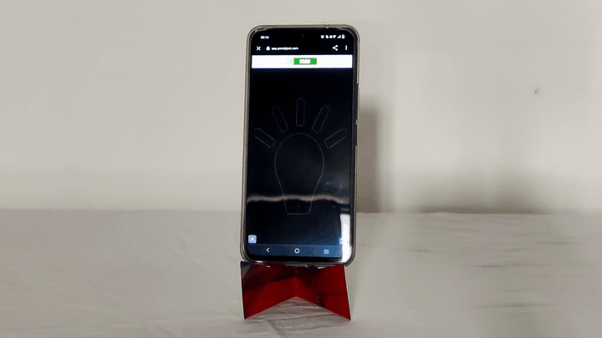
What will we do?

Slide 4

What is an LED?
Have you ever looked really closely at your TV or smartphone screen? It's made up of millions of tiny, powerful lights called LEDs.
LEDs are everywhere around us, from the big ones that light up a room to the tiny ones that work together to create the images you see on a screen.

Slide 5

What about the cellphone screen?
Your cellphone screen is packed with thousands of these tiny LEDs. When you watch a video or look at a photo, these are the lights that turn on and off to form the image.
When we prototype with Protobject, these are the very LEDs we are controlling with our code!

Slide 6
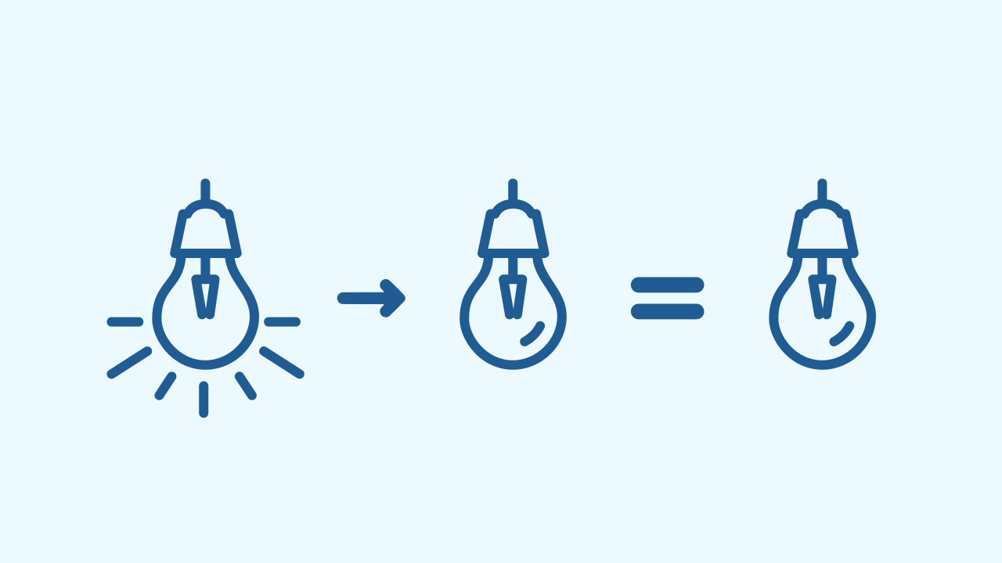
The Problem with Speed
Here's a puzzle: imagine you tell your prototype to turn a lamp ON, and then in the very next instruction, you tell it to turn OFF. You'd expect to see a quick flash, right? But you'd actually see nothing!
Why? Machines are incredibly fast! The lamp does turn on, but it turns off so quickly that our human eyes can't even perceive it.

Slide 7
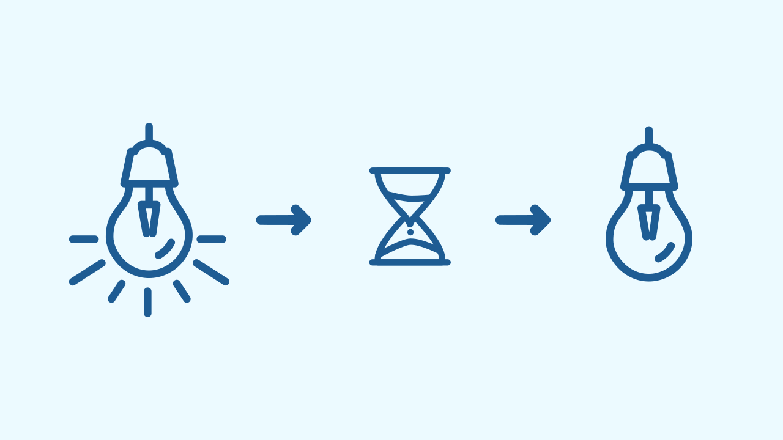
Instructions Must Be Precise!
Computers can't guess what we want. If our instructions are ambiguous, the program won't work as expected.
In our flashing light puzzle, the missing piece was telling the computer how long to wait between turning the light on and turning it off. This action of pausing for a specific duration is called Timing.

Slide 8

What does 'timing' mean?
To make a light flash like a beacon, we need to create a sequence that includes wait times, or delays, between the ON and OFF commands.
In programming, we can measure time in different units. In Protobject, we can use seconds or milliseconds (1000 milliseconds = 1 second) to control our timing perfectly.

Slide 9
Create a Beacon
We’re going to create a prototype of a beacon.
Press Add device and select the Lamp component.
Scan the QR code with your smartphone.
If you don't have a smartphone, you can press Open in this window to open the lamp on the same computer.

Slide 10
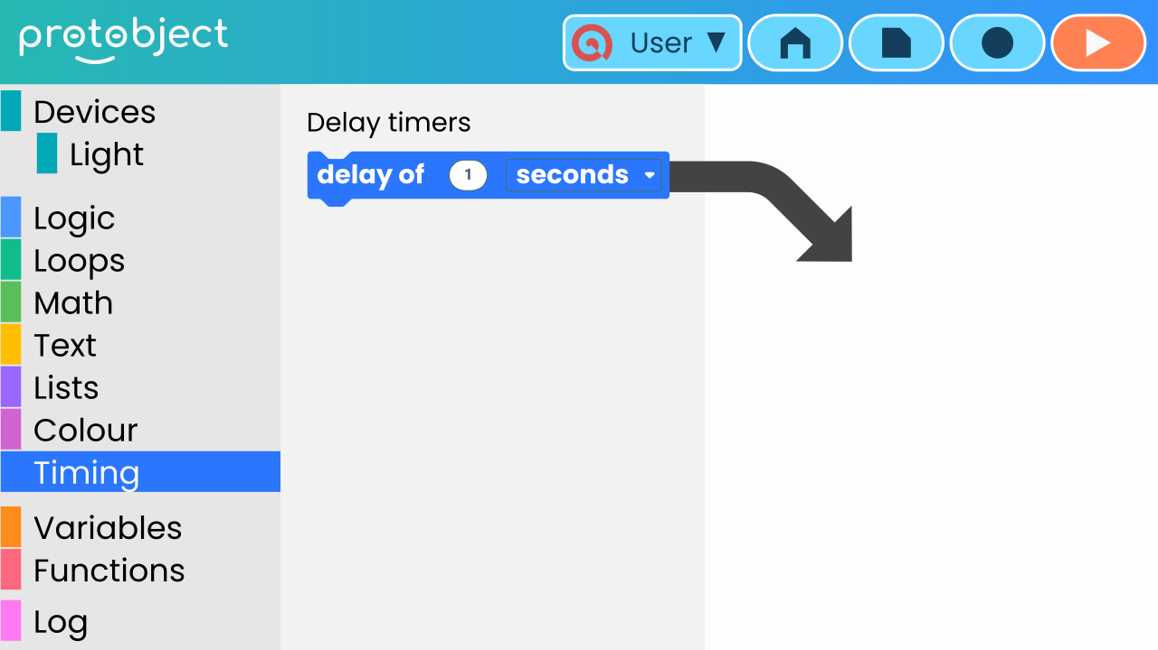
Where are the delay blocks located?
First, let's find the blocks that control time. Open the <category>Timing</category> category.

Slide 11
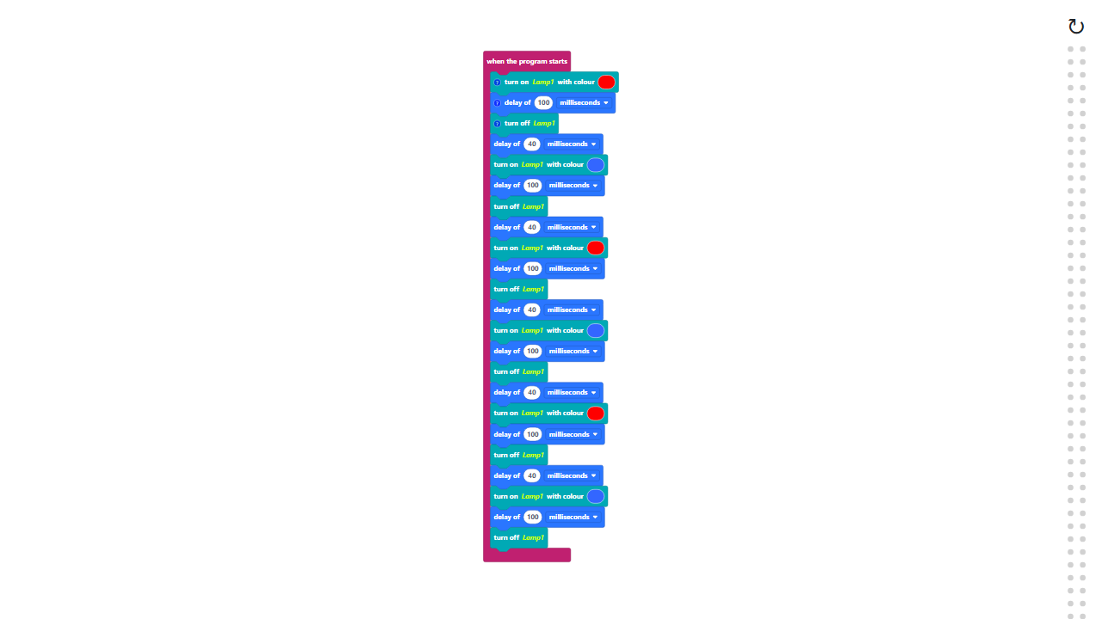
Code Composition
Click on the question mark to open the comments that explain the code.
*Remember*: the delay blocks are located in the Timing category.
https://app.protobject.com/generate?en-a02-timing&en&dynamic&-1

Slide 12
Reflect
★ In what other real-world situations could you use timing and delays? Think about games, animations, or even tools you use every day.

