Slide 1

English
This presentation is automatically generated.
You can freely edit it and add any extra content you wish.
Español
Esta presentación se genera automáticamente.
Puedes modificarla a tu criterio y añadir cualquier contenido adicional que desees.
Italiano
Questa presentazione è generata automaticamente.
Puoi modificarla liberamente e aggiungere eventuali contenuti extra che desideri.

Slide 2
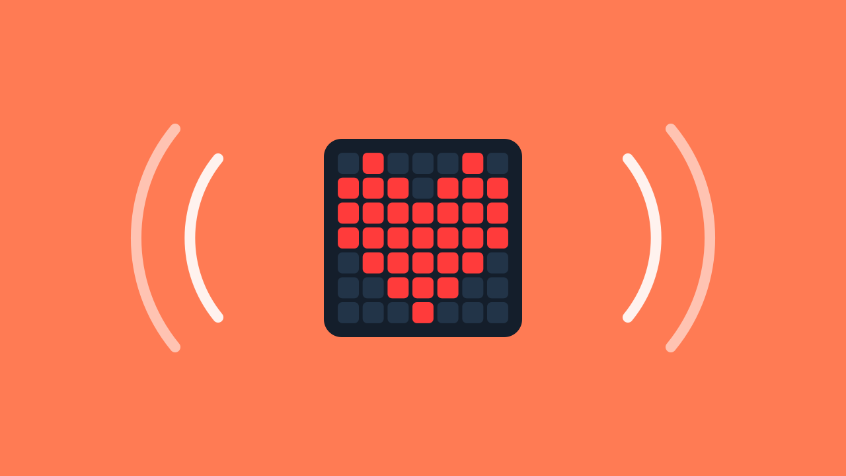
The Blinking Heart
Discover sequences and timing: program a glowing heart that turns on and off with the rhythm you decide.

Slide 3

What is an LED?
Have you ever looked closely at the screen of your TV or smartphone? It is made of millions of tiny, powerful lights called LEDs.
LEDs are all around us, from the big ones that light up a room to the small ones that work together to create the images you see on a screen.

Slide 4

And the phone screen?
Your phone's screen is full of thousands of these tiny LEDs. When you watch a video or look at a photo, these are the lights turning on and off to form the image.
Our glowing heart works the same way: it is a drawing made of LEDs, and with our code we decide when it turns on and when it turns off.

Slide 5
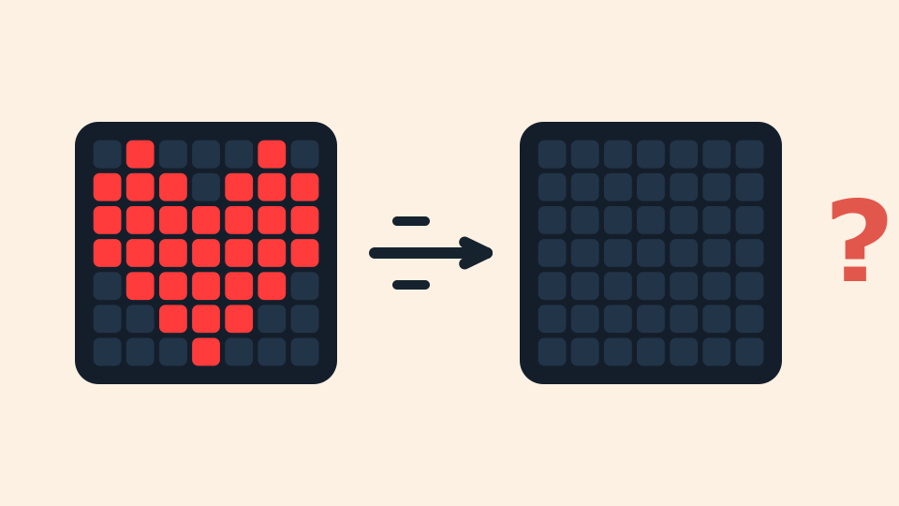
The Speed Problem
Here is a riddle: imagine telling your prototype to turn the heart on and then, in the very next instruction, to turn it off. You would expect to see a quick flash, right? But you would actually see nothing!
Why? Machines are incredibly fast! The heart turns on, but it goes dark so quickly that our human eyes cannot even notice it.

Slide 6
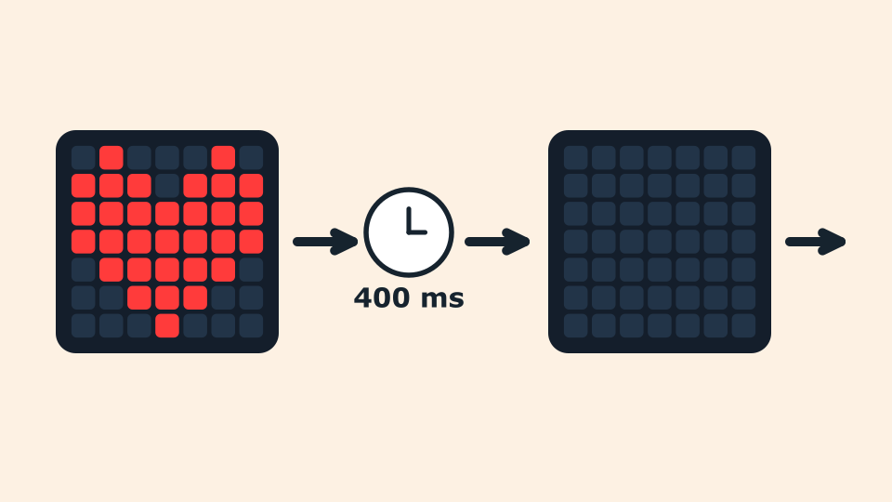
The Pause that Makes Everything Visible
Computers cannot guess what we want: we have to tell them how long to wait between one instruction and the next. This act of pausing for a precise amount of time is called timing.
In programming we can measure time in seconds or in milliseconds (1000 milliseconds = 1 second). With a 400-millisecond pause between turning on and turning off, the heart's blink becomes perfectly visible.

Slide 7
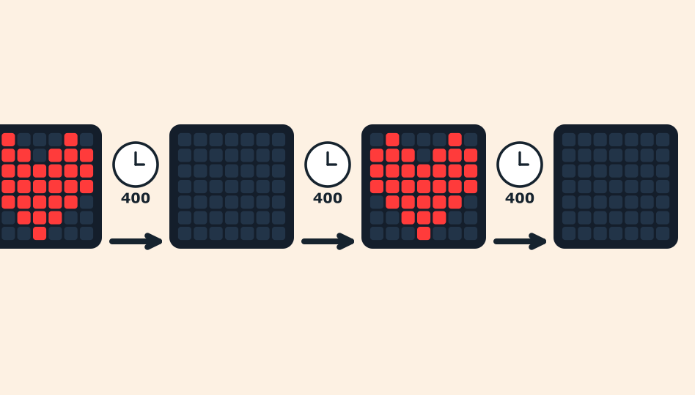
A Sequence with Rhythm
In programming, a sequence is a series of instructions that run one after another, in strict order, from top to bottom.
Our sequence will be: turn the heart on, wait, turn the heart off, wait. And then again, as many times as we want the heart to blink. The pauses between one instruction and the next are what gives the rhythm.

Slide 8
Create
Let's build our blinking heart.
Open Protobject on the computer and press Add device, then select the LEDDraw component: it is the panel where the heart will blink.
Scan the QR code with your smartphone.
The wait blocks live in the Timing category.
Remember that if you do not have a smartphone to scan QR codes, you can press Open in this window to open the component on the same computer.

Slide 9

Code Composition
The whole sequence lives inside the when the program starts block, which runs it from top to bottom: turn on, wait, turn off, wait — repeated several times, one instruction after another. To turn the heart off you draw an empty panel, with every square switched off.
Click the question marks to open the comments that explain the code. *Remember*: the wait blocks are in the Timing category.
https://app.protobject.com/generate?heart-blinking&en&dynamic&-1

Slide 10
Now start the prototype!
Press the green <runbutton>RUN</runbutton> button and look at your device: the heart blinks with the rhythm you programmed!

Slide 11
Reflect
Your heart is blinking! In what order do the instructions of your sequence run?
What would happen if you removed the pauses? And if you made them longer, or shorter?
In what other real-world situations could you use timing? Think of traffic lights, illuminated signs, games, or even tools you use every day.

