Slide 1

English
This presentation is automatically generated.
You can freely edit it and add any extra content you wish.
Español
Esta presentación se genera automáticamente.
Puedes modificarla a tu criterio y añadir cualquier contenido adicional que desees.
Italiano
Questa presentazione è generata automaticamente.
Puoi modificarla liberamente e aggiungere eventuali contenuti extra che desideri.

Slide 2
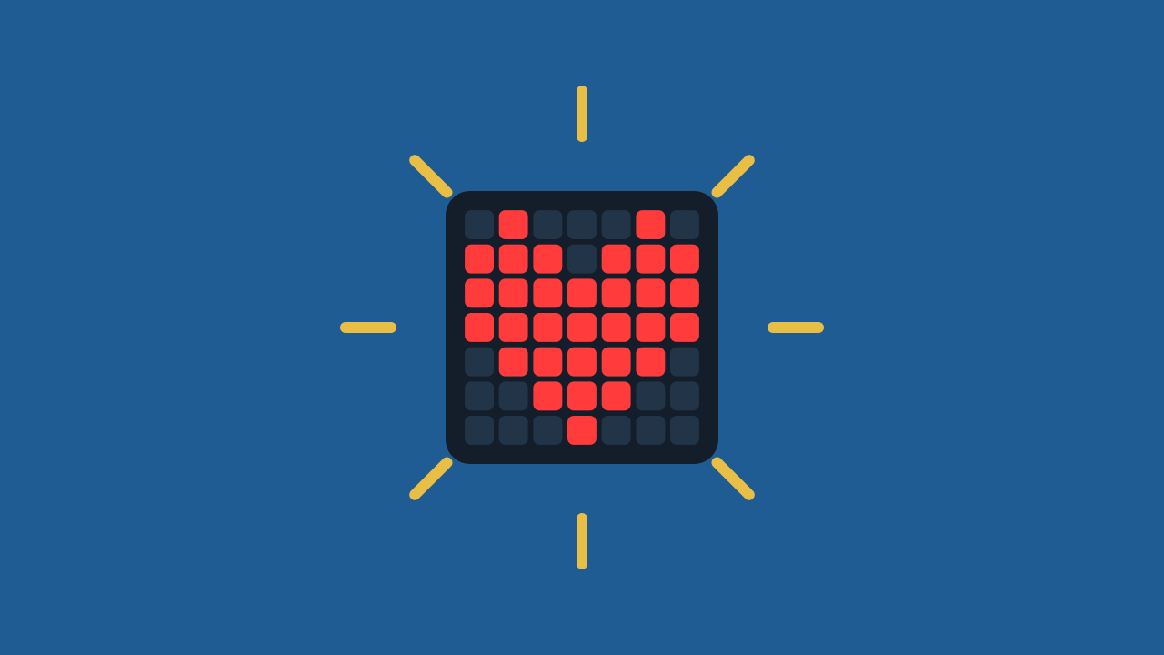
Turn On a Heart
Take your first step into the world of programming: with a single block instruction you will light up a glowing heart.

Slide 3
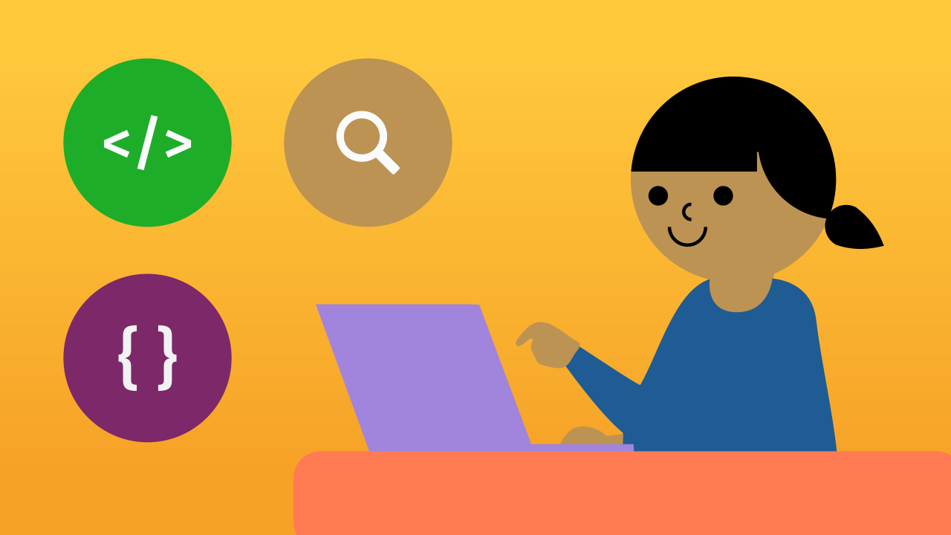
What is Programming?
Programming means giving a computer a series of specific instructions to complete a task. This way, the computer knows exactly what to do by following the steps you set out.
Programmers use a special language that computers can understand. We call it a programming language, and it can be based on text or on blocks.

Slide 4
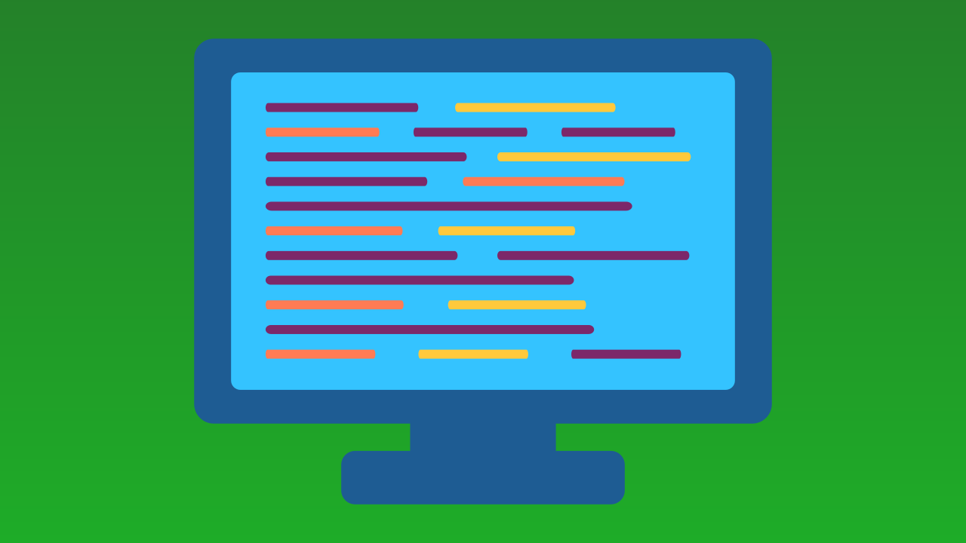
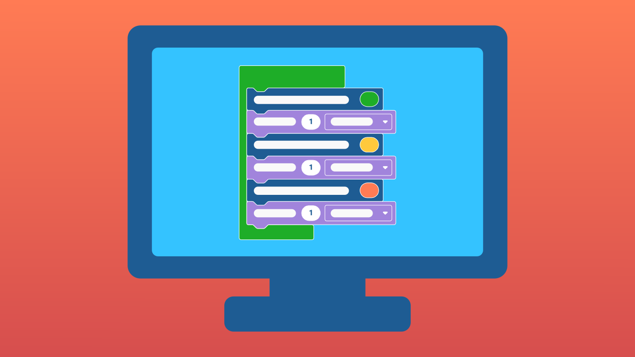
Text vs. Blocks: Two Ways to Program
Text programming is like writing a recipe from scratch, using languages such as Python, Java or C++. It can be hard for beginners.
Block programming, on the other hand, is like building with LEGO® bricks. Each block is a ready-made piece of code you can simply drag and snap together with others, no typing needed.
This is exactly the kind of programming we use in Protobject!

Slide 5
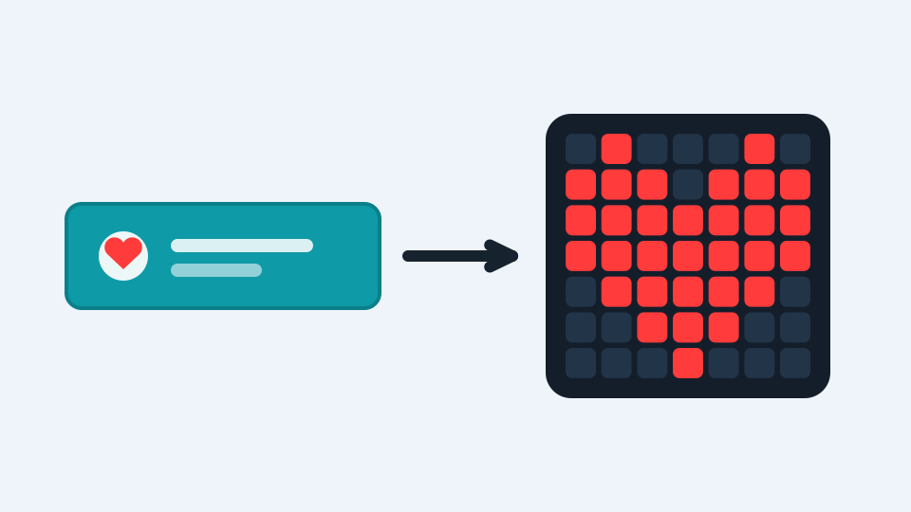
One Instruction, One Effect
In Protobject every block is an instruction: an order your device will carry out to the letter.
Today we will use a single block. That block will tell a panel of tiny lights — an LED panel — to show a heart-shaped drawing. One single instruction, and the heart lights up: that is a program, the smallest one in the world!

Slide 6
Create
Let's light up a glowing heart with Protobject.
Open Protobject on the computer and press Add device, then select the LEDDraw component: it is the panel where the heart will light up.
Scan the QR code with your smartphone.
Remember that if you do not have a smartphone to scan QR codes, you can press Open in this window to open the component on the same computer.

Slide 7

Code Composition
Every program starts from the when the program starts block: everything you put inside it runs in order. Our program has a single instruction: the block that draws the heart. Put it inside, light up the squares in the shape of a heart, and the program is ready.
Click the question marks to open the comments that explain the blocks.
https://app.protobject.com/generate?heart-on&en&dynamic&-1

Slide 8
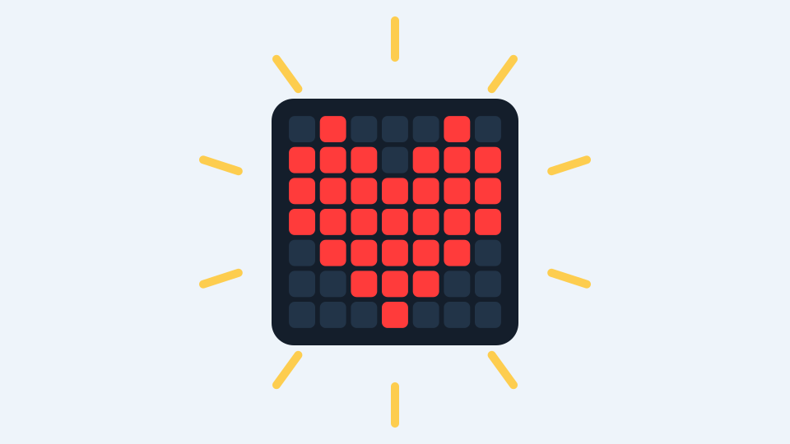
Now start the prototype!
Press the green <runbutton>RUN</runbutton> button and look at your device: the heart lights up!

Slide 9
Reflect
You lit up the heart with a single instruction. What exactly did you *order* the device to do?
If you wanted a heart in another colour, what would you change in the block?
And to turn it off? What instruction do you think it would take?

