Slide 1

English
This presentation is automatically generated.
You can freely edit it and add any extra content you wish.
Español
Esta presentación se genera automáticamente.
Puedes modificarla a tu criterio y añadir cualquier contenido adicional que desees.
Italiano
Questa presentazione è generata automaticamente.
Puoi modificarla liberamente e aggiungere eventuali contenuti extra che desideri.

Slide 2

Light Up an LED
Take your very first step into the world of coding by learning the magic of block programming.

Slide 3
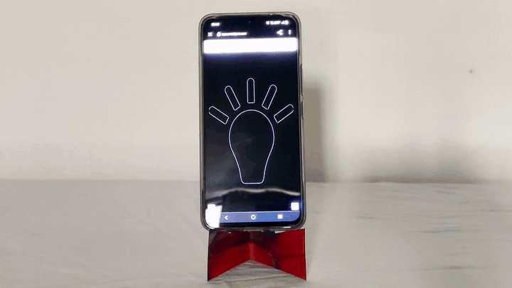
What will we do?

Slide 4

What is Programming?
Programming is all about giving a computer a set of specific instructions to complete a task. This way, the computer knows exactly what to do by following the steps you laid out.
Programmers use a special language that computers can understand. We call this a programming language, and it can be text-based or block-based.

Slide 5
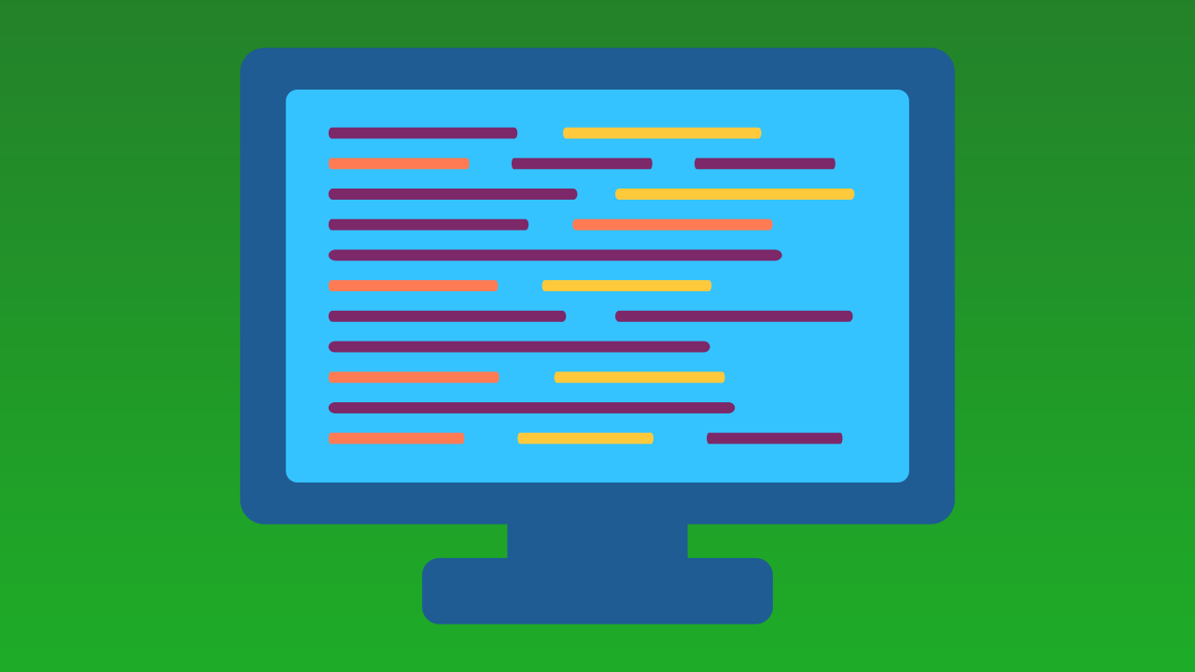
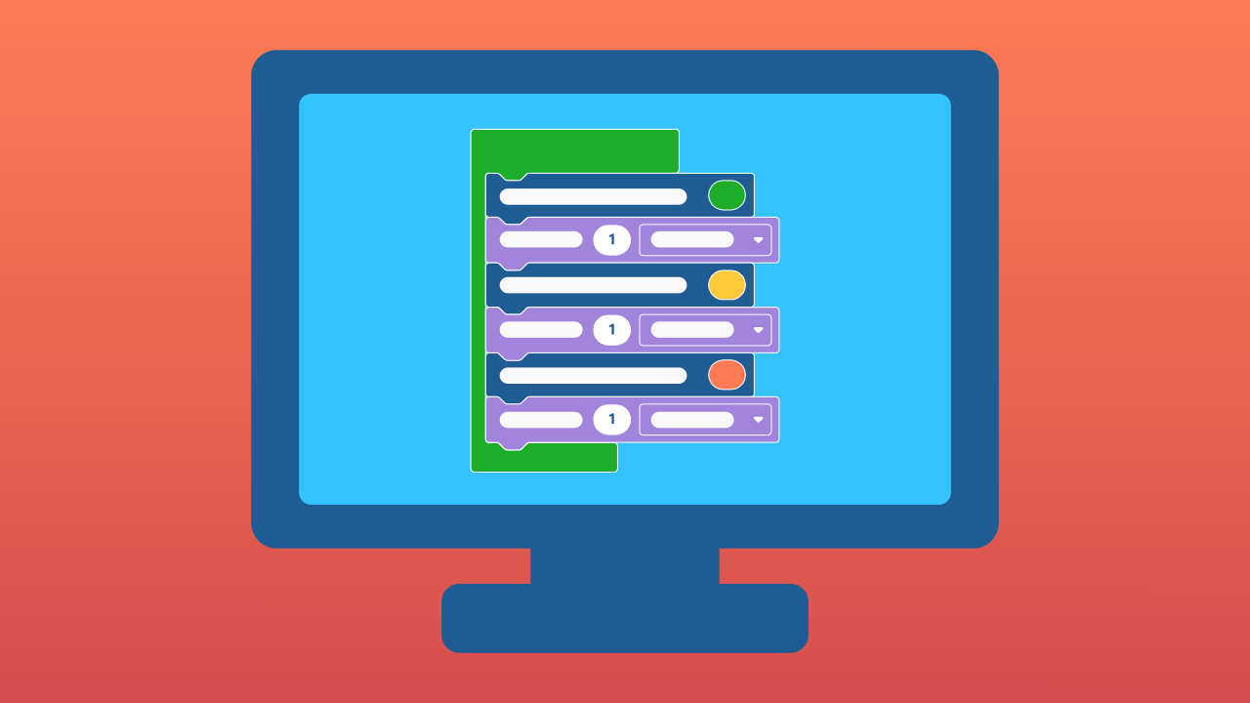
Text vs. Blocks: Two Ways to Code
Textual programming is like writing a recipe from scratch, using languages like Python, Java, or C++. It can be tricky for beginners.
Block-based programming, on the other hand, is like building with LEGO® bricks. Each block is a pre-made piece of code that you can simply drag and snap together with others, no typing required.
This is exactly the kind of programming we use in Protobject!

Slide 6
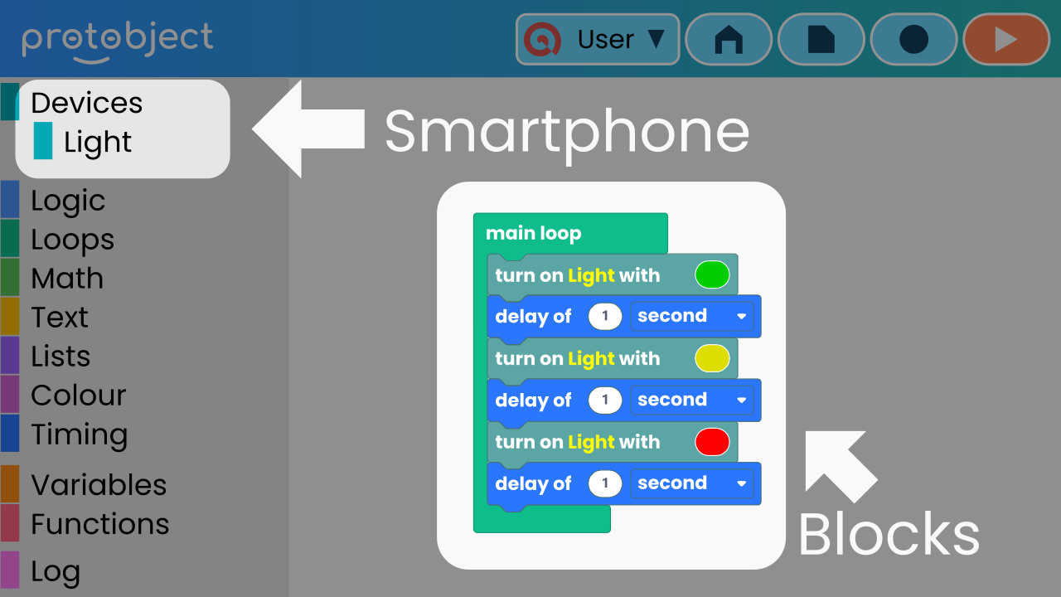
Welcome to Protobject!
Protobject lets you program your smartphone and have it interact with the world around you.
How? It's simple! You connect a device, build your code by dragging blocks into the workspace, and then activate your prototype!

Slide 7
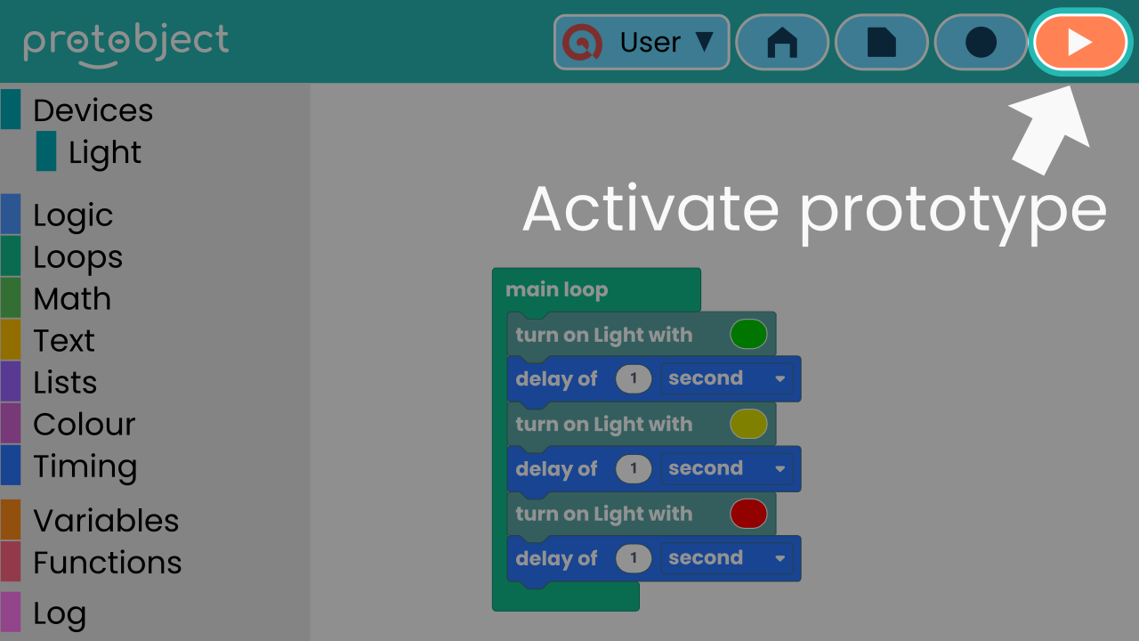
Activate Your Prototype
When your code blocks are ready, you can bring your prototype to life by pressing the red button.
We are ready to start experimenting! Follow the instructions below and create your very first invention.

Slide 8
Create
Let’s make a lamp on our smartphone and turn it on with Protobject.
Press Add device and select the component Lamp.
Scan the QR code with your smartphone.
Remember that if you don't have a smartphone to scan the QR codes, you can press Open in this window to open the components on the same computer.

Slide 9
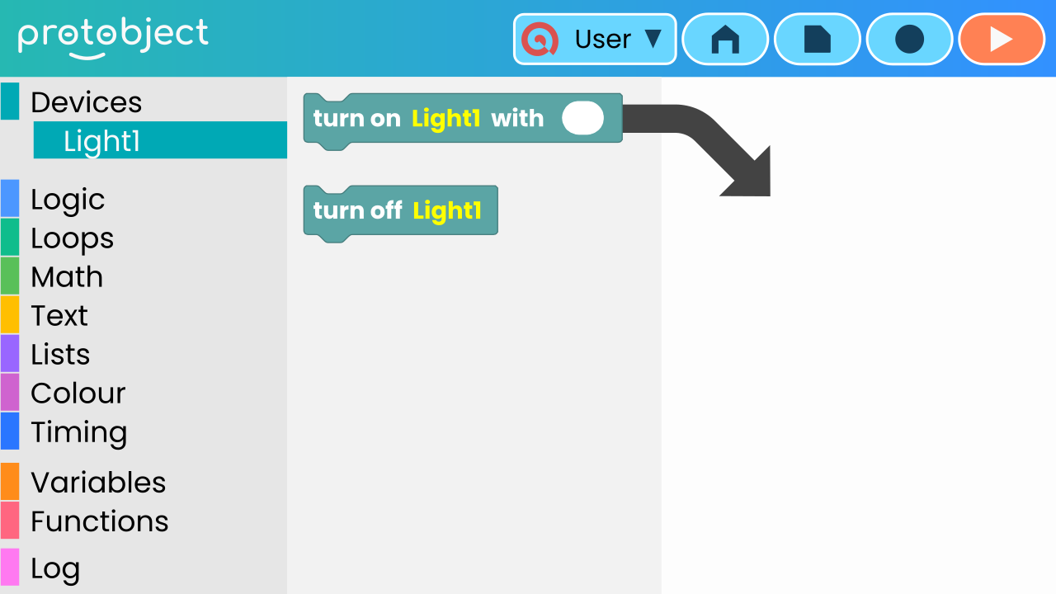
Drag the TURN ON block
Awesome! Let's power up our LED lamp!
Each block represents an action. We’ll start by using just one block that will allow us to turn on our LED lamp.
To do that, drag the TURN ON block to the workspace.

Slide 10
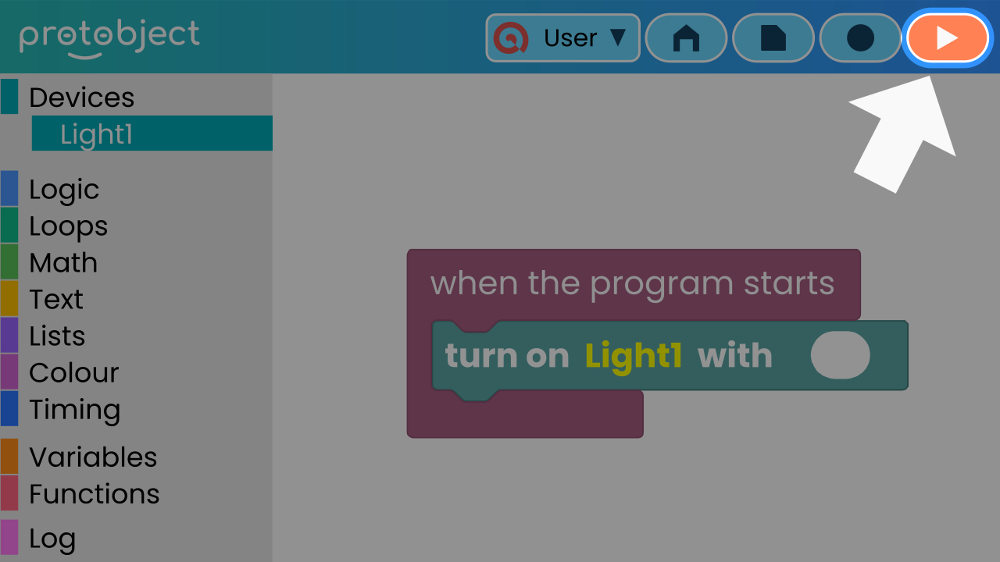
Now activate the prototype!
Your LED lamp should turn on!

Slide 11
Reflect
You've mastered turning the lamp on. What's the next logical step? How would you turn it off?
Have you tried adding the TURN OFF block right after the first one?

